Slide 1


Slide 2


Important information about starting your studies
The International Office at the University of Augsburg has put together a series of presentations for international first-year students with the most important information about studying and living in Augsburg.
This presentation is the third of seven. It covers the basic terms that you need to be familiar with during your studies. We recommend that you carefully review all presentations so that you are well prepared to start your studies and can clarify any important questions.
All presentations are available online and can be downloaded via this link:
https://www.uni-augsburg.de/en/portal/internationals/abschluss/study-preparation-course/.

Slide 3
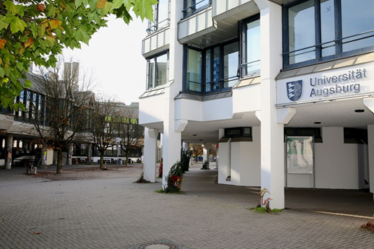
Important terms at the University of Augsburg
  Types of universities
  Enrollment/ de-registration
  Faculty/ chair/ institute
  Lecturers
  Types of courses
  Standard duration of study
  Credit Points/ SWS/ ECTS
  Modules
  Module catalogue
  Examination regulations
  STUDIS - The Online Examination Office
  Digicampus - Course Registration

Slide 4

Types of universities in Germany
Hochschule
⟶ Umbrella term for educational institutions where one can study
Hochschulen für angewandte Wissenschaften
⟶ = Universities of Applied Sciences
⟶ Focus on practice
⟶ Less variety in study programs
Universitäten
⟶ = Universities
⟶ Focus on theory
⟶ Wide range of study programs
⟶ Possibility of pursuing a doctorate

Slide 5
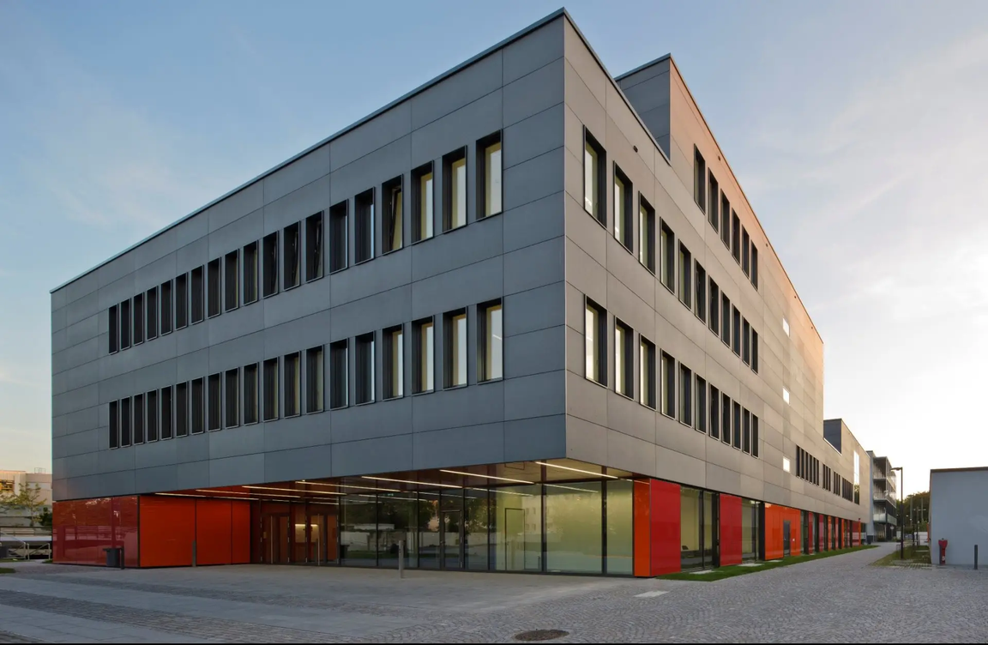

Types of universities in Augsburg
You are studying at the University of Augsburg.
However, there is also a University of Applied Sciences in Augsburg, the “Technische Hochschule Augsburg”.

Slide 6

Enrollment/ De-registration
Enrollment
= “Immatrikulation”
⟶ Next step after receiving the letter of acceptance
⟶ This is how you become a student
⟶ necessary in order to take exams
De-registration
= “Exmatrikulation”
⟶ University membership ends
⟶ Reasons:
  one has completed one's studies
  one no longer wishes to study
  repeatedly failing exams (compulsory de-registration)

Slide 7

Faculty/ chair/ institute
Faculty (= “Fakultät”)
⟶ Teaching and administrative unit of a university
⟶ encompasses related sciences
Institute (= “Institut”)
⟶ Organizational unit at a university or faculty
⟶ consists, for example, of chairs that share a common thematic umbrella term
Chair/ department (= “Lehrstuhl)
⟶ Subunit within a faculty/ institute
⟶ refers only to a specific academic field

Slide 8








Faculties at the University of Augsburg
Faculty of Philology and History:
Linguistics, literature, cultural studies,
and historical disciplines
(4.586 students)
Faculty of Catholic Theology:
Catholic Theology
(290 students)
Faculty of Mathematics, Natural Sciences, and Engineering:
Physics, Mathematics, Materials Science, Industrial Engineering
(2.076 students)
Faculty of Economics:
Business Administration, Economics, Global Business Management
(2.352 students)
Faculty of Law:
Legal Studies
(2.635 students)
Faculty of Applied Computer Science:
Computer Science, Geography
(2.517 students)
Faculty of Philosophy and Social Sciences
Education, Music, Art, Social Sciences,
Media, Philosophy
(2.685 students)
Faculty of Medicine:
Human Medicine, Midwifery
(738 students)

Slide 9

Lecturers
Lecturers (=“Dozierende”)
⟶ Teachers at universities and other educational institutions
Professors (= “Professor:innen”)
⟶ Highest-ranking teachers at German universities
⟶ A professorship is obtained through habilitation.
Research associates (=“wissenschaftl. Mitarbeitende”)
⟶ working on a research project
⟶ Responsibilities: Research, teaching

Slide 10

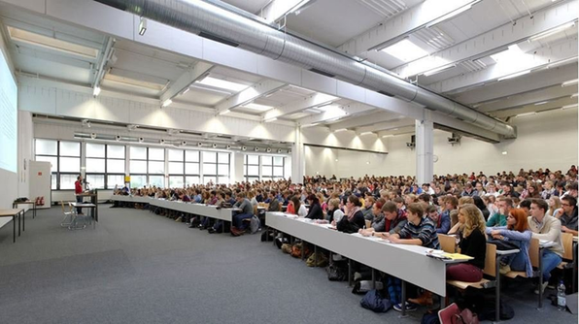
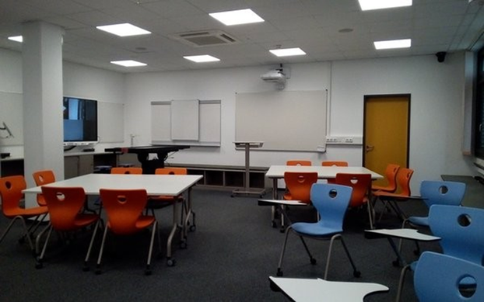


Types of courses
Lecture (= “Vorlesung”)
⟶ Teachers lecture on a topic
⟶ little opportunity for questions or discussion
⟶ usually more listeners than at seminars
Seminar (= “Seminar”)
⟶ Knowledge is deepened
⟶ Discussions in small groups
⟶ Presenting skills are developed through giving presentations.
Exercise (= “Übung”)
⟶ practical application of scientific methods to specific questions
⟶ usually accompanying a lecture
Tutorial (= “Tutorium”)
⟶ a kind of “tutoring” led by students in higher semesters
⟶ usually accompanying a course

Slide 11

Standard duration of study
Standard duration of study
(= “Regelstudienzeit“)
= Number of semesters in which students should complete their studies according to the examination regulations.
⟶ varies from subject to subject
⟶ varies from university to university
⟶ Completion of studies possible after fewer or more semesters (maximum duration of study!)
Semester
= Half-year of study
⟶ includes the lecture period and the subsequent lecture-free period
⟶ winter semester: 01.10. – 31.03.
⟶ summer semester: 01.04. – 30.09.

Slide 12
Credit Points/ SWS/ ECTS
Credit points (= “Leistungspunkte” (LP)):
⟶ Points used to measure students' academic performance
⟶ 1 credit point = approximately 30 working hours
SWS:
⟶ Semesterwochenstunden (=weekly hours per semester)
⟶ 1 SWS = one hour (à 45 minutes) per week
⟶ A course usually has 2 SWS = 90 minutes per week.
ECTS:
⟶ European Credit Transfer and Accumulation System
⟶ Europe-wide recognition of the degree program
⟶ measures the average workload in hours

Slide 13
Modules
  A module is a teaching unit consisting of several courses on a topic that is addressed from different perspectives (in the respective courses).
  Completing a module can usually take between one and three semesters, as the corresponding courses do not have to be taken in the same semester.
  Each component (lecture, seminar, or exercise) is graded with a certain number of credit points.
A distinction is made between:
⟶ Basic modules, which are usually taken in the 1st and 2nd semesters
⟶ Advanced modules, which are usually taken in the 3rd and 4th semesters
⟶ Specialisation modules, which are usually taken in the 5th and 6th semesters
A distinction is also made between compulsory and elective modules.
Further information can be found on the website of the University of Augsburg.

Slide 14

Module catalogue
Your module catalogue contains important information for your studies!
There you will learn:
  which modules you must complete during your studies
  which courses are offered in the current semester. You therefore need your current module handbook each semester in order to be able to put together your timetable each semester.
  The module catalogues for all degree programs can be found here:
https://mhb.uni-augsburg.de/.

Slide 15

Examination regulations
The examination regulations (= “Prüfungsordnung” (PO)) for your degree program provide an overview of the general conditions for your examinations:
  Examination content
  Requirements for registering for examinations
  Requirements for passing
  Examination dates
  Examination procedure
  (possible orientation examination)
(⟶ Not every degree program has an orientation exam. The orientation exam determines which exams you must complete by a certain deadline. The specific exams and exact deadlines are specified in the examination regulations for the respective degree program.)
The examination regulations for the individual degree programs can be found here: https://www.uni-augsburg.de/de/services/rechtssammlung/. (You must search for your degree program in the alphabetical index at the bottom of the page.)
Caution: Regular updates to the examination regulations are possible!

Slide 16
Examination regulations
Retaking exams:
  Failed exams must generally be retaken within six months, at the latest on the next possible exam date. For more detailed information on your specific degree program, please refer to your examination regulations.
  Voluntary retaking of a passed module to improve your grade is not permitted.
Non-participation in an examination:
  If you are ill and unable to attend, please obtain a medical certificate stating the period of illness without delay.
  Keep the certificate in a safe place. If you have not passed all the required examinations by the end of a deadline (orientation examination or maximum duration of study), you can apply for an extension of your study period by submitting the relevant evidence.

Slide 17
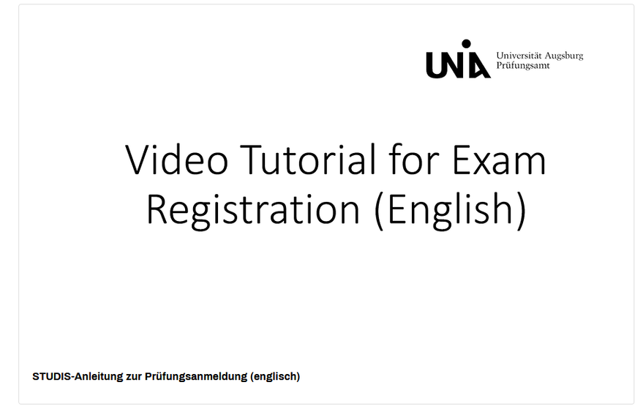
STUDIS - The Online Examination Office
You can register for your exams via the online examination office STUDIS.
On this website of the University of Augsburg, you will find detailed instructions that explain the exam registration process step by step in German and English:
https://www.uni-augsburg.de/de/studium/organisation-beratung/pruefungen/was-sind-pruefungen/anleitung-studis/

Slide 18
Digicampus - Course Registration
You can create your timetable using the online platform “Digicampus.”
The following link will take you to an introductory video from the University of Augsburg (approx. 20 min): https://www.youtube.com/watch?v=P39-G32PEeM.
If the video in German does not help you, we recommend that you attend the study preparation course offered by the international office, where we will help you create your timetable.
Tips for creating a timetable provided by the Central Student Advisory Service:
  Before creating your timetable, you should first attend the central introductory event at the University of Augsburg (if you understand German) and especially the subject-specific introductory event for your degree program. You will receive important information there!
  Until then, you can already familiarize yourself with the structure of your studies and put together a preliminary timetable.
  It is completely normal if your timetable changes during the first two weeks of your first semester.
  If you have any questions, please contact the academic advisors or the student council for your degree program.
  Consider your own interests.

Slide 19
Open questions?
The International Office at the University of Augsburg has put together a series of presentations for international first-year students with the most important information about studying and living in Augsburg.
This presentation is the third of seven. We recommend that you carefully review all presentations so that you are well prepared to start your studies and can clarify any important questions:
https://www.uni-augsburg.de/en/portal/internationals/abschluss/study-preparation-course/.
If you still have questions after reviewing all the presentations, please feel free to send us an email at: svk@aaa.uni-augsburg.de.

