Slide 1
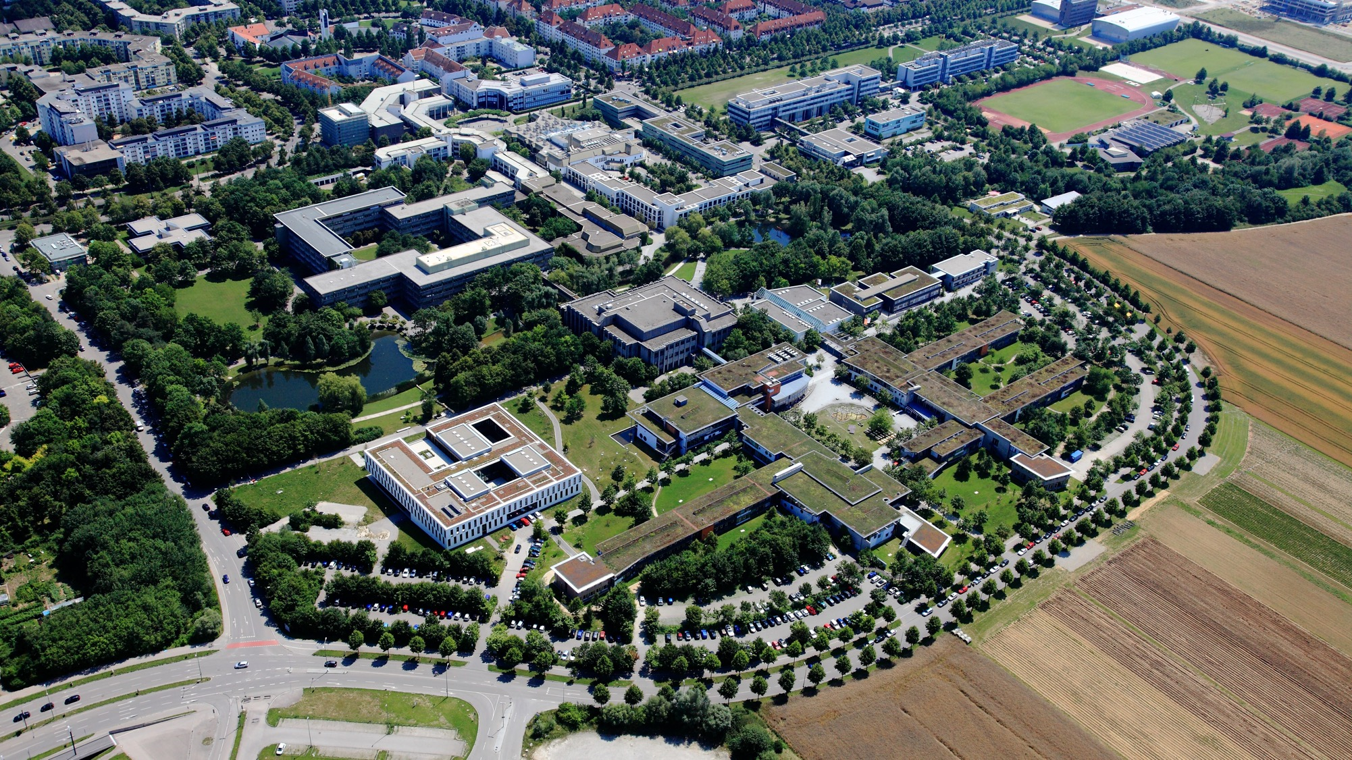









Health

Slide 2


Important information about starting your studies
The International Office at the University of Augsburg has put together a series of presentations for international first-year students with the most important information about studying and living in Augsburg.
This presentation is the fifth of seven. It covers the healthcare system in Germany and explains what you need to know as a student. We recommend that you carefully review all presentations so that you are well prepared to start your studies and can clarify any important questions.
All presentations are available online and can be downloaded via this link:
https://www.uni-augsburg.de/en/portal/internationals/abschluss/study-preparation-course/.

Slide 3

Program
Overview of the German Healthcare System
Services covered by Public Health Insurance
Doctor’s visits, dentists, pharmacies, hospitals, vaccinations
Prescriptions, referrals, sick leave
What to do in an emergency
Services offered at the University of Augsburg

Slide 4








Types of Health Insurance in Germany
Anyone studying at a German university needs health insurance. There are two types available for international students (residence under §16b):
Public health isurance
Private health insurance
… and many more …
… and many more …

Slide 5
Private health insurance
Private health insurance
There are countless international and national providers The immigration office (for non-EU citizens) generally only accepts German providers!
Please note: Once you have private health insurance during your studies, you can no longer switch to public health insurance during your studies!
People under 30 can choose private health insurance; people 30 or older must choose private health insurance
Key differences from public health insurance:
Benefits have to be specifically defined between the insured and the insurance company
The amount of payments are based on the “booked” benefits as well as the insured person's age, gender (and income)
The insured initially pay all costs themselves but can later apply for reimbursement

Slide 6
Public health insurance
Public health insurance
The purpose of the public health insurance is to ensure the health of its insured members by:
prevention
relieving acute symptoms
Rehabilitation
There are currently more than 100 public health insurance plans
Public health insurance plans are required by law to provide their insured members with certain benefits (mandatory benefits)
And may offer additional benefits (supplementary benefits)
Student Health Insurance:
Approximately 145 euros per month for health insurance, including long-term care insurance
possible until the age of 30 or until the end of the 14th semester (with the possibility of an extension, e.g., due to a disability or raising children)

Slide 7
Benefits of public health insurance (1/2)
to prevent illness:
Vaccinations (e.g., MMR, polio, tetanus, diphtheria, COVID-19, influenza, etc.)
Preventive checkups (dentist, twice a year); ophthalmologist, dermatologist, and gynecologist (once a year)
Fitness classes (gym, online classes → to get an overview of these options, you should check with your insurance provider!)
for the early detection of diseases:
e.g., cancer screening → skin cancer screening every two years starting at age 20
In case of (acute) illness:
Medical care (including psychotherapy)
Supply of medicines
Hospital treatment and nursing care
Public health insurance

Slide 8
Benefits of public health insurance (2/2)
for medical rehabilitation:
Support following a stroke, heart attack, accident, removal of a tumor, etc.
pregnancy and maternity care:
Prenatal checkups
Hospital delivery
Postnatal care (for mother and child)
Important:
The coverage offered by different insurance companies varies slightly → it is important to research the specific details with each provider. → You can also find an overview here: https://krankenkassen.check24.de.
Public health insurance

Slide 9
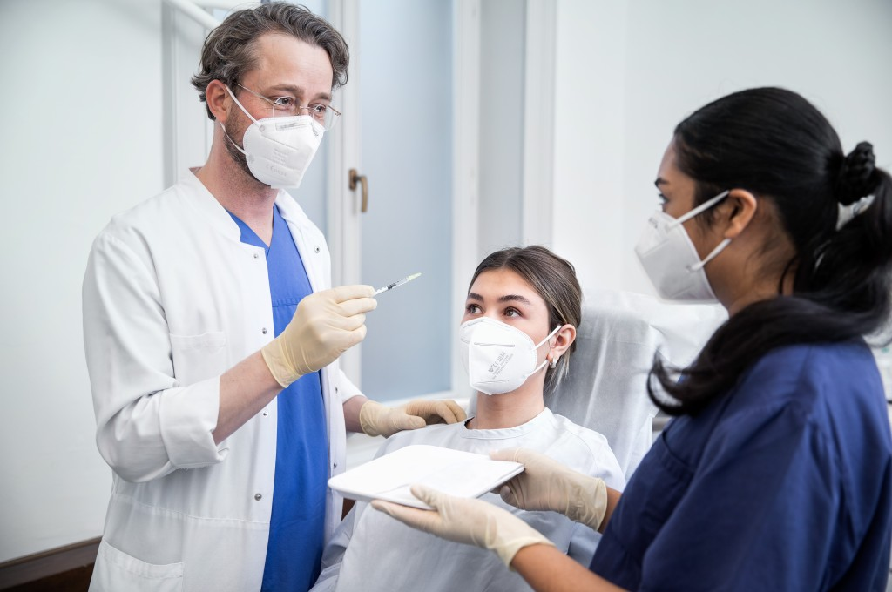
The doctor‘s visit
Which doctor should I see?
You can choose your own doctor
Your first visit should be to a general practitioner
The following platforms can help you find an appointment: www.jameda.de/ or www.doctolib.de
Asking other students about their experiences is also a good idea

Slide 10
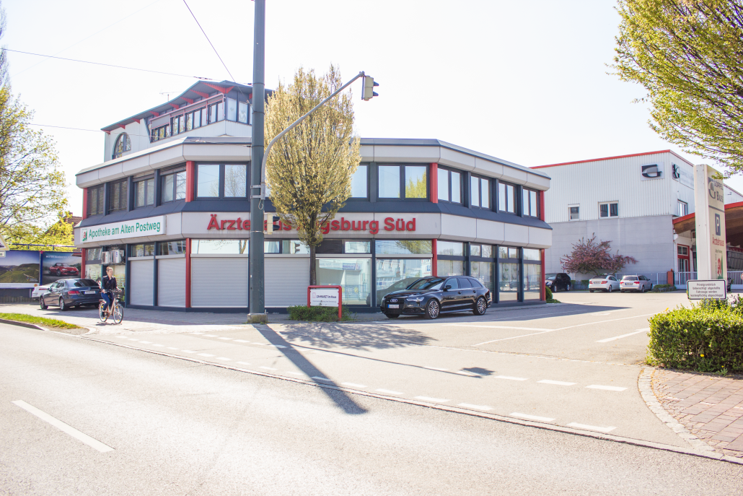
General practitioners in the (immediate) area
WH Göggingen:
MVZ Schwaben - Göggingen,
https://mvz-schwaben.de/goeggingen/
WH Univiertel/ Haus Edith Stein/ Bgm-Ulrich-Str.:
Ärztehaus am Alten Postweg, https://mvzaugsburg.de/
Dr. Irmer & Dr. Zickler, http://www.irmer-zickler.de/
WH Prinz-Karl-Viertel
Dr. Inge Sandler, https://www.ingesandler.de/

Slide 11
Preparing for a doctor's visit
Find a doctor who accepts patients
Schedule an appointment (by phone or through an app, such as Doctolib)
Write down any questions and, if necessary, look up any terms in the dictionary
(Home visits are not common in Germany!)
If you suddenly feel very unwell, or if you need an appointment urgently, say so on the phone!

Slide 12

The doctor‘s visit
Bring your insurance card!
arrive on time (10 minutes before the scheduled appointment)
At the reception desk: Introduce yourself by name, state the time of your appointment, and present your health insurance card
Fill out the medical history form
Wait for instructions
Be prepared to wait: Sometimes you may have to wait a long time even if you have an appointment.

Slide 13

In the doctor's office
Describe your symptoms
What treatment does the doctor recommend?
It’s okay to ask questions! Feel free to ask if there’s something you don’t understand.
At the end of the conversation, check to make sure that all questions, etc., have been answered.
If you don't feel comfortable with your doctor, you can switch doctors or get a second opinion!

Slide 14
At the pharmacy
There are over-the-counter and prescription medications
People with public health insurance can obtain their medications upon presenting a prescription (copayment of up to 10 euros)
Opening hours: 9 a.m. to 6 p.m.
Outside of opening hours, an emergency service is also available (at night and on weekends; additional fee of 2.50 euros)
→ Information in the local newspaper or online: http://www.aponet.de/service/notdienstapotheke-finden.html
4 different types of prescriptions:
pink → The patient pays a maximum of 10 euros (prescription is stored digitally on the card → e-prescription)
green → Over-the-counter medications; the patient pays the full cost
blue → Private prescription; patient pays the full amount
yellow → strong painkillers, strict monitoring
The pharmacist will give you instructions on how to take your medication. Again, if anything is unclear, please ask!
Tip: Many over-the-counter medications are cheaper at Rossmann, dm, Müller, etc.!

Slide 15
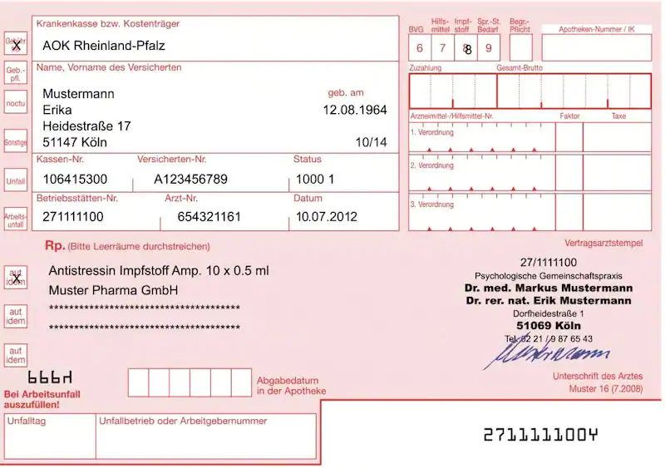
The pink prescription (digital e-prescriptions are much more common)
For prescription medications:
Copayment amount: at least 5 euros, max. 10 euros per medication

Slide 16

The green prescription
For over-the-counter medications: You must pay for these yourself.

Slide 17
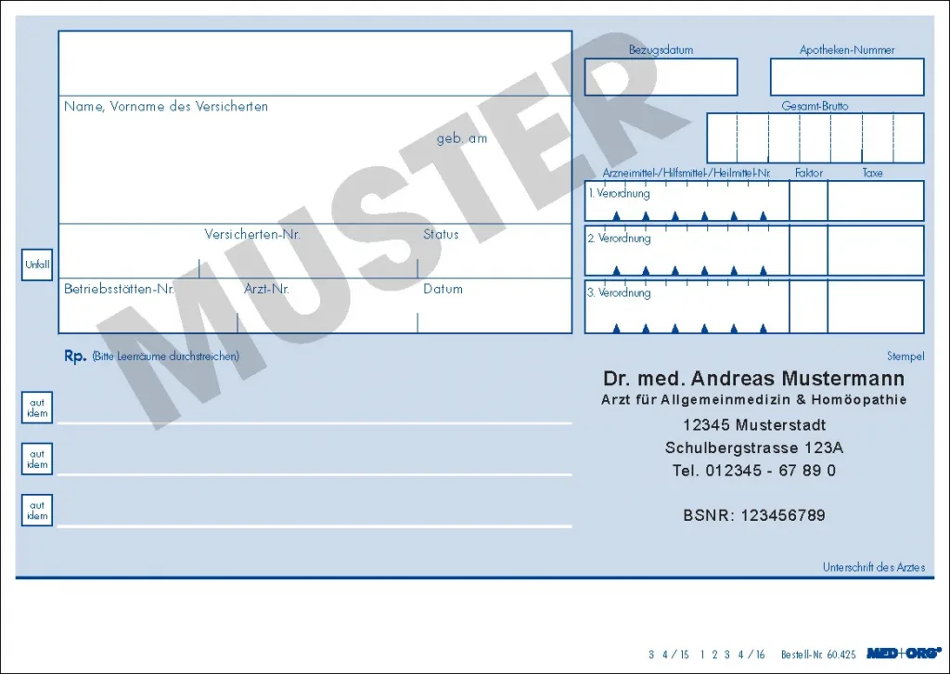
The blue or white prescription (private prescription)
A prescription medication that is not covered by health insurance:
You must pay for these yourself.

Slide 18
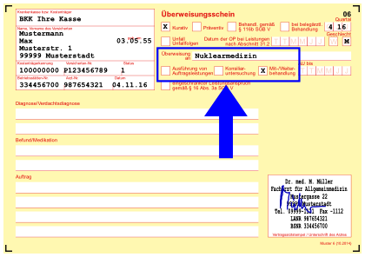

The doctor's referral
Referral from a general practitioner to a specialist (internist, orthopedist, etc.)
Why?
facilitates the exchange of information between general practitioners and specialists
For example: a general practitioner collects reports from specialists and can compile them into a comprehensive overview

Slide 19
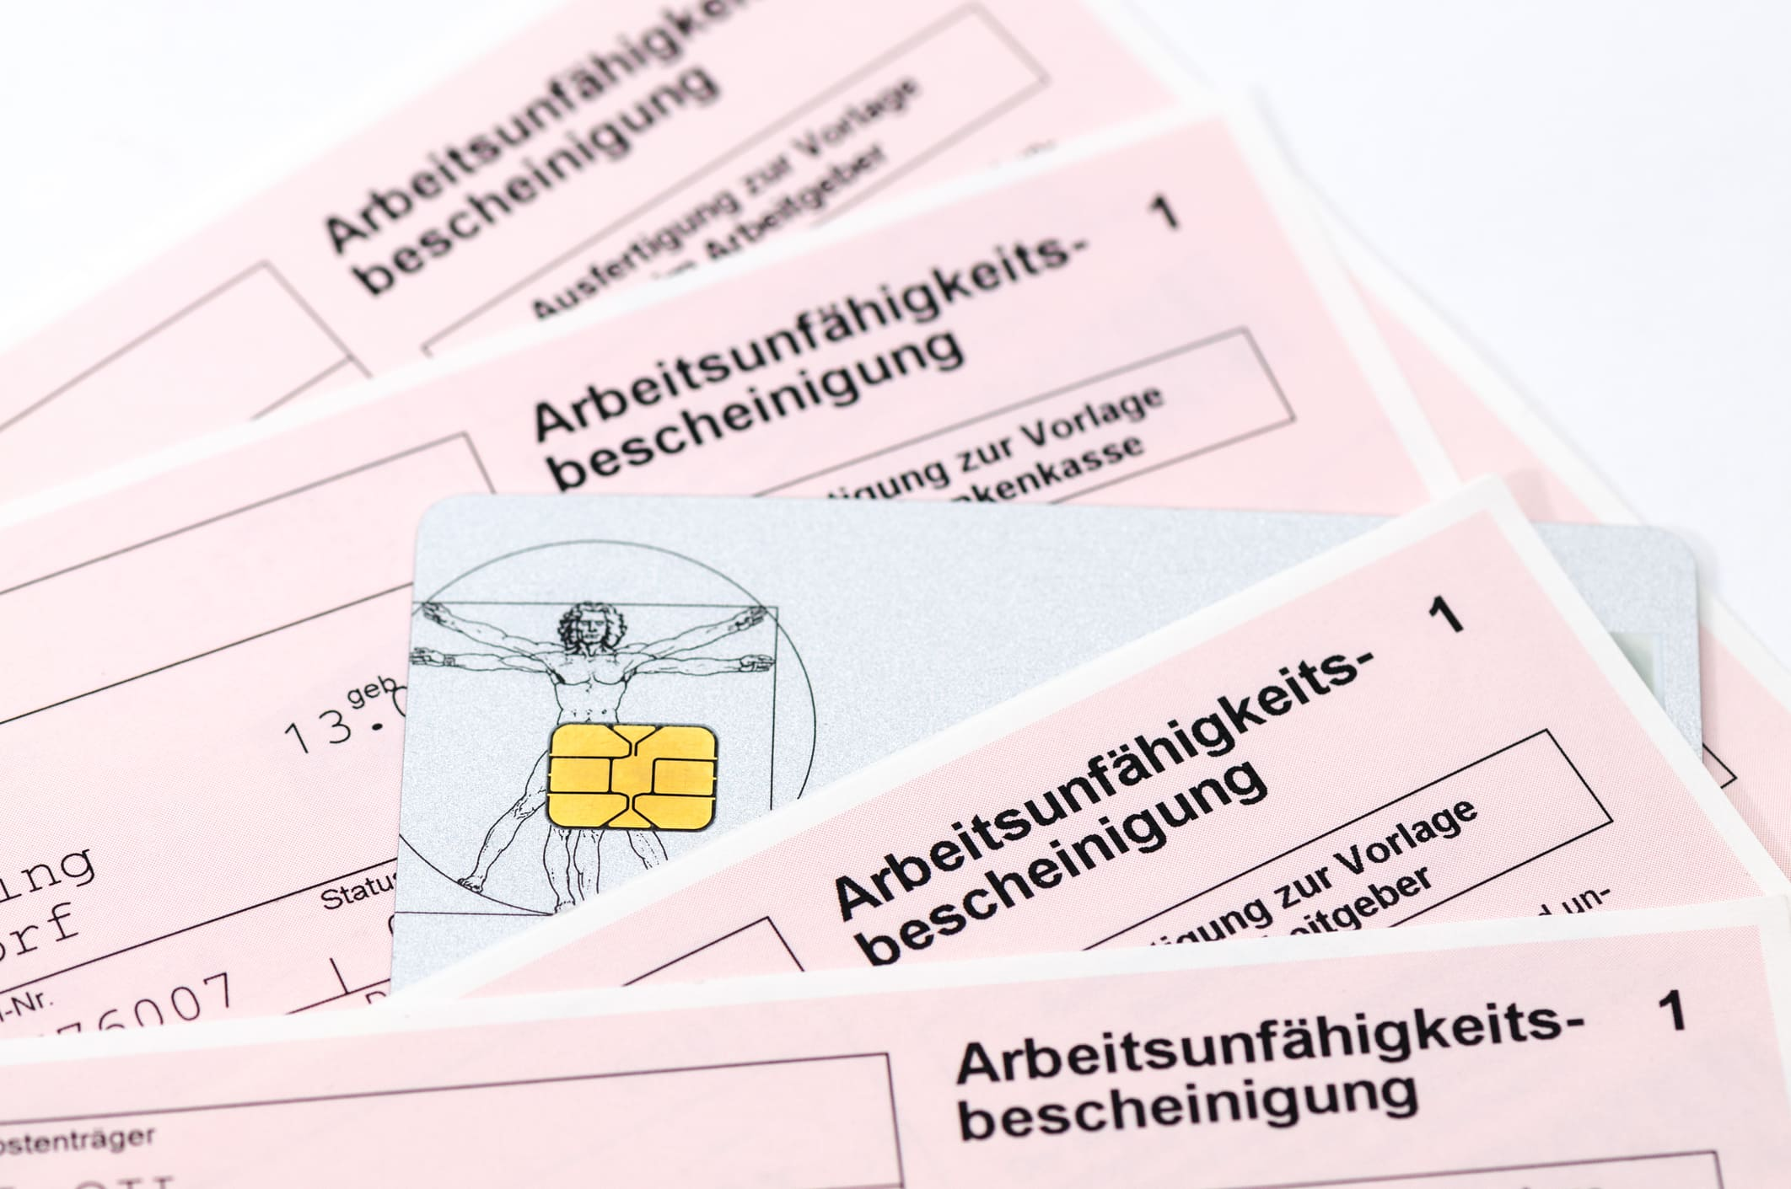
Sick leave
For those with public health insurance, sick leave certificates have been digital since January 1, 2023.→ The doctor’s office submits the sick leave notification electronically to the public health insurance provider.
People with public health insurance must report sick to their employers as usual.
When an employee is on sick leave, employers can access the sick leave notification directly online through the health insurance provider.
Patients with public health insurance will receive only a paper copy for their records. You should keep this copy, especially if you get sick during exam season!

Slide 20
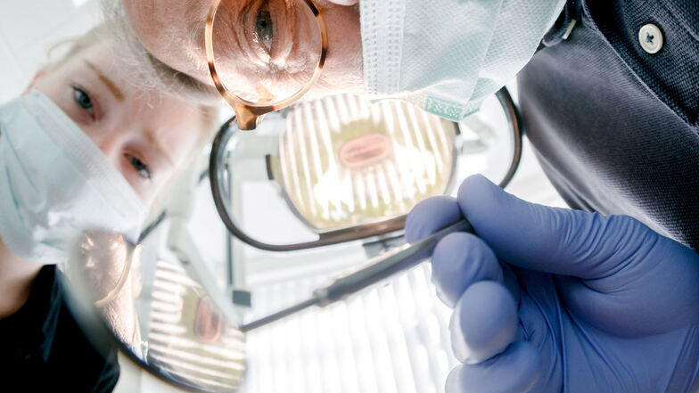
The Dentist Visit
1–2 times a year for preventive care
Public health insurance:
Preventive checkups (2 per year are covered)
Tooth-preserving treatments (fillings)
Tooth extraction
Fixed subsidy for dental prosthetics (dentures, bridges, crowns)
Those who visit the dentist regularly are rewarded (there is something called the bonus booklet)!
In some cases: professional teeth cleaning
private health insurance:
contractually agreed services, usually limited to pain relief in the most cost-effective manner

Slide 21
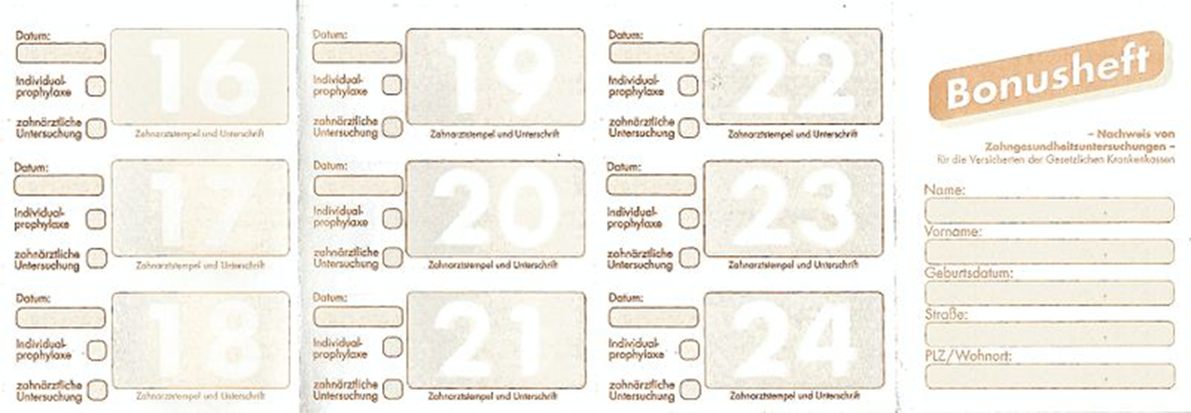
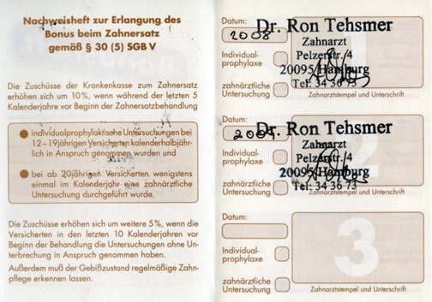
Dentist – bonus booklet
Or digital version

Slide 22
vaccinations
In Germany, there is no mandatory vaccination requirement (except for measles for people who work in schools).
However, certain vaccinations are recommended for adults (STIKO):
Diphtheria
Tetanus
Whooping cough (pertussis)
Polio
Measles, mumps, rubella
TBE (tick-borne encephalitis)
Influenza
COVID-19
Vaccination schedule in many languages:
https://www.rki.de/DE/Themen/Infektionskrankheiten/Impfen/Informationsmaterialien/verschiedene-Sprachen/Impfkalender/impfkalender-mehrsprachig.html?nn=16779318

Slide 23


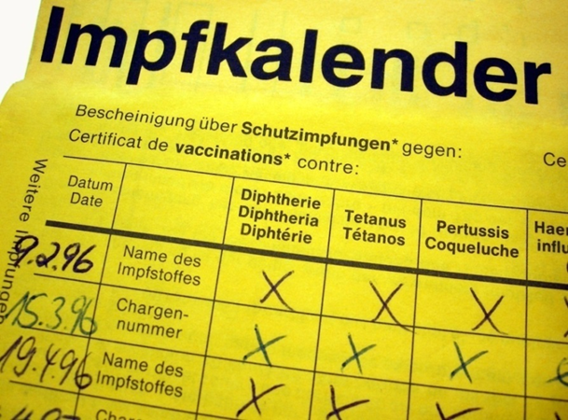
The vaccination record
also available as an app:
ImpfPassDE

Slide 24
The hospital stay (1/2)
Outpatient treatment:
takes place at a hospital, after which you can go home, e.g., for minor procedures
Follow-up care is often provided by the general practitioner
Inpatient treatment:
with hospitalization
Referral from a general practitioner or treating specialist
Be sure to bring your referral slip to the hospital!
Hospital contract: A written contract is provided for inpatient stays
public health insurance:
Covers the costs of hospitalization and treatment
Patient copayment: €10 per day for up to 28 days per calendar year
Special requests are subject to an additional charge
private health insurance:
Payments according to insurance contract

Slide 25
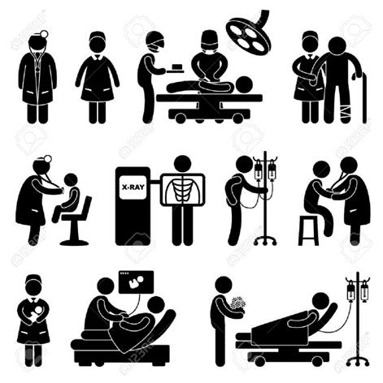
The hospital stay (2/2)
Surgeries:
The procedure is explained to the patient beforehand.
Be sure to ask if there’s anything you don’t understand!
Feel free to bring someone along to help with translation!
The doctor must explain all the risks.
The patient signs a consent form.
Everyday Life in the Hospital:
The nursing staff takes care of the patients' needs.
The patient's condition is assessed during the daily check-up.
Feel free to ask questions! Be open and honest!

Slide 26
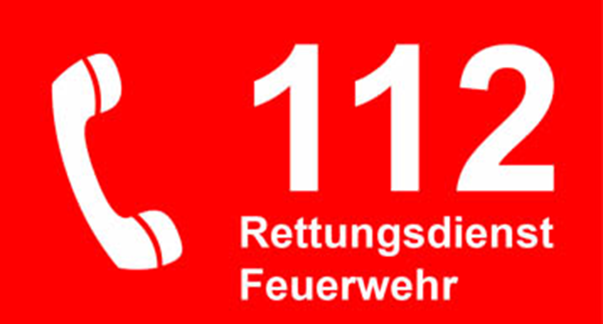
What to do in an emergency
Emergencies → Situations in which the person involved is in danger of injury or death, e.g.
High fever
Shortness of breath
Broken bones
Severe bleeding
Poisoning
Unconsciousness

Slide 27

What to do in an emergency
Rescue chain
1. Securing and self-protection
rescue oneself and others from the danger zone
Secure the accident scene if possible
2. Providing first aid*
3. Make an emergency call (112) and give the following information:
Where did it happen?
What happened?
How many people were injured or affected?
What kind of injury?
Wait for further questions!
* Everyone is required to provide first aid—at the very least, you must call emergency services. Failure to provide first aid is a criminal offense. Exceptions: the victim refuses assistance, the victim is dead, someone else is already helping, you would put yourself in danger, or you would be neglecting your duty of care (toward your children).

Slide 28

What to do in an emergency
4. Continue to provide first aid
e.g., wound care, patient care, etc...
5. Emergency medical services arrive and take over care
6. The patient arrives at the hospital emergency room

Slide 29

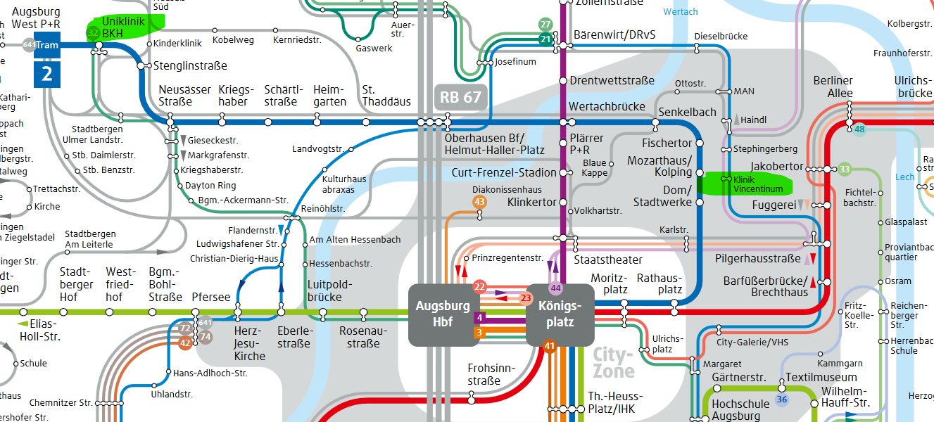
What to do in an emergency
In the case of non-life-threatening emergencies (pinched fingers, fever, pain), you can also go to the emergency room on your own
Can be reached by calling: 116 117
available whenever the general practitioner's office is closed
KVB Bereitschaftspraxis Vincentinum
Franziskanergasse 12 - 86152 Augsburg (central)
Busses 35 und 44 „Klinik Vincentinum“
Tram 1 „Fuggerei“ (distance approx. 500 m)
KVB Bereitschaftspraxis Uniklinikum
Stenglinstraße 2, 86156 Augsburg (entrance Notaufnahme)
Bus 32 & Tram 2 “Uniklinik“
https://www.kvb.de/patienten/
aerztlicher-bereitschaftsdienst#c8743

Slide 30

Emergency numbers
Call 112 in case of a life-threatening emergency
Call the emergency service 116117 for non-life-threatening conditions and outside of office hours when treatment cannot wait

Slide 31
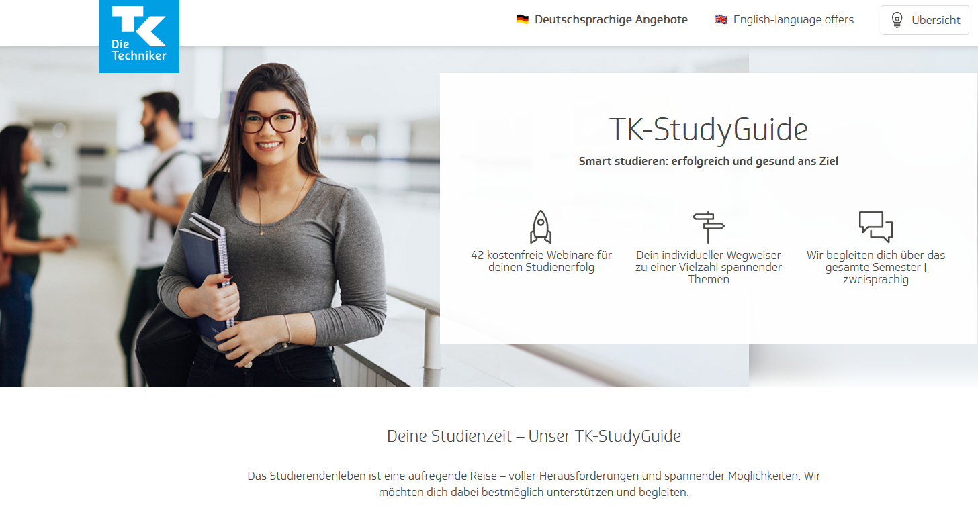
Other services and networks
In its TK-StudyGuide, Techniker Krankenkasse offers a wide range of courses designed to strengthen students' soft skills and health. The program is free for all students (regardless of their health insurance provider) and is also available to students who are not yet in Germany.
You can find more information on the following website: https://online.gib-base.de/gib/TK/l42gts/.

Slide 32

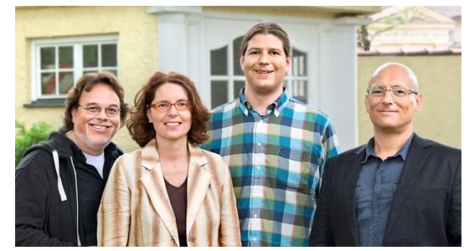
Other services and networks
Use information provided by health insurance companies (brochures, online portals) → https://www.tk.de/service/app/2009028/gesundheitskurs/ergebnis.app?faces-redirect=true
Illustrated health dictionary → https://www.studierendenwerke.de/beitrag/erste-hilfe-illustriertes-gesundheitswoerterbuch-hinweise-fuer-auslaendische-studierende-in-deutschland-1
B!st – Student Services Counseling → https://studierendenwerk-augsburg.de/sprechzeiten/ Counseling on the following topics: - Social and student finance counseling - Social and legal advice - Psychological counseling - Counseling for students with disabilities and chronic illnesses

Slide 33
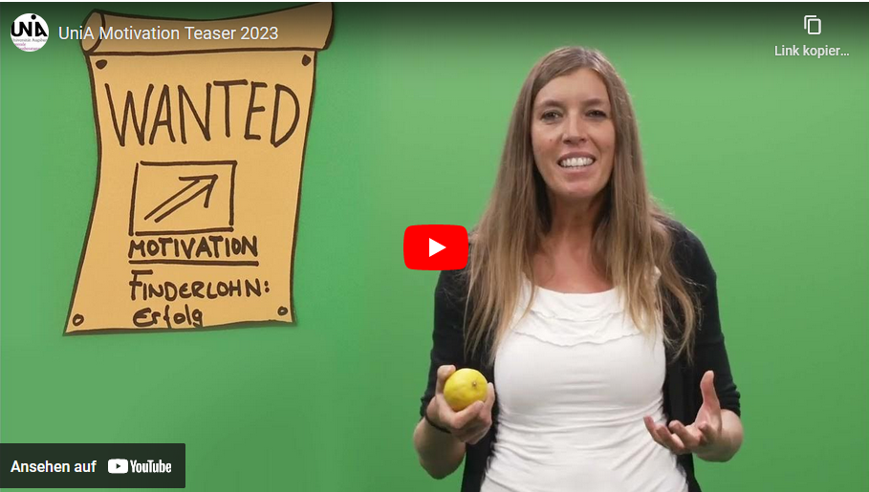
Other services and networks
Student Advice and Counseling Service:
Academic advising, exam management, time management and self-management, study-work-life balance counseling, psychological support and counseling
Zoom series and workshops for students:
https://www.uni-augsburg.de/en/organisation/einrichtungen/studienberatung/workshops/
Topics: Creating a study plan, resilience during your studies, time management, writing papers, procrastination, self-motivation and motivation to learn, etc.
Take advantage of university sports and health management programs:
https://hsa.sport.uni-augsburg.de/index.php/en

Slide 34

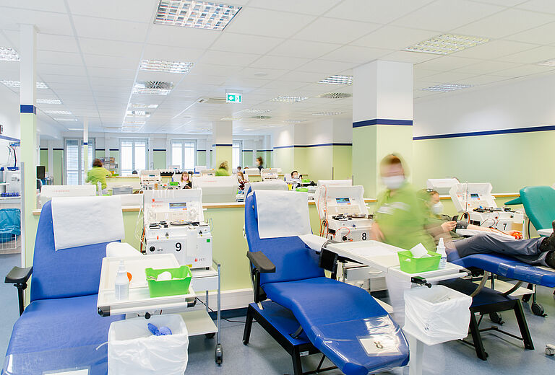
Donating blood
You can donate blood at the Red Cross. The donation itself takes about 10 minutes, and as a thank-you, you’ll receive a snack and a small gift. For your first donation, your blood will be tested free of charge. If you’re interested, you can find an appointment near you here: https://www.blutspendedienst.com/.
If you're interested, you can also donate plasma in the city center: https://www.haema.de/plasmaspende/. You will receive €25 as compensation for each donation.

Slide 35
Open questions?
The International Office at the University of Augsburg has put together a series of presentations for international first-year students with the most important information about studying and living in Augsburg.
This presentation is the fifth of seven. We recommend that you carefully review all presentations so that you are well prepared to start your studies and can clarify any important questions:
https://www.uni-augsburg.de/en/portal/internationals/abschluss/study-preparation-course/.
If you still have questions after reviewing all the presentations, please feel free to send us an email at: svk@aaa.uni-augsburg.de.

