Slide 1
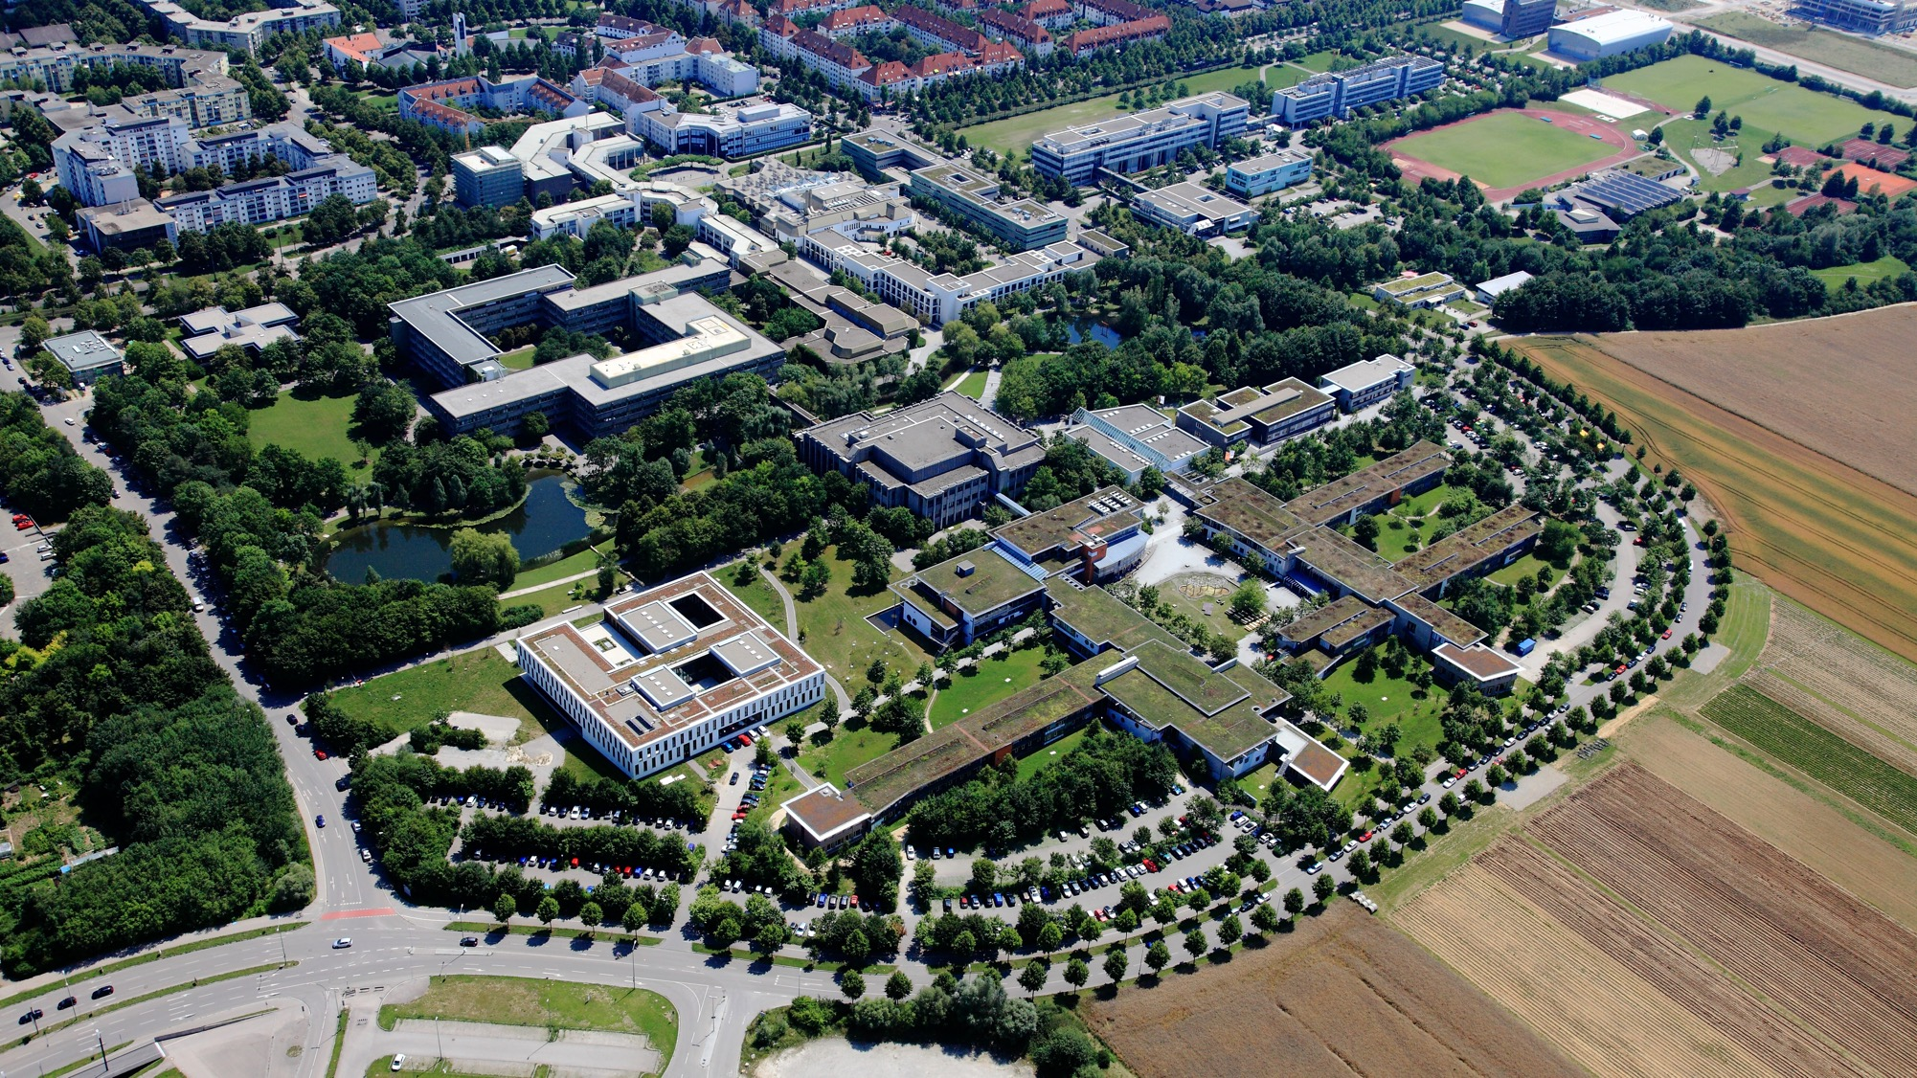









Job Applications

Slide 2


Important information about starting your studies
The International Office at the University of Augsburg has put together a series of presentations for international first-year students with the most important information about studying and living in Augsburg.
This presentation is the seventh of seven. It covers the job application process in Germany. We recommend that you carefully review all presentations so that you are well prepared to start your studies and can clarify any important questions.
All presentations are available online and can be downloaded via this link:
https://www.uni-augsburg.de/en/portal/internationals/abschluss/study-preparation-course/.

Slide 3

Applying for a Job in Germany

Slide 4
Job Postings
provide information on:
Institution →What kind of employer/scholarship provider is this?
Task → What needs to be done?
Requirements/Qualifications → Who are they looking for?
Terms and conditions → How many hours? For how long? How much do you get paid?
Type of application → What kind of documents do you need? Is it a digital application?
Application deadline
Contact → important for future correspondence

Slide 5
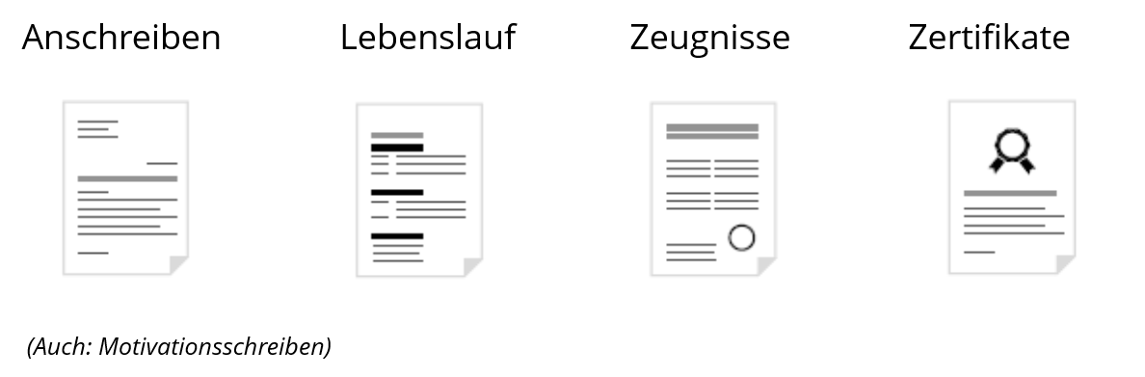
These documents should be included in a job application
Letter of Motivation (= „Anschreiben / Motivationsschreiben“)
Resume (= „Lebenslauf“)
Certificates (= „Zeugnisse / Zertifikate“)

Slide 6
These documents do not (!) belong in a job application
Email address, phone number, or letters of recommendation from reference persons (unless explicitly requested, e.g., for scholarship applications)
Employment contracts (if you do not have a reference letter, please do not submit the employment contract instead!)

Slide 7
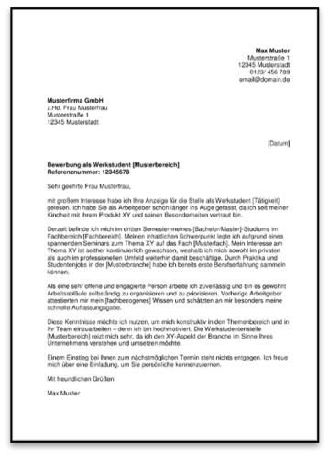
The Letter of Motivation
Why?
gives a first impression of who you are
explains why you are a good fit for the position
addresses the requirements listed in the job posting
highlights your strengths and skills
provides examples to “back up” your claims
This should convince the employers that you are the right person for the job

Slide 8
Letter of Motivation – Form and Content 1/2
Rule of thumb: not longer than one page
Letterhead:
Sender's Address
Recipient's Address
City and Date (on the right!)
Subject line
Introduction:
Form of address (as personal as possible → e.g., Dear Dr. Süß)
Brief(!) personal information
Start the introduction with your strongest argument in your favor

Slide 9
Letter of Motivation – Form and Content 2/2
Main section:
Specifically addressing the tasks mentioned in the job posting
→ Where and when have I done this before?
Specifically addressing the requirements
→ Where and how have I acquired these skills?
Aligning your knowledge and skills with the job requirements
Closing:
Express your appreciation for an opportunity to speak with them.
Signature:
Handwritten, original (scanned if necessary)

Slide 10
Letter of Motivation – Common Mistakes
The use of clichés such as …
“I am writing to apply for…”
    “…I was very interested to learn about this position”
    “The experience I gained during my internships has given me strong teamwork skills and…”
Too long
Merely a repetition of your resume
The letter of motivation does not address the requirements of the job posting

Slide 11
Letter of Motivation for Scholarships
In addition to the usual information, you will need the following:
Information on your financial situation
Details regarding your income
If applicable, proof of income (your own, your parents’, or your spouse’s)

Slide 12
The Resume
Relevance: Everything in your resume should be appropriate for the position and relevant to it
Length: Maximum of two pages
If including a photo, use a professional headshot (usually in the top right corner)
Structure:
In reverse chronological order
Dates (month and year) are on the left
Details: small things matter: 2021-22 / 2022 - 2023
Don’t forget the date and signature
Make sure everything looks consistent and is complete (all important information is included)!

Slide 13
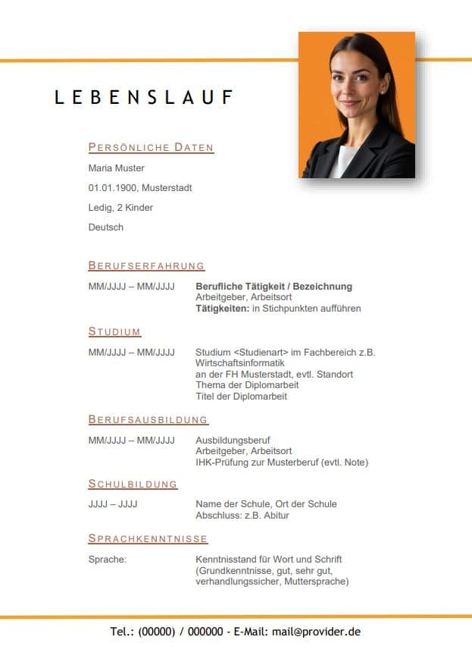
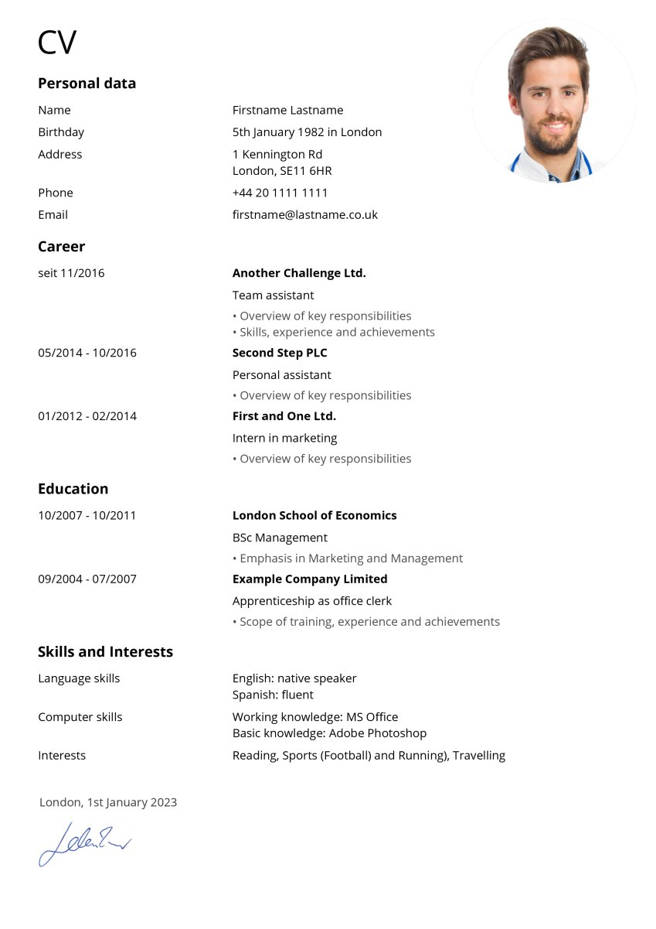
Resume - Examples

Slide 14
Resume – possible subsections
Personal Information / Personal Data
Educational Background
Academic Studies / Higher Education
Work Experience / Career History, etc.
Internships
Part-time Jobs During Studies
Additional Qualifications (e.g., social/ university involvement, computer skills)
Language skills / Foreign languages
IT skills
Personal interests / Hobbies
Volunteer work
Special notes (e.g., scholarships, memberships, etc.)
Military service / Civilian service (should always be a separate category)
Notes:
EU-Bürger (+ Schweiz, Norwegen, Irland, Liechtenstein)
unbefristete Aufenthaltserlaubnis (§ 7a AufenthG/EWG) oder Daueraufenthaltserlaubnis (§ 5 Abs. 5 FreizügG/EU).
als Arbeitnehmer freizügigkeitsberechtigt
verheiratet mit EU-Bürger (selbständig, arbeitssuchend, Ausbildung)
ein Elternteil ist EU-Bürger (selbständig, arbeitssuchend, Ausbildung)
Erwerbstätigkeit in Deutschland vor dem Studium (thematischer Bezug!)

Slide 15

Application photo
Tips for Your Application Photo
Use a professional photo
Appropriate, industry-standard attire
Neutral background
Size: between 6x4 cm and 9x6 cm
Your face should be facing the center of the page
Guideline:
The more important the position being advertised, the more important it is to include a photo on your resume.A resume with a photo is also more important in the private sector than, for example, in the public sector.

Slide 16
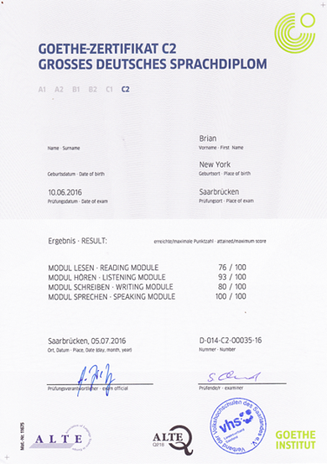

Certificates
All items listed on the resume must be supported by a certificate or confirmation in order for the application materials to be considered “complete.”
→ A reference letter is a written document from the employer detailing the duration, nature, and course of the employment relationship.
(Employment) references and/or certificates
School and university certificates
Academic transcript (e.g., STUDIS transcript)
Internships/part-time jobs
Professional development (computer courses, etc.)
Certificates of attendance
Language proficiency certificates
…

Slide 17
Open questions?
The International Office at the University of Augsburg has put together a series of presentations for international first-year students with the most important information about studying and living in Augsburg.
This presentation is the seventh of seven. We recommend that you carefully review all presentations so that you are well prepared to start your studies and can clarify any important questions:
https://www.uni-augsburg.de/en/portal/internationals/abschluss/study-preparation-course/.
If you still have questions after reviewing all the presentations, please feel free to send us an email at: svk@aaa.uni-augsburg.de.

