Slide 1
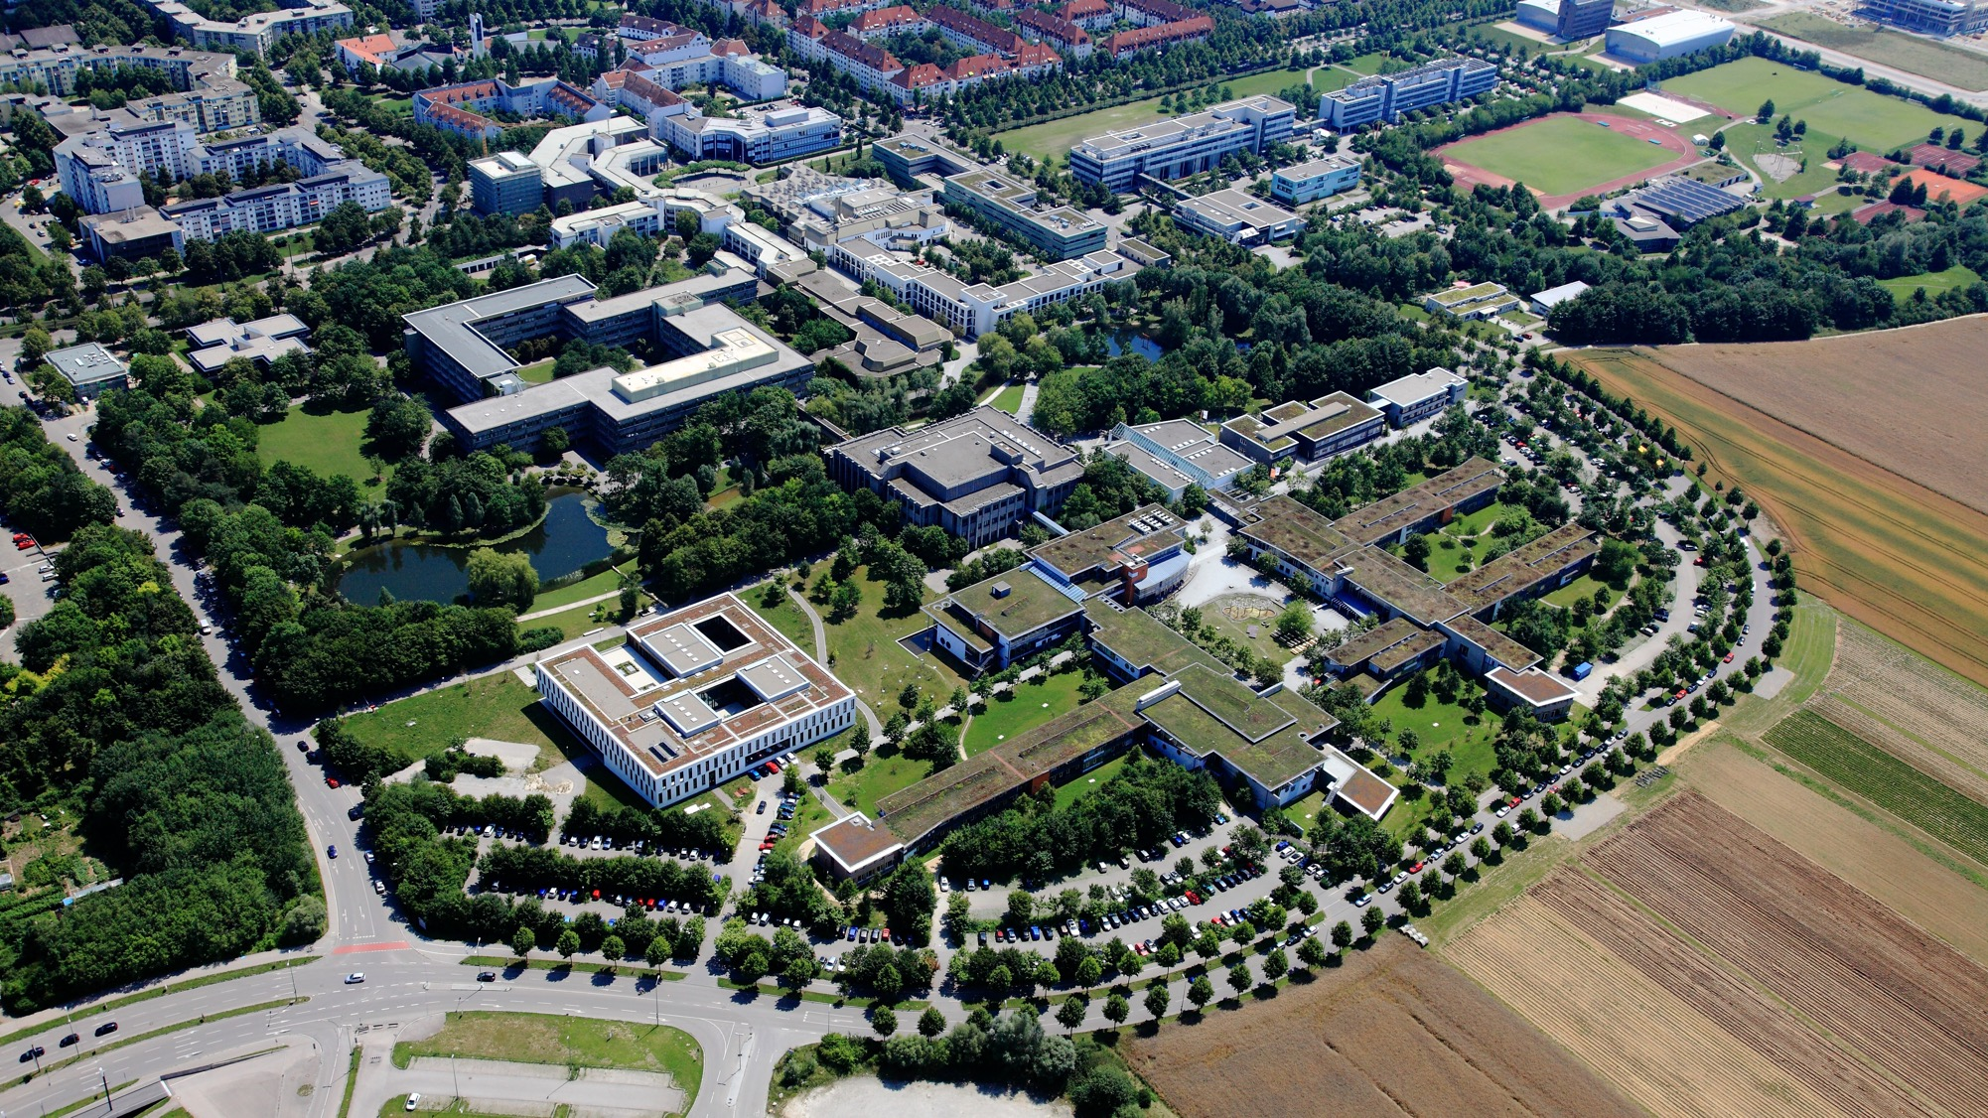









First Steps

Slide 2


Important information about starting your studies
The International Office at the University of Augsburg has put together a series of presentations for international first-year students with the most important information about studying and living in Augsburg.
This presentation is the second of seven. It covers the first steps you need to take before and after your arrival. We recommend that you carefully review all presentations so that you are well prepared to start your studies and can clarify any important questions.
All presentations are available online and can be downloaded via this link:
https://www.uni-augsburg.de/en/portal/internationals/abschluss/study-preparation-course/.

Slide 3
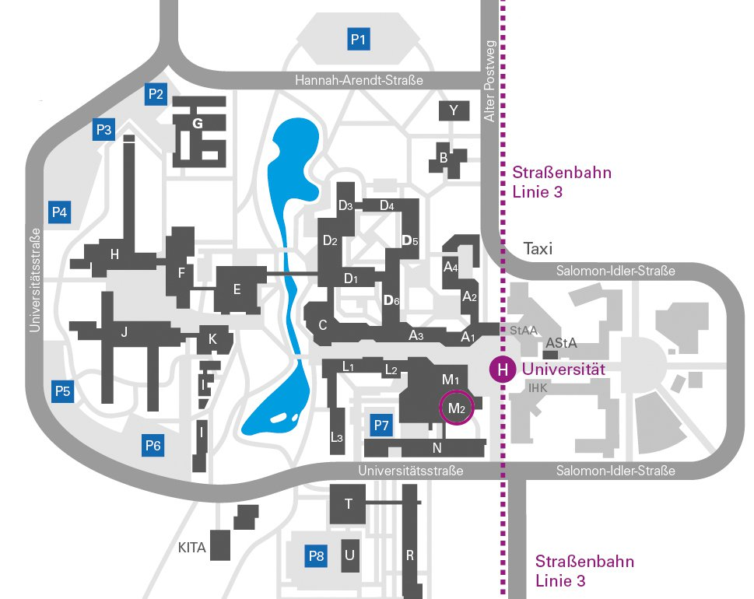
Your contacts at the International Office at the University of Augsburg
Dr. Stephan Hollensteiner – Head of the International Office
stephan.hollensteiner@uni-a.de
Tel. (+49) 821598-5135
Margot Schenker-Binder – Service Center for Academic Immigration (non EU: Registration with the City and Residence Permit)
hbst@aaa.uni-augsburg.de
Tel. (+49) 821 598-5448
Birgit Kirchner – Organizational questions in general birgit.kirchner@uni-a.de
Tel. (+49) 821 598-5065
Olivia Mannes – questions about the study preparation course
svk@aaa.uni-augsburg.de
Tel. (+49) 821 598-5065
You can find us in Building M2.

Slide 4
First steps
upon receiving admission
immediately upon arrival
after enrollment
(later) after arrival
Research important dates
Find a room
Pay your semester fees
Sign up for the Buddy Program
Subscribe to the AAA mailing list
Redirect your student email
Research introductory events
Sign up for the city tour
Find your way around the public transportation system
Buy a SIM card
Open a bank account
Get health insurance
Register at the university
Get your CampusCard
Get your RZ-ID
Set up eduroam
Generate your Certificate of Enrollment
Digital Services at the University
Register with the city (apply for a residence permit if necessary)
Sign up for a language tandem
Register for the Certificate in Intercultural Key Qualifications (ZIS)
Career Service
Campus-App
Take German courses
Sports center
Student discounts

Slide 5
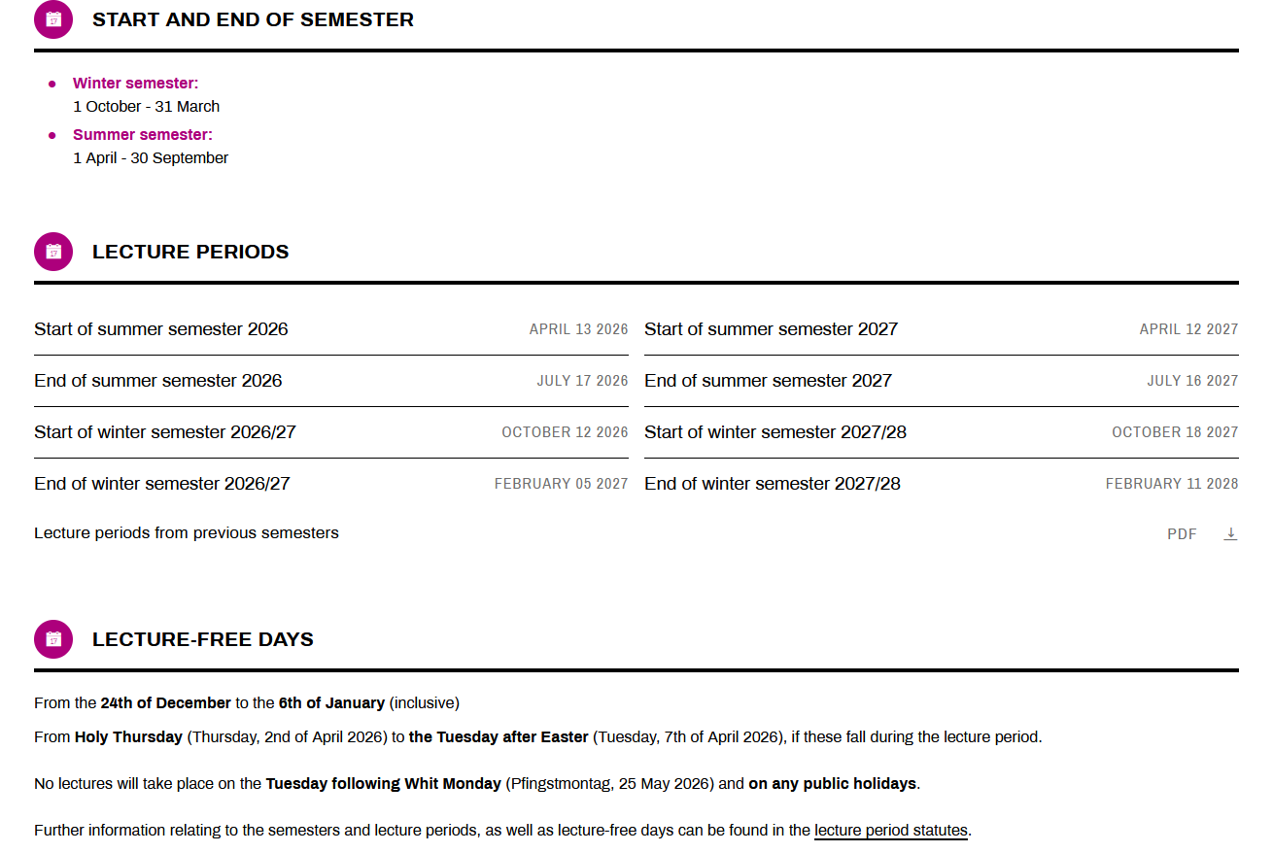

Research important days → https://www.uni-augsburg.de/en/studium/organisation-beratung/fristen-und-termine/

Slide 6

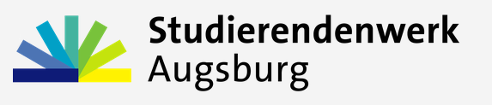



Ein Zimmer (in Augsburg) finden
Wo fängt man an?
Informieren Sie sich über unterschiedliche Wohnformen (Wohnheime, Studentenwerk, privat)
https://www.uni-augsburg.de/de/studium/studieren-augsburg/wohnen/
Bewerben Sie sich bei mehreren Anbietern.
Bleiben Sie aktiv! Fragen Sie nach! Suchen Sie selbst immer weiter!
Informieren Sie sich auch über Zimmer zur Zwischenmiete (in WGs, Wohnheimen, Hostels, Jugendherbergen etc.) für mehrere Wochen/ Monate/ ein Semester.
Suchen Sie nach Facebook-Gruppen (z. B. WG & Wohnung Augsburg gesucht) und fragen dort nach freien Zimmern
Gute Möglichkeiten sind auch: Wg gesucht, ImmoScout24, Kleinanzeigen, Studierendenwerk Augsburg und Augsburger Allgemeine.
Notes:
Wer hat schon ein Zimmer? Wer sucht noch?

Slide 7
Find a room (in Augsburg)
Where to start?
Read up on the different types of housing (dormitories, Studierendenwerk, private rentals) https://www.uni-augsburg.de/en/studium/studieren-augsburg/wohnen/
Send your application to a variety of options.
Stay proactive! Ask around! Keep searching on your own!
Also look into short-term rentals (in shared apartments, dorms, hostels, youth hostels, etc.) for several weeks, months, or a semester. A temporary solution like this allows you to search while you’re in Augsburg, which is often easier.
Search for Facebook groups and ask there if anyone has a room available.
Other good options are: Wg gesucht, ImmoScout24, Kleinanzeigen, Studierendenwerk Augsburg und Augsburger Allgemeine.
Notes:
Wer hat schon ein Zimmer? Wer sucht noch?

Slide 8

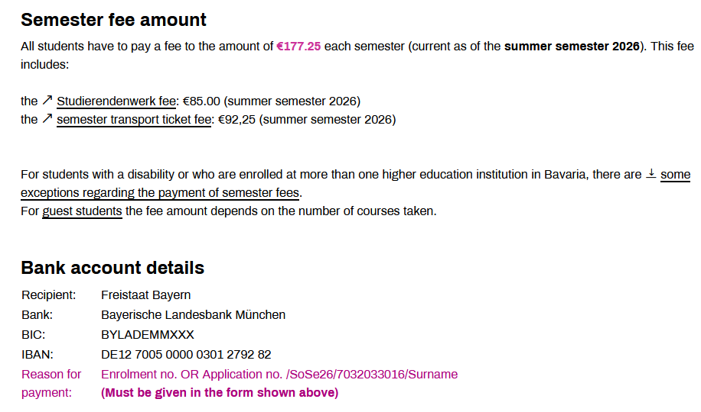
Pay your semester fees
You need to make the payment every semester (January/July): “Rückmeldung”
→ https://www.uni-augsburg.de/en/studium/organisation-beratung/organisation-und-formales/semesterbeitrage/

Slide 9
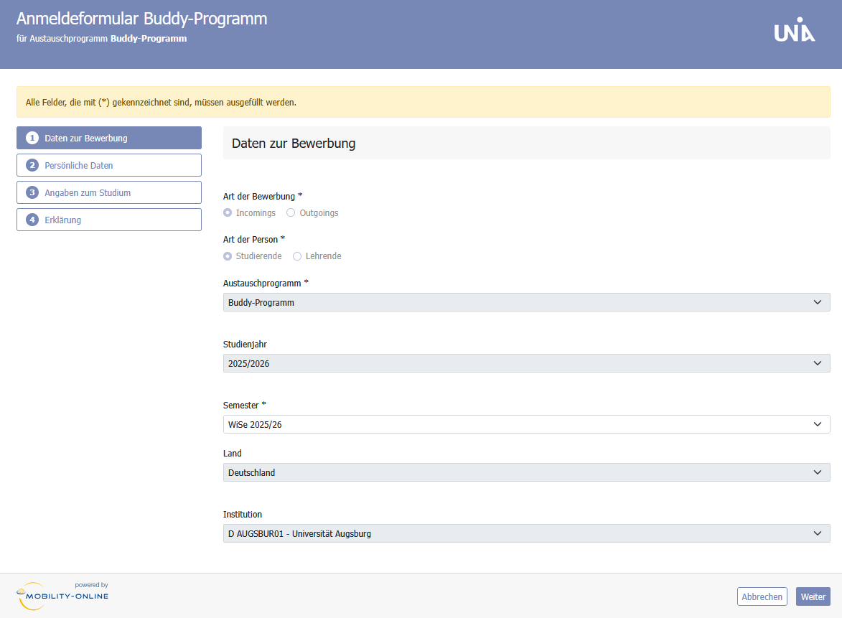

Sign up for the Buddy Program
To help international students settle into life in Augsburg, the Buddy Program pairs them with local students, known as “buddies.” These buddies serve as points of contact who offer help and guidance while they themselves benefit from the intercultural exchange.
For new international students
To make the start of your studies easier and to assist with organizational questions
Augsburg students in higher semesters volunteer their time
You can sign up here!

Slide 10

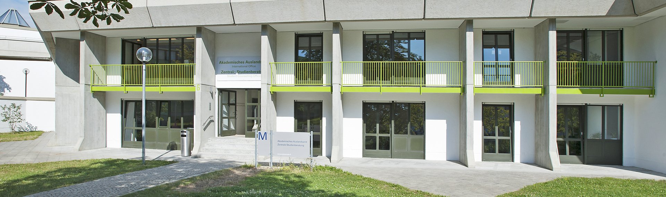
Subscribe to the AAA mailing list
For information on events, scholarship announcements, etc.
Simply send an email to info@aaa.uni-augsburg.de with the subject line: aaa-infomail

Slide 11


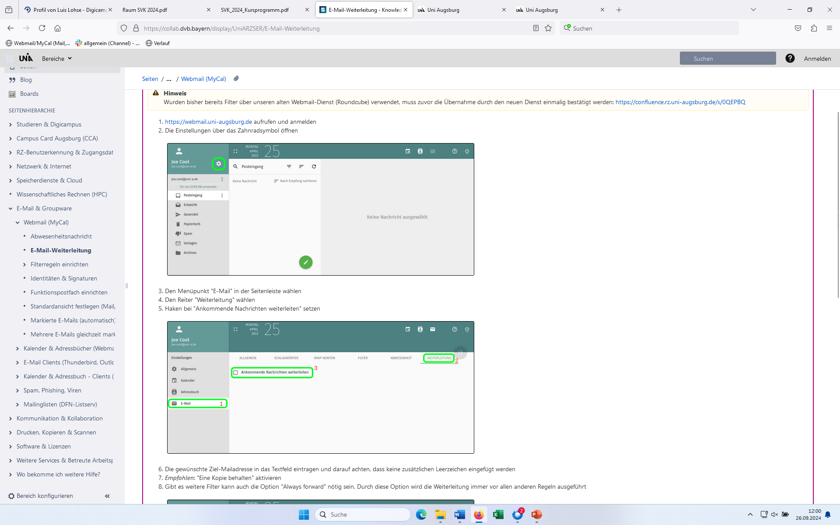
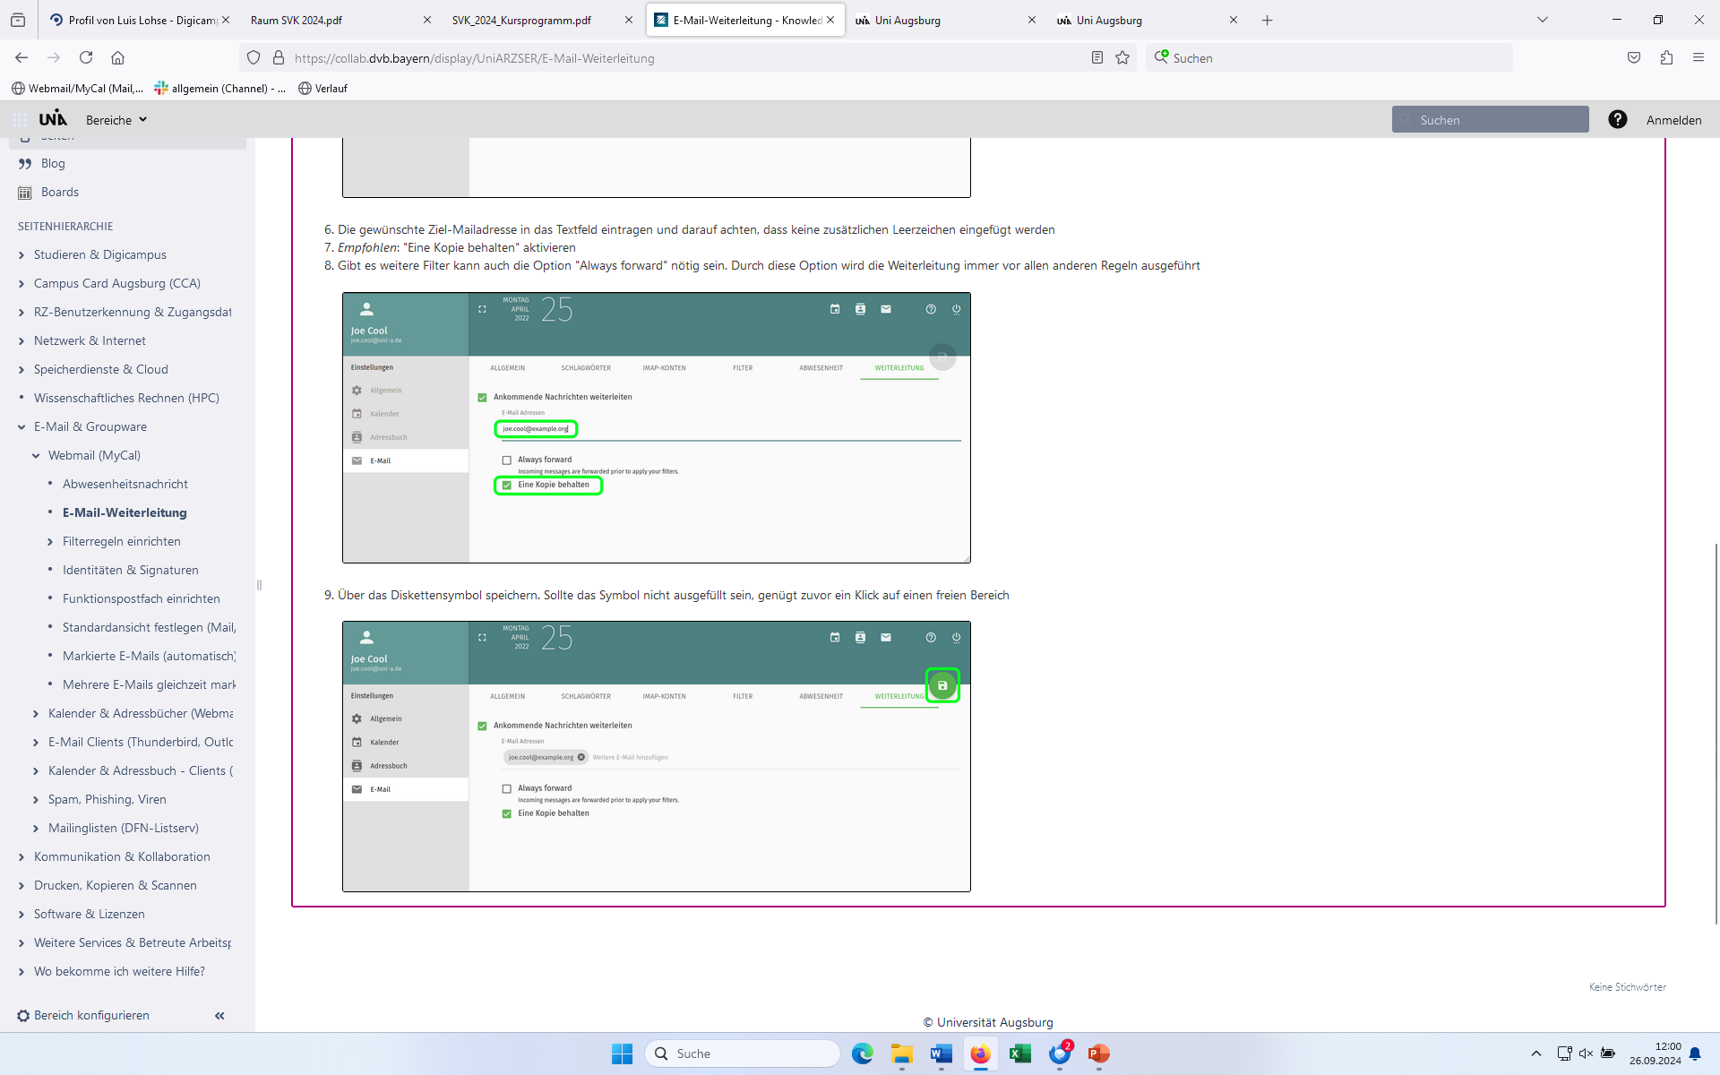
Redirect your student email
Please note: Some departments, such as the examinations office, will only respond to emails sent from your university email address!!!
Through the University of Augsburg’s webmail service, you will receive your own student email address, which you can use to send emails and receive important information. Many students find it easier to forward these emails to their usual email provider so they don’t miss any important information:
You can access the webmail service via the following link: https://webmail.uni-augsburg.de

Slide 12


Research introductory events
There will be a general/central orientation session in German for all first-year students on Thursday, April 9, 2026, from 1:30 to 3:30 p.m. in Lecture Hall 1009, Building H. There, you will receive basic information about studying at the University of Augsburg. At the end of the preparatory course, we will go there together. No registration is required.
Even more important than the general orientation session is the orientation session for your specific subject(s). You can find it via the following link: https://www.uni-augsburg.de/de/studium/organisation-beratung/beginn-verlauf/einfuhrungsveranstaltungen/ (→ You need to scroll down to find your subject.) At the orientation session, you will learn how your specific degree program is structured and how to best organize your studies. Attendance is strongly recommended!

Slide 13
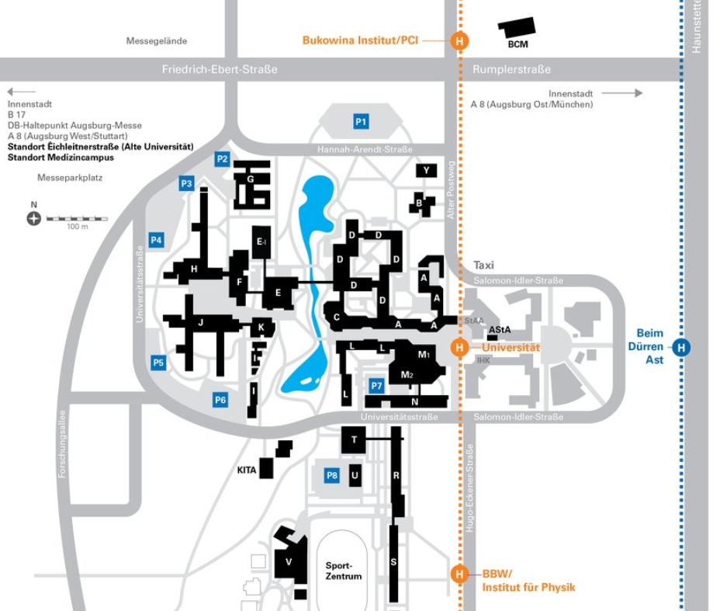
Central orientation session for all first-year students
The general orientation session for first-year students in all degree programs will take place on Thursday, April 9, 2026, from 1:30 p.m. to 3:30 p.m. in Lecture Hall 1009, Building H in German.
Following the president’s introduction, the various service facilities and service platforms will introduce themselves to you.
If you speak German, we recommend that you attend the general orientation session, as it will provide you with a comprehensive, interdisciplinary introduction to your studies at the University of Augsburg. If this session conflicts with subject-specific orientation sessions, we recommend that you attend the subject-specific session. There you will receive more detailed information about your specific course schedule and other important questions.
https://www.uni-augsburg.de/de/studium/organisation-beratung/beginn-verlauf/einfuhrungsveranstaltungen/#zentral

Slide 14

Sign up for the city tour
Explore Augsburg with other international students on a free guided tour of the city! The professional tour is free of charge for you. You may have to pay for any small entrance fees yourself.
The city tour will be in English.
Date: Saturday, April 11, 2026, 2:00 p.m. to approximately 3:00 p.m.
Meeting point: Town Hall Square
Please note: You must register and sign up for the city tour here: https://augsburg.esn.world/events

Slide 15
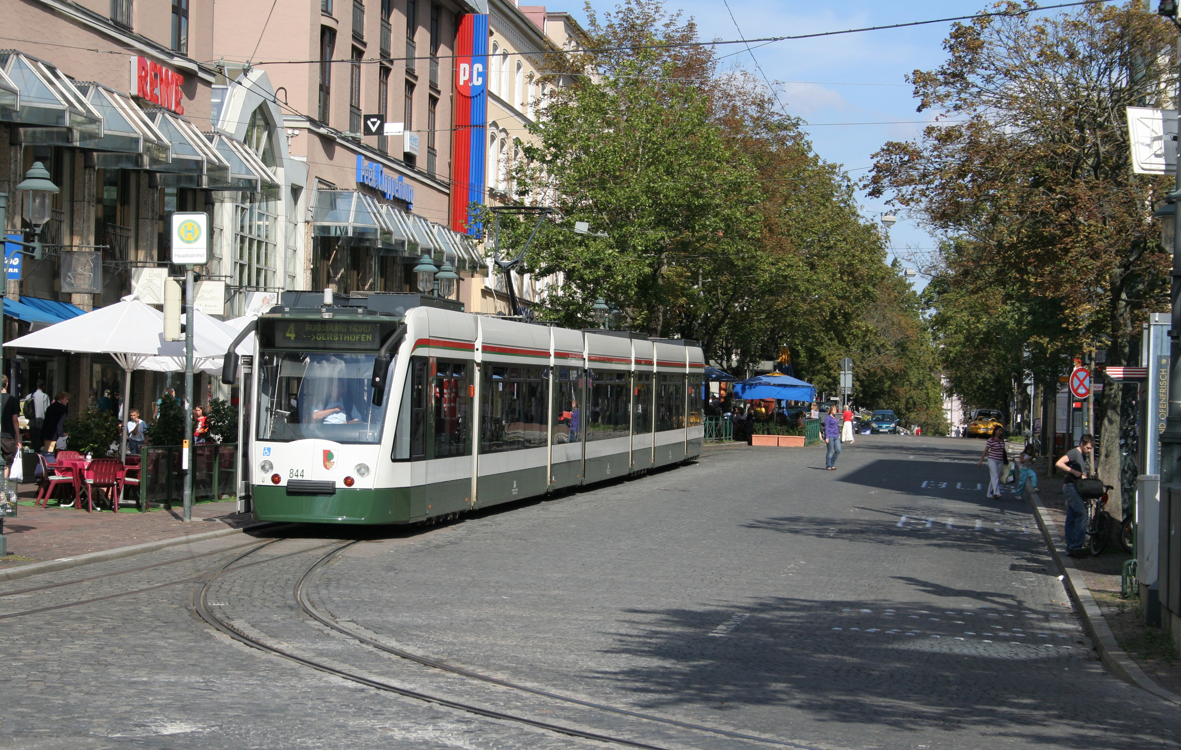

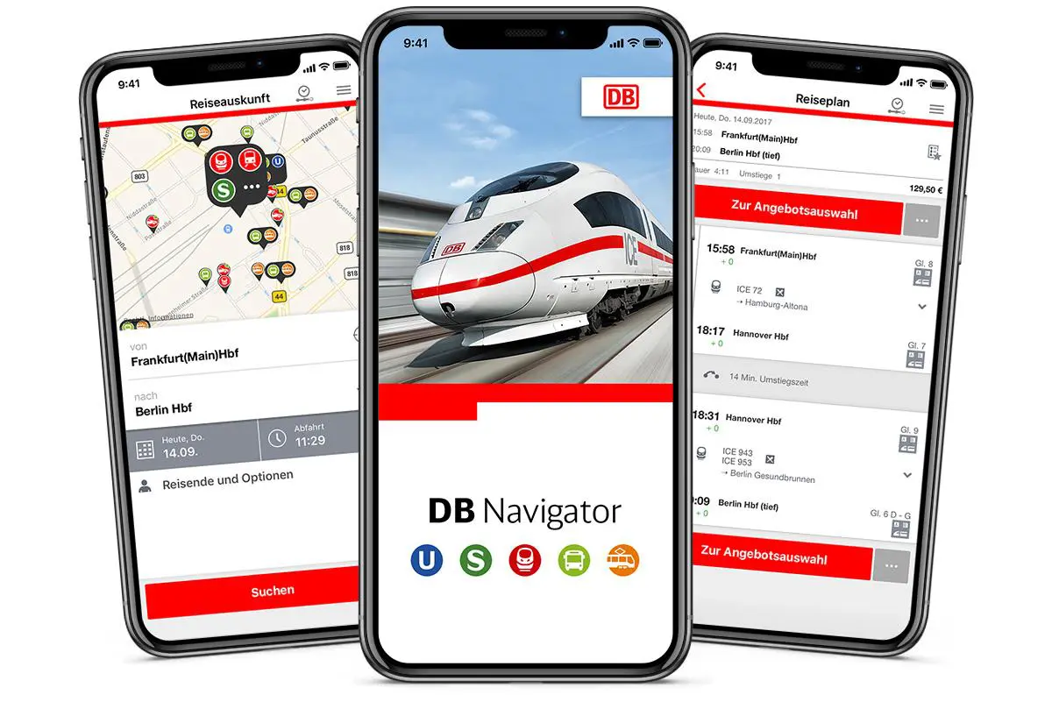
Find your way around the public transportation system
A great way to navigate public transportation in Augsburg is the “mein AVV” app: https://www.avv-augsburg.de/service/app-meinavv. There, you can view available connections and purchase tickets.
Please note: Once you receive your CampusCard, it serves as your ticket on Augsburg’s trams and buses!
Online Journey Planner: https://fahrtauskunft.avv-augsburg.de/sl3+/trip?lng=en
Overview of the route network:
https://www.avv-augsburg.de/verbindungen/liniennetzplaene
For travel outside of Augsburg, use Deutsche Bahn (DB): https://int.bahn.de/en?dbkanal_007=sprachauswahl-en
(→ App „DB Navigator“)

Slide 16
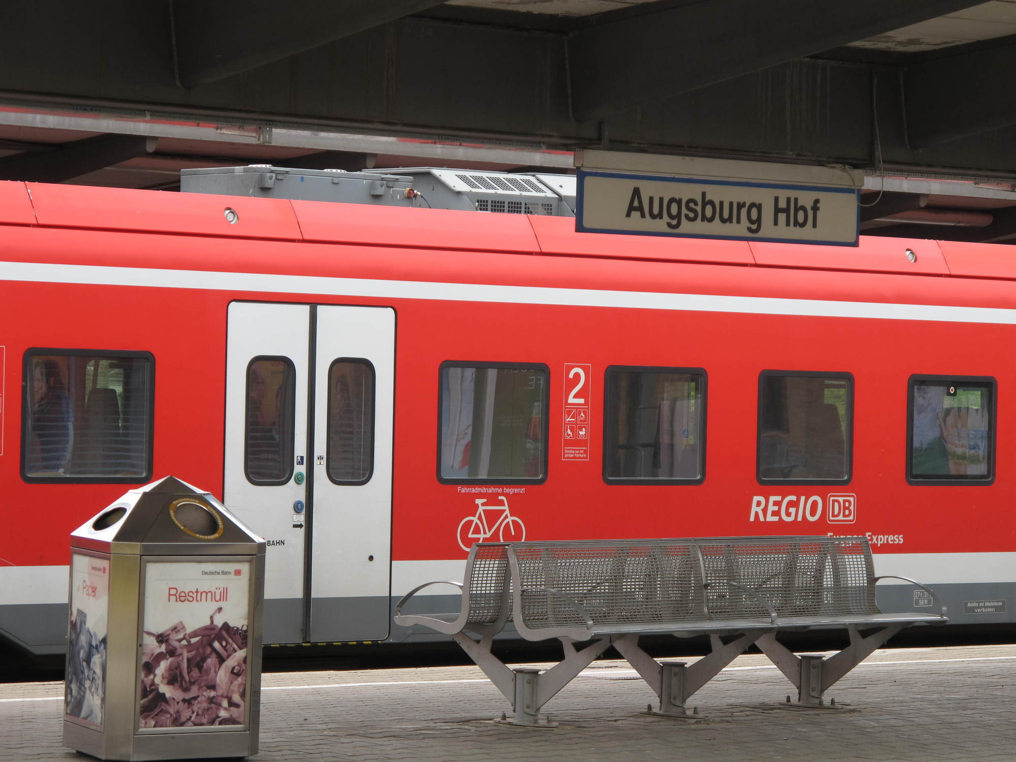
Deutschlandticket – Student discount
With the “Deutschlandticket” for €27.62 per month, students can use regional and local public transportation services without restriction.
This includes trams, buses, S-Bahn, U-Bahn, and regional trains (RB, RE).
This does not apply to long-distance trains (ICE, IC).
The subscription always begins on the 1st of the month.
The subscription can be canceled by the 10th of the month for termination at the end of the month.
To purchase a discounted D-Ticket, you will need:
Your RZ ID
Bank details for a SEPA account with an IBAN and BIC from the EU (no credit cards!)
No other active subscription

Slide 17


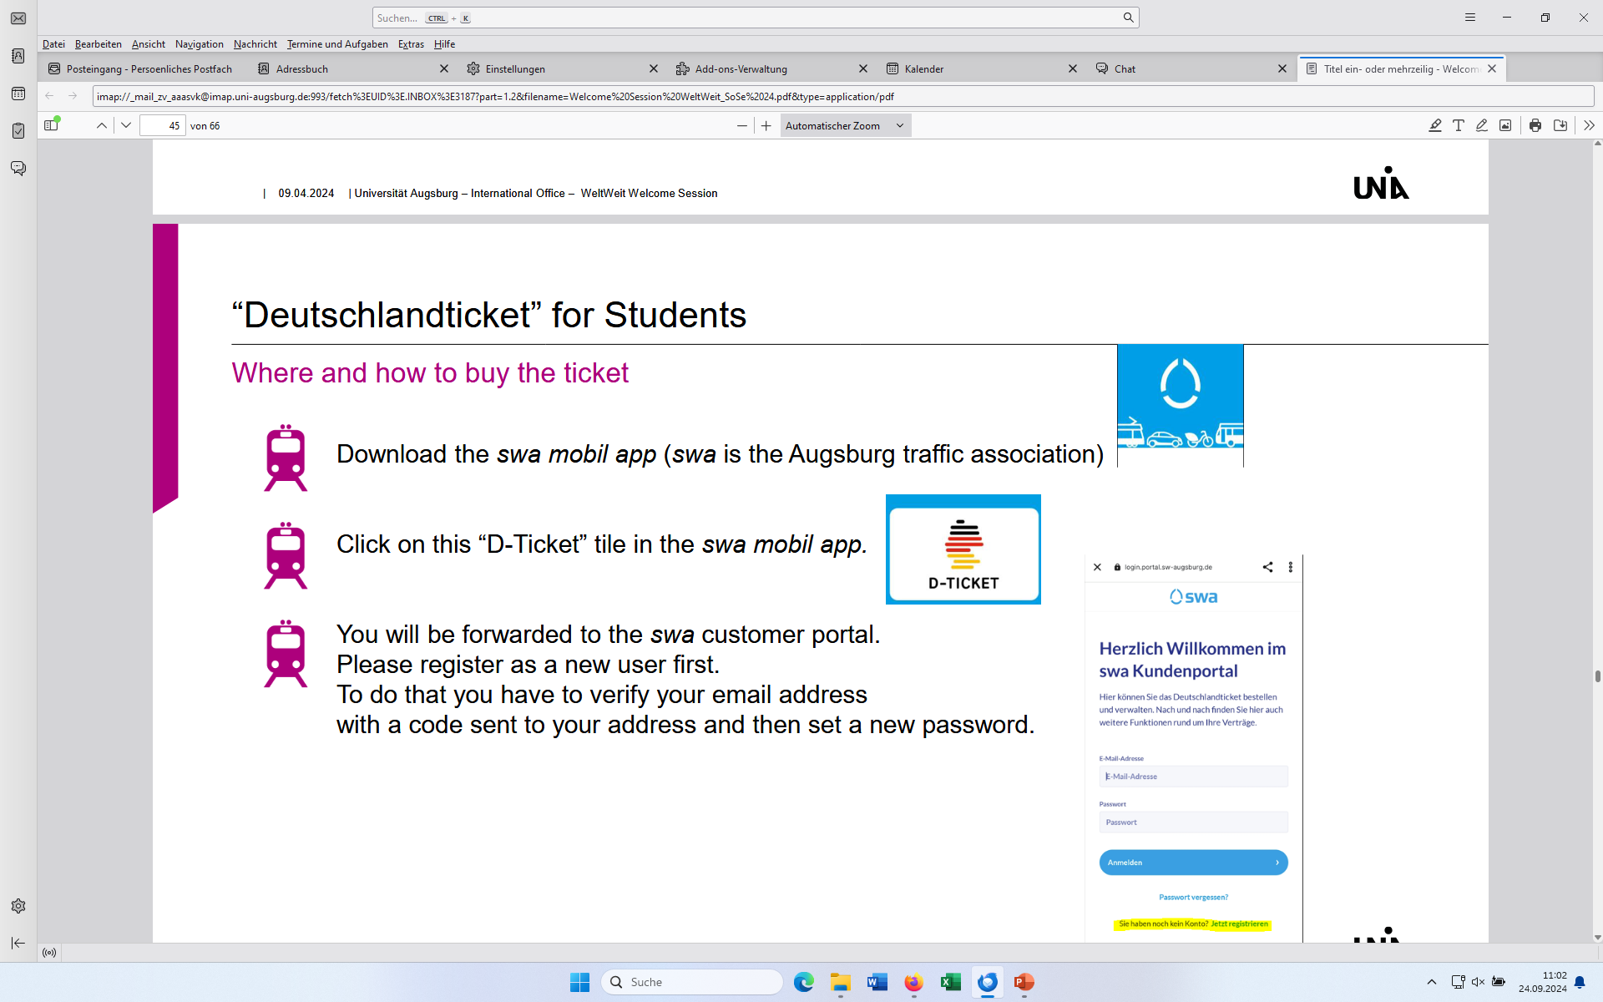
Buy the Deutschlandticket
Download the swa Mobil-App from Stadtwerke Augsburg (swa) (https://www.sw-augsburg.de/deutschlandticket/#c11260)
In the app, tap on “D-Ticket” .
You will be redirected to the swa customer portal. There, you will need to register as a new customer and verify your email address.

Slide 18
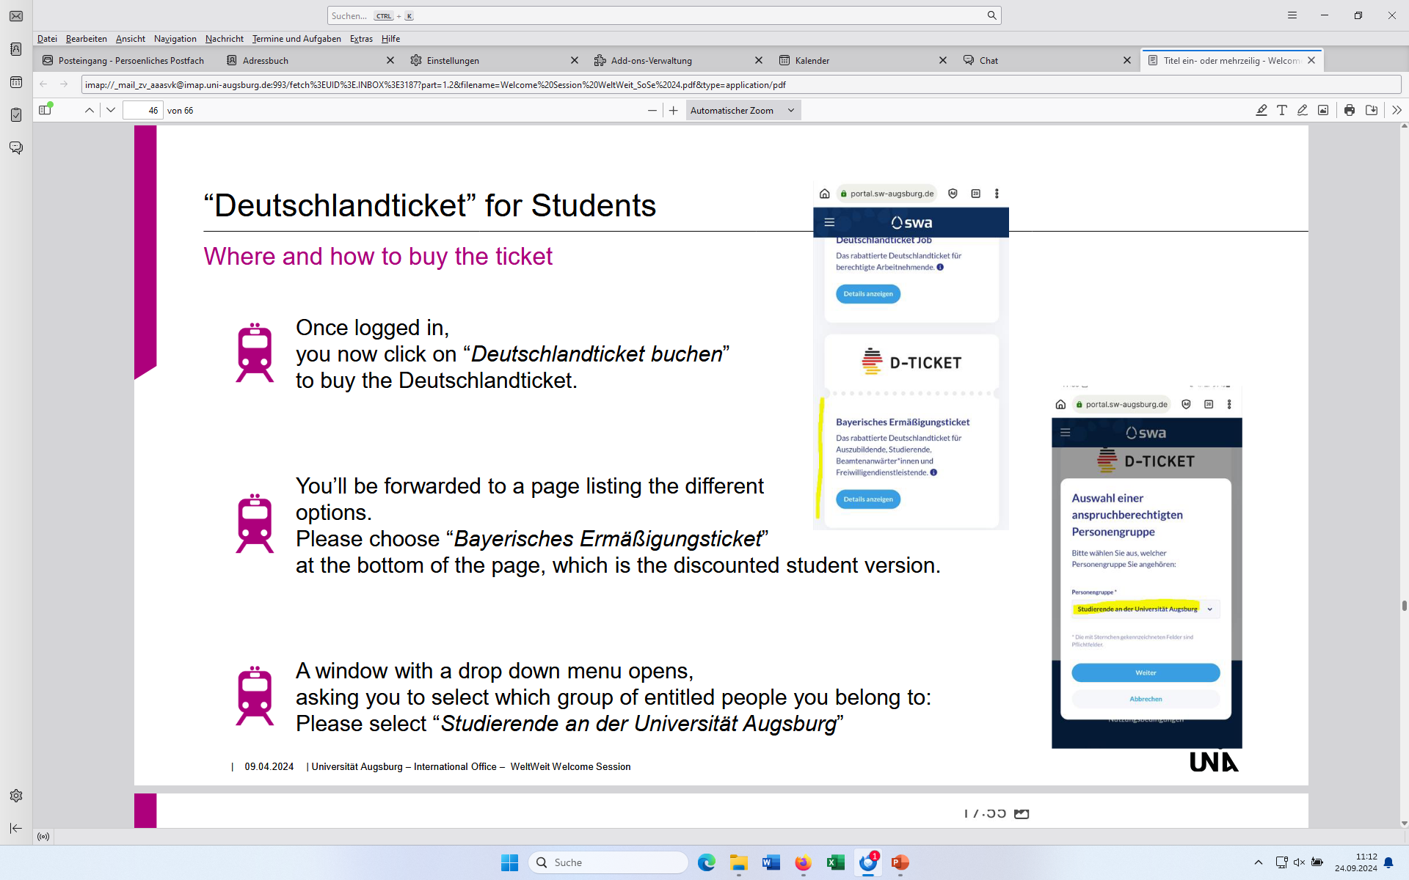
Buy the Deutschlandticket
Once you've logged in, click on “Deutschlandticket buchen”.
You will be redirected to a page listing various options. Select “Bayerisches Ermäßigungsticket”.
A drop-down menu will appear; select “Studierende an der Universität Augsburg.

Slide 19
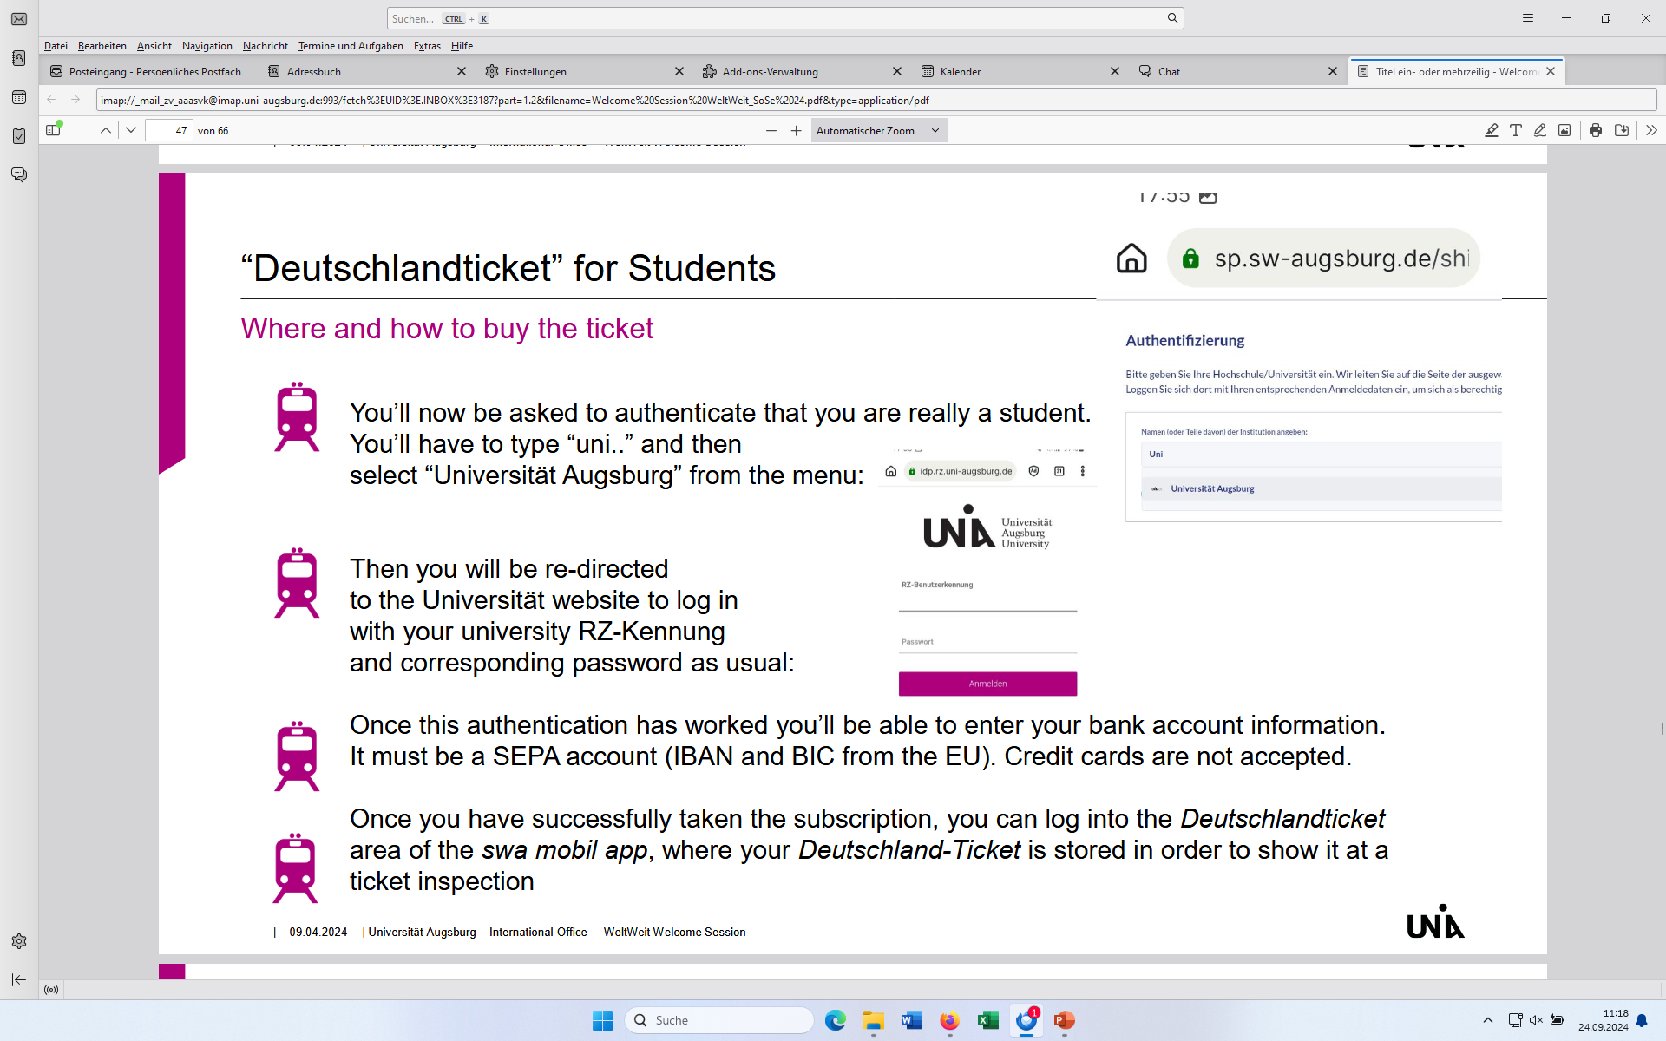
Buy the Deutschlandticket
During authentication, you must select “Universität Augsburg”.
You will be redirected to a university website where you will need to log in using your RZ ID.
After authentication, you must provide your bank details. It must be a SEPA account with an IBAN and BIC from the EU. Credit cards are not accepted.
Once you have completed your purchase, you will find your Deutschlandticket in the “D-Ticket” section of your swa Mobil app.

Slide 20
First steps
upon receiving admission
immediately upon arrival
after enrollment
(later) after arrival
Research important dates
Find a room
Pay your semester fees
Sign up for the Buddy Program
Subscribe to the AAA mailing list
Redirect your student email
Research introductory events
Sign up for the city tour
Find your way around the public transportation system
Buy a SIM card
Open a bank account
Get health insurance
Register at the university
Get your CampusCard
Get your RZ-ID
Set up eduroam
Generate your Certificate of Enrollment
Digital Services at the University
Register with the city (apply for a residence permit if necessary)
Sign up for a language tandem
Register for the Certificate in Intercultural Key Qualifications (ZIS)
Career Service
Campus-App
Take German courses
Sports center
Student discounts

Slide 21








Buy a SIM card
Shortly after you've arrived, you should buy a SIM card for your cell phone.
A cell phone contract usually only makes sense if you plan to stay in Germany for several years.
Alternatively, you can purchase prepaid cards starting at €10. These are available at electronics stores like MediaMarkt and Saturn, drugstores like dm, Müller, and Rossmann, or supermarkets like Aldi. The cost depends on your usage.

Slide 22


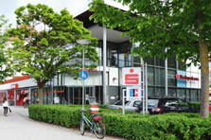
Open a bank account
You’ll need to open a bank account if you:
plan to stay in Germany for several years
need to pay rent for a dorm room – only German bank accounts are accepted there!
want to get German health insurance
want to work while studying in Germany
want to withdraw cash for free in Germany – you’ll need cash from time to time in your daily life!
We recommend that you choose a bank with branch offices or ATMs that are easily accessible to you.Most international students choose the Stadtsparkasse Augsburg because it has many ATMs located throughout the city.
To open a bank account, make an appointment at a bank branch of your choice, such as Stadtsparkasse Univiertel:
contact: 0821/32550
email address: bc38@sska.de
address: Hermann-Köhl-Str. 9, 86159 Augsburg
You can also open an account with an online bank (e.g., N26)!

Slide 23
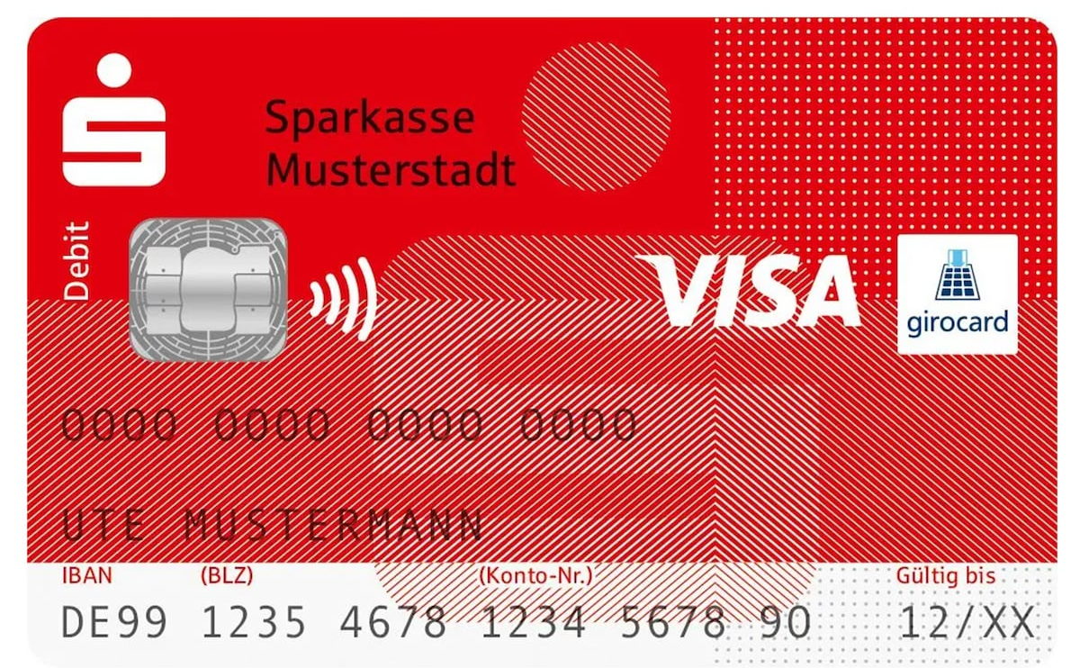
Open a bank account
Required documents:
German cell phone number (for online banking!)
Your full address in Germany (including your apartment number if you live in a dormitory)
Your registration confirmation from the city OR your lease agreement
Your letter of admission from the university (as proof that you will be a student; in that case, the account is free until you turn 28) or your certificate of enrollment
Your tax identification number* from your home country
You will receive your debit card in the mail in about two weeks
* Your tax identification number (TIN) is used to verify your identity. If you do not pay taxes in your home country, you do not need to provide a number. In that case, you will need to sign a form stating that you are not liable for taxes.

Slide 24

Payment Methods in Germany
Debit card or credit card (widely used in everyday life)
Often also in cash (especially for smaller amounts)
Bank transfer (= “Überweisung”) (cashless transfer from one's own account to another—e.g., via online banking)
Direct debit authorization (=“Einzugsermächtigung” or “Lastschrift”) → automatic deduction from your account, e.g., rent, phone bill, health insurance
Recurring payment (= “Dauerauftrag”) → the bank is instructed to transfer a specific amount to the same recipient on a regular basis

Slide 25
Get health insurance
Valid health insurance is required for enrollment!
For EU citizens:
Health insurance from your home country is sufficient—you need a valid EHIC card!
Required for enrollment: “Insurance Certificate for Enrollment.” This can be obtained from a German public health insurance provider by presenting your EHIC card
Please note:
Your existing international health insurance must be renewed.
Your international health insurance will only cover the costs it would cover in your home country. Any additional costs must be paid out of pocket.
You may need German health insurance if you plan to work in Germany.

Slide 26
Get health insurance
In Germany, a distinction is made between private and public health insurance:
Public health insurance:
Available only to students under 30 years of age
Excellent insurance coverage
No issues with the immigration office accepting the insurance
Cost: approx. €145 per month
All public health insurance plans offer roughly the same benefits
You can find an overview of all public health insurance plans here: https://www.gesetzlichekrankenkassen.de/kassen/kassen.html
Private health insurance:
For students over 30
More affordable, but with fewer benefits than public health insurance
You must pay for treatment out of pocket first and will then be reimbursed
Monthly payments increase with age
You cannot switch to public health insurance retroactively while you are a student!
Examples: MAWISTA, care concept

Slide 27



Get health insurance
If you're unsure which insurance plan to choose, consider the following:
Does the insurance company have an office in Augsburg?
If so, where exactly?
Is there a specific contact person for students?
Make an appointment and get some advice!
If you have any questions:
Techniker Krankenversicherung (TK): Herr Georg Schöllhorn
georg.schoellhorn@tk.de
Telefon +49 (0)175 - 722 51 72
AOK Augsburg:
augsburg.team41@service.by.aok.de
Telefon +49-821 321-0
Barmer: Frau Ngoc Oanh Le,
ngocoanh.le@barmer.de
Telefon +49 (0)160 90456297

Slide 28
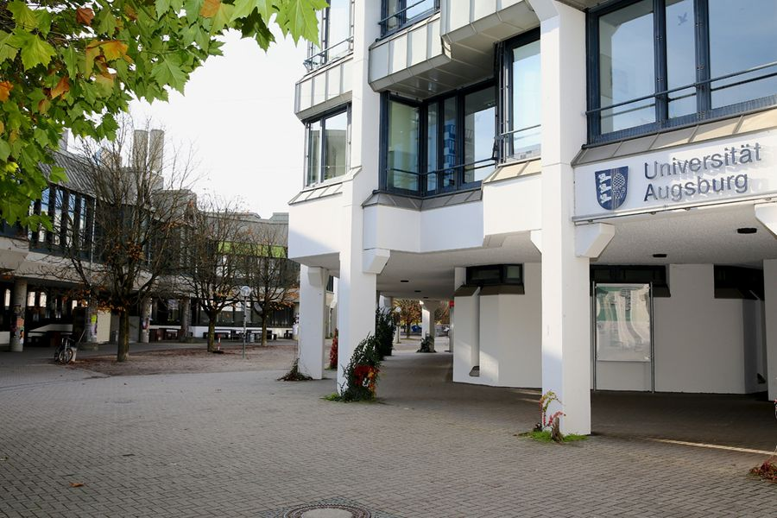
Register at the university
You can find all the information on the University of Augsburg website:
https://www.uni-augsburg.de/en/studium/bewerbung/einschreibung/
The contact person for international students is Ms. Kirschner (bewerbung-studium@zv.uni-augsburg.de) at the Registrar's Office:
https://www.uni-augsburg.de/de/organisation/einrichtungen/studierendenkanzlei/kontakt-und-team/stanislava-kirschner/

Slide 29
First steps
upon receiving admission
immediately upon arrival
after enrollment
(later) after arrival
Research important dates
Find a room
Pay your semester fees
Sign up for the Buddy Program
Subscribe to the AAA mailing list
Redirect your student email
Research introductory events
Sign up for the city tour
Find your way around the public transportation system
Buy a SIM card
Open a bank account
Get health insurance
Register at the university
Get your CampusCard
Get your RZ-ID
Set up eduroam
Generate your Certificate of Enrollment
Digital Services at the University
Register with the city (apply for a residence permit if necessary)
Sign up for a language tandem
Register for the Certificate in Intercultural Key Qualifications (ZIS)
Career Service
Campus-App
Take German courses
Sports center
Student discounts

Slide 30

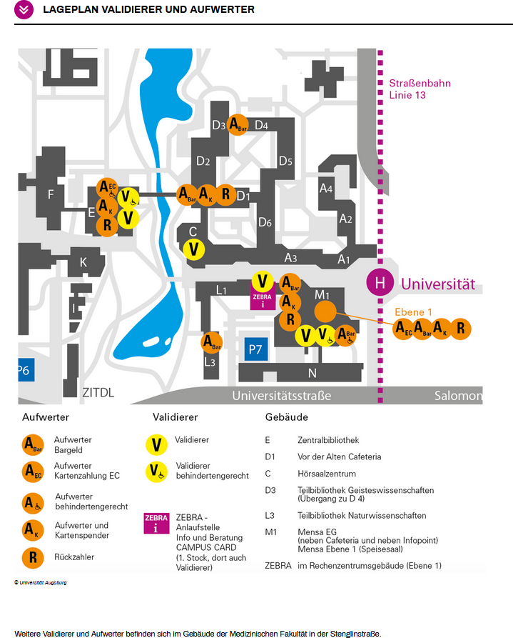
Get your CampusCard
You will receive your CampusCard after enrollment (by post)
CampusCard = Student ID, public transportation ticket, campus payment card, opens the gate to Parking Deck 1
The CampusCard must be validated each semester by using a “Validierer” on campus (a new “Valid until...” date is printed on it)
There are several “Validierer” and “Aufwerter” on campus—machines where you can validate your CampusCard and add money to it. You can find a campus map here: https://www.uni-augsburg.de/de/services/campus-card-augsburg/private-bezahlkarte/

Slide 31

Get your RZ-ID
RZ ID = “RZ-Kennung” → User ID (combination of last name and first name) and password
You will need your RZ ID to access all of the University of Augsburg’s digital services (VIBS Portal, Digicampus, STUDIS), to use computer workstations on campus, and to access eduroam and your student email account.
You will receive your RZ ID by post after successfully enrolling.
Please note: Your RZ ID is your access key to all of the university’s digital services EXCEPT the OPAC library catalog!
ID: Your library user number on your CAMPUS CARD
Password: The default password is the four-digit date of your birth (e.g., August 9 = 0908). You can change this password at any

Slide 32
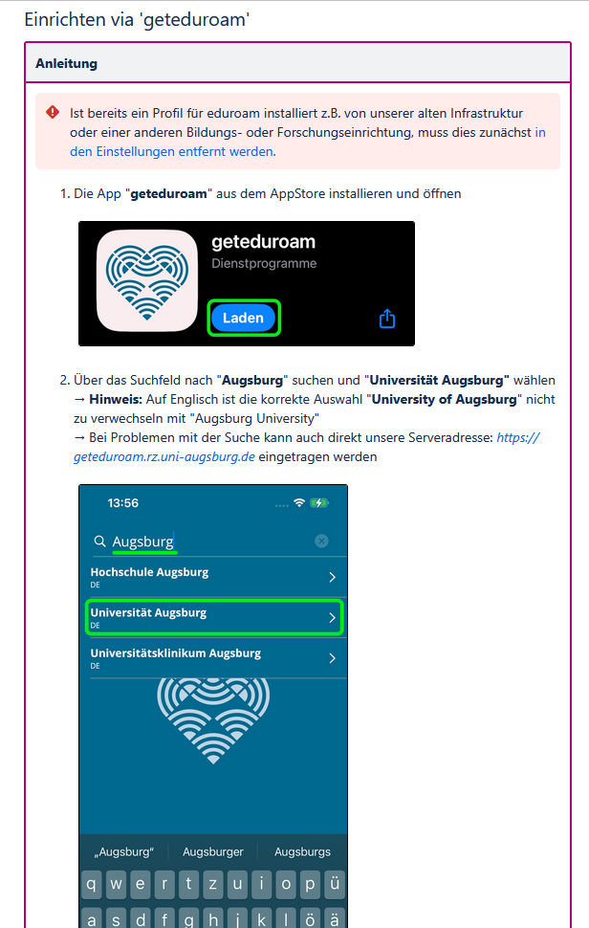
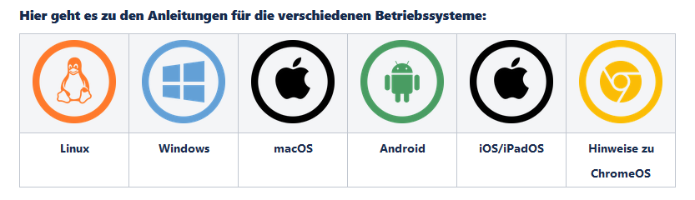
Set up eduroam
There are two Wi-Fi networks at the university: Bayern WLAN and eduroam
Bayern WLAN is an open network and can be used by anyone
Eduroam is the Wi-Fi network for students and staff at the university and usually provides a better internet connection: → To set up eduroam, you will need your RZ ID → The IT center provides setup instructions for various operating systems on the university's websit: https://collab.dvb.bayern/spaces/UniARZSER/pages/1759256918/eduroam+-+Einrichtung+und+Verbindung?showLanguage=en_GB

Slide 33
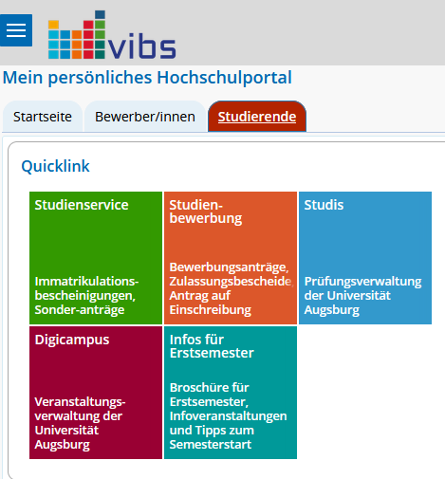
Generate your Certificate of Enrollment
You will need your certificate of enrollment for various purposes, such as opening a free bank account or, if necessary, for the Academic Immigration Office "Hochschulbetreuungsstelle", etc.
You can download your certificate of enrollment from the VIBS online portal. Here you can find instructions for students: https://www.uni-augsburg.de/en/organisation/einrichtungen/studierendenkanzlei/online-services/

Slide 34
Digital Services at the University
There are several online platforms that are important for you as a student:
Digicampus: Here you can organize your studies and register for virtually all courses, seminars, and lectures, as well as language courses. You’ll also find relevant information about each course there. In addition, it serves as a discussion platform for lecturers and students.
VIBS: On the VIBS portal, you can, among other things,
submit your application and enrollment,
update your contact information,
check the status of your semester fees (semester ticket, student services fee),
print your enrollment, academic progress, and fee payment certificates, and
apply for a transfer or a dual degree program.
STUDIS: Here you can register for exams and view your grades.
OPAC: OPAC is the catalog of the Augsburg University Library, which you can use for your literature research.

Slide 35

Two-factor authentication for web services at the University of Augsburg
Microsoft Authenticator App
Two-factor authentication is required to log in to the University of Augsburg's online services. The second factor is set up using the Microsoft Authenticator app.
To do this, use the standard Microsoft login via https://login.microsoft.com and the instructions in the IT center's KnowledgeBase: https://collab.dvb.bayern/spaces/UniARZSER/pages/1015913883/2-Faktor-Authentifizierung+einrichten+EntraID?showLanguage=en_GB

Slide 36

Install Microsoft 365
All students have access to a personal Microsoft account.
You can register using your university email address: <first name>.<last name>@uni-a.de
Password: the current password of your RZ user ID
All students have access to a license for the Microsoft Office package (Word, Excel, PowerPoint) through their university Microsoft account
Step-by-step instructions: https://collab.dvb.bayern/spaces/UniARZSER/pages/395639129/Microsoft+Office+365+M365+Apps+for+Enterprise
FAQ: https://www.uni-augsburg.de/de/organisation/einrichtungen/rz/it-services/beschaeftigte/m365/faq
Before using the M365 services for the first time, you must agree to the university’s terms of use. You can do this after logging in at https://myaccount.microsoft.com.

Slide 37
First steps
upon receiving admission
immediately upon arrival
after enrollment
(later) after arrival
Research important dates
Find a room
Pay your semester fees
Sign up for the Buddy Program
Subscribe to the AAA mailing list
Redirect your student email
Research introductory events
Sign up for the city tour
Find your way around the public transportation system
Buy a SIM card
Open a bank account
Get health insurance
Register at the university
Get your CampusCard
Get your RZ-ID
Set up eduroam
Generate your Certificate of Enrollment
Digital Services at the University
Register with the city (apply for a residence permit if necessary)
Sign up for a language tandem
Register for the Certificate in Intercultural Key Qualifications (ZIS)
Career Service
Campus-App
Take German courses
Sports center
Student discounts

Slide 38
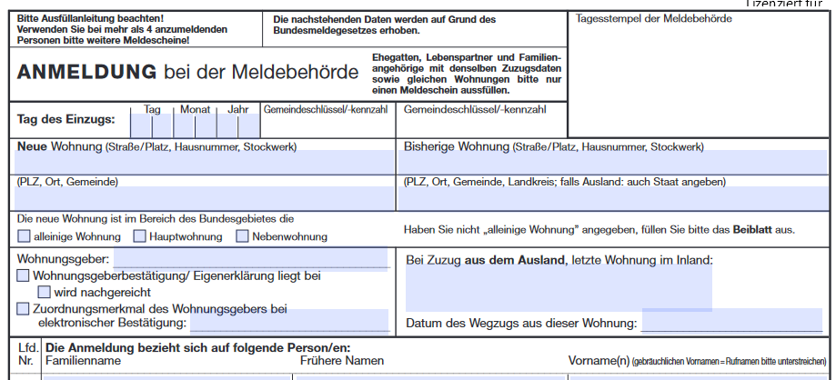
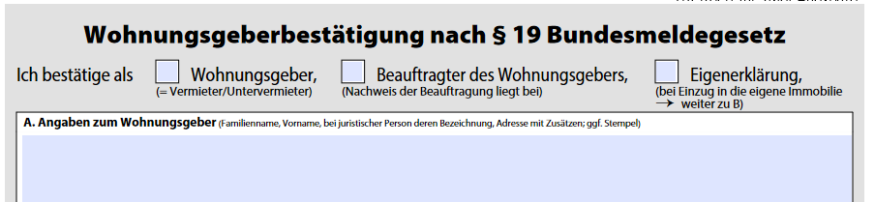
Non-EU citizens: Register with the city and apply for a residence permit
When: within 14 days of moving to Augsburg
Register your residence:
Please schedule an appointment via email (aufenthalt@augsburg.de).
Documents: Passport, visa/residence permit, registration form, landlord's confirmation
Information: https://www.uni-augsburg.de/en/portal/internationals/academic-immigration-office/angekommen/registration-city/
If you need to apply for a residence permit (non-EU), you can do so at the same time.
Documents: Application form, passport, certificate of enrolment, proof of sufficient funds (bank statement showing 11,208 euros or a letter of financial support), current proof of health insurance
Fee: 100 euros
Information: https://www.uni-augsburg.de/en/portal/internationals/academic-immigration-office/angekommen/residence-permit/
Please send all documents as a single PDF file if possible.

Slide 39
EU citizens: Register with the city
When: within 14 days of moving to Augsburg
You can make an appointment online at a citizens' office: https://buergeramt-augsburg.termine-reservieren.online/select2?md=3 (→ scroll to „Meldewesen“)
Required documents: ID card/passport, landlord's confirmation, registration form
You can find the registration form on the following website: https://www.augsburg.de/buergerservice-rathaus/buergerservice/dienste-a-z/aemterweise/leistungen-buergeramt-einwohnerwesen/anmeldung-der-wohnung

Slide 40

Sign up for a language tandem
Sign up for the International Office’s language tandem program if, for example, you’d like to improve your German skills.There, you’ll be paired with a native speaker who’s interested in learning your native language. This way, you can help each other!
Registration: https://www.uni-augsburg.de/en/portal/internationals/interkulturelles/language-tandem/registration-language-tandem/

Slide 41
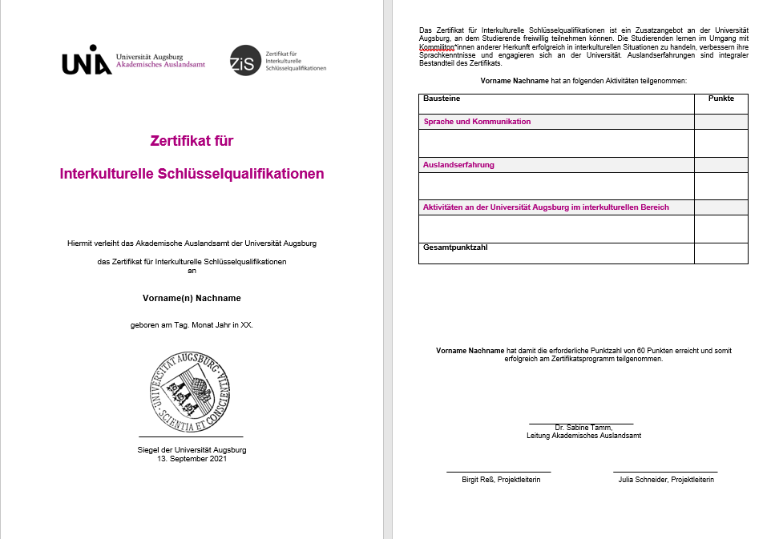

Register for the Certificate in Intercultural Key Qualifications (ZIS)
„Zertifikat für interkulturelle Schlüsselqualifikationen“ – Gain intercultural experience – in Augsburg!
Since 2019, the ZIS has been available to German and international students in all fields of study, provided they have earned at least 20 points in each of the three modules: “Language and Communication,” “Study Abroad Experience,” and “Intercultural Activities at the University of Augsburg.”
Points can be earned by participating in various intercultural events offered at the University of Augsburg. Certificate participants are free to choose which events they wish to attend.
Information and registration: https://www.uni-augsburg.de/en/studium/ausland/interkulturelles/zis/

Slide 42
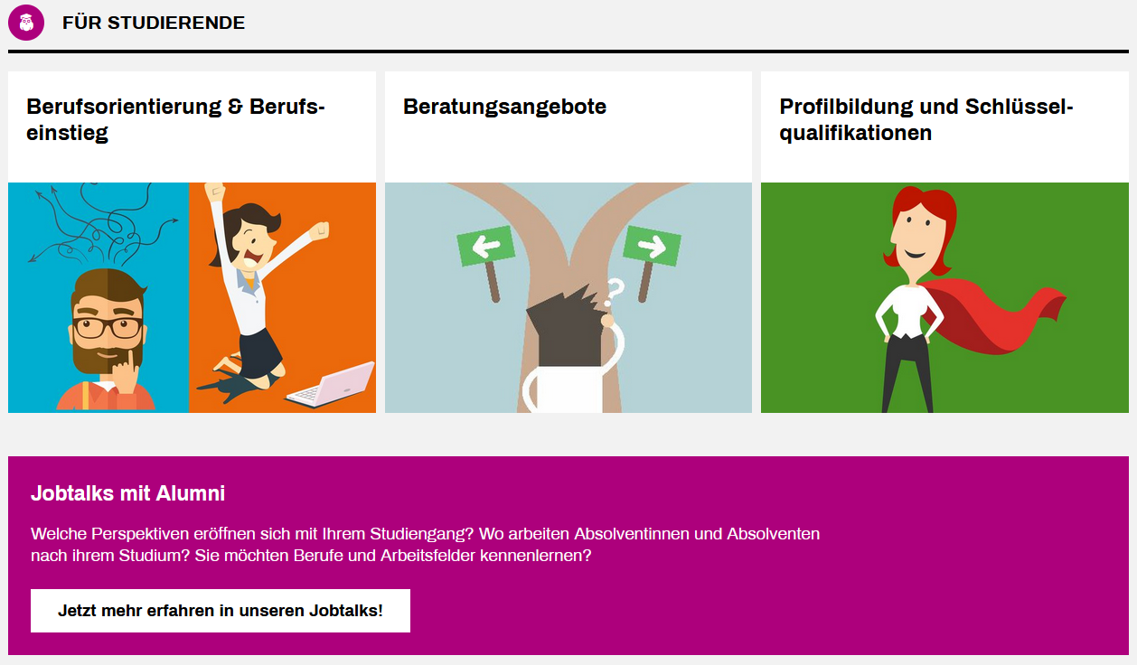
Career Service
The Career Service regularly organizes information sessions and workshops for students on career guidance and entering the workforce. You can also find internships and job listings on the website.
https://www.uni-augsburg.de/de/organisation/einrichtungen/career-service/.
You can find current events here: https://www.uni-augsburg.de/de/organisation/einrichtungen/career-service/veranstaltungsubersicht/.

Slide 43
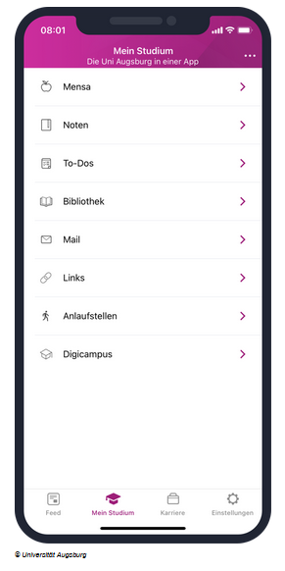

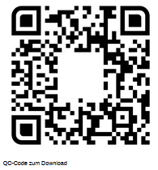
Campus-App
The University of Augsburg app offers an overview of:
Cafeteria menu
Grade overview
To-do list feature
Link to OPAC account
Integration of university email
Important links
Contact points
Link to Digicampus
News feed
Download:
https://www.uni-augsburg.de/de/services/uniaugsburg-app/

Slide 44

Take German courses
The Language Centre at the University of Augsburg offers free German courses:
27 courses at all levels
Courses: https://www.uni-augsburg.de/de/organisation/einrichtungen/sz/fremdsprachenangebot/deutsch-als-fremdsprache/kursangebot-kursanmeldung/
Registration Information: https://www.uni-augsburg.de/de/organisation/einrichtungen/sz/fremdsprachenangebot/deutsch-als-fremdsprache/einstufungstest/
Online level test: https://einstufungstests.klett-sprachen.de/eks/DaF-A1-C1/
Registration for courses at the appropriate level!
Here’s what you need to do:
Online level test
Course registration on Digicampus (Tuesday, April 7, 2026, 2:00 p.m. to Friday, April 10, 2026, 2:00 p.m. → Course assignments will be announced on Friday, April 10, 2026, at 3:00 p.m.)
Courses begin in the first week of the lecture period (April 13–17, 2026)

Slide 45
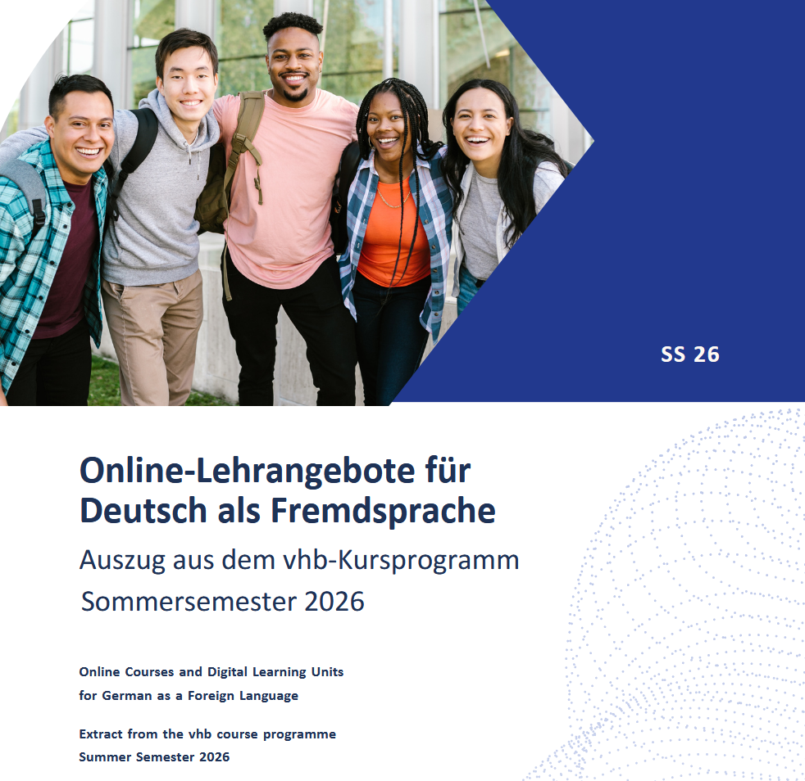
Take German courses
The Virtual University of Bavaria also offers online courses that international students can take for free to improve their German language skills.
For more information, please visit the following website: https://www.vhb.org/studierende/international/deutsch-als-fremdsprache/

Slide 46

Sports center
→ https://hsa.sport.uni-augsburg.de/index.php/en
The course list for the 2026 summer semester will be available online starting in early April! Registration opens on April 16 at 10:00 a.m.
The courses are very popular, so sign up as soon as possible!!
Courses begin on April 20.
University sports courses are not only a great way to stay active, but also to meet new people!

Slide 47


Student discounts
There are several ways you can take advantage of discounts as a student, for example:
UNIDAYS: https://www.myunidays.com/DE/de-DE (Samsung, hp, Media Markt, Study Smarter, Lingoda, Duolingo, Quizlet, Emma, …)
ISIC (International Student Identity Card): https://isic.de/en/benefits/ (Z.B. Komoot, Samsung, FlixBus, FlixTrain, Mister Spex, …)

Slide 48
Open questions?
The International Office at the University of Augsburg has put together a series of presentations for international first-year students with the most important information about studying and living in Augsburg.
This presentation is the second of seven. We recommend that you carefully review all presentations so that you are well prepared to start your studies and can clarify any important questions:
https://www.uni-augsburg.de/en/portal/internationals/abschluss/study-preparation-course/.
If you still have questions after reviewing all the presentations, please feel free to send us an email at: svk@aaa.uni-augsburg.de.

