Slide 1
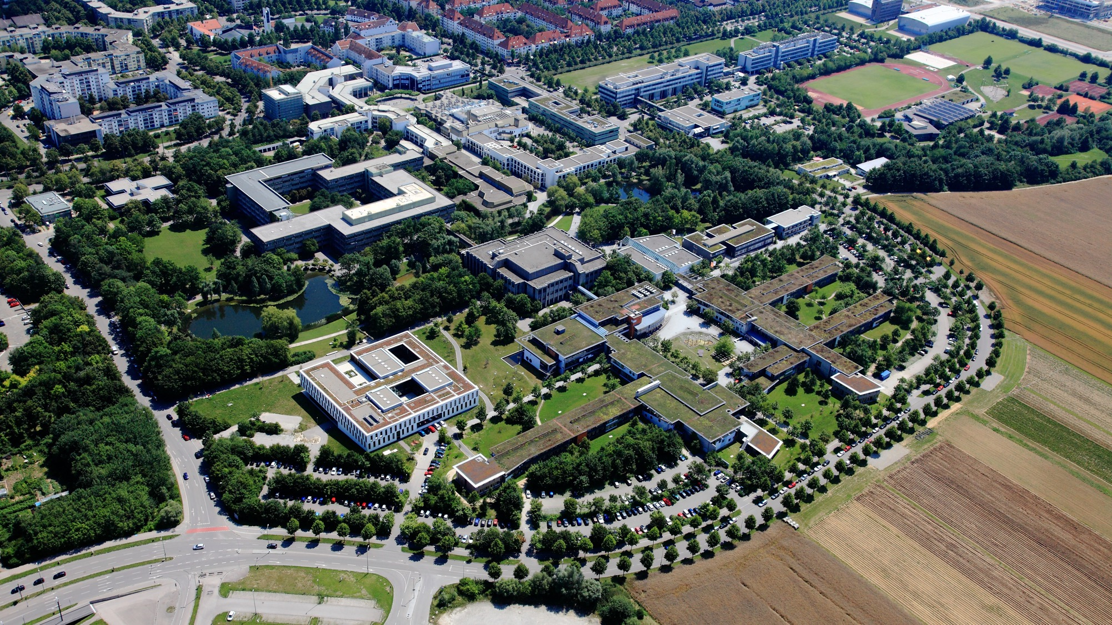









Financing Your Studies

Slide 2


Important information about starting your studies
The International Office at the University of Augsburg has put together a series of presentations for international first-year students with the most important information about studying and living in Augsburg.
This presentation is the second of seven. It addresses the question of how you, as students, can finance your studies. We recommend that you carefully review all presentations so that you are well prepared to start your studies and can clarify any important questions.
All presentations are available online and can be downloaded via this link:
https://www.uni-augsburg.de/en/portal/internationals/abschluss/study-preparation-course/.

Slide 3

Outline
Facts and figures
  How much money do you need?
  Financing your studies – Statistics
Scholarships
  offered by the University of Augsburg
  other scholarships
BAföG – for international students?
Financial assistance in emergencies
Student jobs
  Student assistant jobs at the university
  Student jobs outside the university

Slide 4
The (financial) situation of international students at German universities 1/2
There are currently just under 500,000 international students in Germany (about 17 percent of all students)
(https://mediendienst-integration.de/integration/hochschule.html, 27.09.2025)
Main motivations: high quality of life, desire to work in Germany after completing one's studies, Germany's economic situation, getting to know Germany
95% organize their stay on their own – just like you!☺ - they come without an exchange program
Challenges: Finding accommodation, connecting with German classmates, navigating the academic system, and financing one's studies and living expenses

Slide 5
The (financial) situation of international students at German universities 2/2
Financing one‘s studies:
63 % have their parents' support
50 % finance their studies with their own earnings
15 % receive scholarships (mainly German ones)
(54 % have two or three sources of funding)
51% of international students take on jobs while studying; for 75% of them, working is absolutely necessary

Slide 6
Cost of living in Augsburg
At least EUR 900 – 1.000 per month
at least 300 Euro/Monat Rent
approx. 20 Euro/Monat Public broadcasting fee
approx. 130 Euro/Monat Public health insurance
approx. 250 Euro/Monat Groceries
100 – 200 Euro/Monat Books, copies, leisure time, clothing
Attention:
Semester fee (approx. 150 Euro)
Extension of residence permit (non-EU approx. 12.000 Euro)

Slide 7
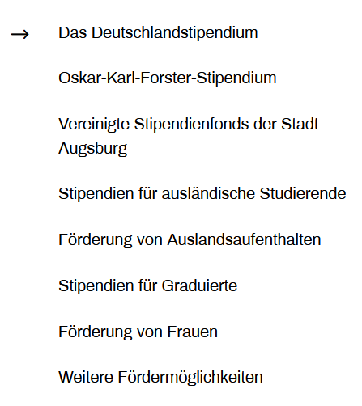
Scholarships at the University of Augsburg
Scholarships offered by the International Office:
- Only for students in their 2nd master’s semester or higher / 3rd bachelor’s semester or higher
- very limited number
- Criteria: Need & Eligibility
- Applications are only accepted if a call for applications has been issued
→ Keep an eye out for posters, flyers, and the aaa-info-mailing list
Scholarship department
- „Book Scholarship” (one-time payment of 100 euros)
- Financial support for women (and families)
- „Deutschlandstipendium“ (300 Euro/Monat)
→ https://www.deutschlandstipendium.de/deutschlandstipendium/de/services/english/the-deutschlandstipendium-best-of-both-worlds-for-students
→ https://www.uni-augsburg.de/de/studium/studieren-augsburg/stipendien/dasdeutschlandstipendium/

Slide 8
Scholarships from other funding sources
A wide range of (political) foundations and associations
Friedrich-Ebert-Stiftung, Hanns-Seidel-Stiftung, Konrad-Adenauer-Stiftung, Heinrich-Böll-Stiftung, Rosa-Luxemburg-Stiftung
Cusanuswerk, Evangelisches Studienwerk, Avicenna-Studienwerk
Stifterverband für die Deutsche Wirtschaft, Stiftung der Deutschen Wirtschaft, DAAD
A wide variety of databases; the most important ones:
- https://www2.daad.de/deutschland/stipendium/datenbank/en/21148-scholarship-database/
- www.stipendiumplus.de
- https://www.begabungslotse.de/themen/stipendium

Slide 9

BAföG for international students
BAföG – Bundes-Ausbildungsförderungs-Gesetz (= “Federal Law on Financial Assistance for Education”)
„Government funding“ → 50% grant & 50% interest-free loan
up to 992 euros per month (depending on the parents' income, rent, etc.)
Loan repayment: five years after the end of the standard period of study, up to 10,010 euros
International students are also eligible for BAföG, though the requirements are strict
→ Contact: Studierendenwerk Augsburg, https://studierendenwerk-augsburg.de/bafoeg/
General information:
→ https://www.mystipendium.de/bafoeg/bafoeg-fuer-auslaender
→ https://www.stw.berlin/en/baf%C3%B6g/baf%C3%B6g-faq/20.-baf%C3%B6g-for-international-students.html
Notes:
EU-Bürger (+ Schweiz, Norwegen, Irland, Liechtenstein)
unbefristete Aufenthaltserlaubnis (§ 7a AufenthG/EWG) oder Daueraufenthaltserlaubnis (§ 5 Abs. 5 FreizügG/EU).
als Arbeitnehmer freizügigkeitsberechtigt
verheiratet mit EU-Bürger (selbständig, arbeitssuchend, Ausbildung)
ein Elternteil ist EU-Bürger (selbständig, arbeitssuchend, Ausbildung)
Erwerbstätigkeit in Deutschland vor dem Studium (thematischer Bezug!)

Slide 10

Financial assistance in emergencies
f.au.st e.V.
can quickly provide assistance if talented international students from lower-income countries need financial aid
→ Scholarships (limited)
→ Student grants
→ mainly loans
https://www.uni-augsburg.de/en/portal/faust-en/

Slide 11
Student Jobs – Legal Basics
Non-EU citizens (residing under §16b) have been permitted to work 140 full days or 280 half days per year, or 20 hours per week (!!), since June 2024.
If you work more than 20 hours a week or have a regular income of over 603 euros per month, you no longer qualify as a “student.” This could lead to problems with your student health insurance.
→ EU students working in Germany need German health insurance (the EHIC card is no longer valid in this case)
→ Consultation for questions:
b!st – Studierendenwerk, https://studierendenwerk-augsburg.de/sprechzeiten/
Check with your health insurance provider

Slide 12
Student assistant positions at the university 1/2
Hiwi = „Hilfswissenschaftler*in“
General term for student or research assistant
→ Students employed by a department, a professor, a project, or another unit at a university
Student assistant = studentische Hilfskraft (SHK) – has not yet graduated,
Income: 14,00 €/h
Resarch assistant = wissenschaftliche Hilfskraft (WHK) – with a (bachelor's) degree,
income: 16,00 €/h
Maximum working hours as a student assistant: 86 hours per month → zählt nicht zu den 140 Tagen, die Nicht-EU-Studierende arbeiten dürfen

Slide 13

Student assistant positions at the university 2/2
Where can you find student assistant positions?
- Studierendenwerk: https://www.studierendenjobs.de/
- Digicampus: „Jobbörse“ (student assistant job board and “external” jobs)
- Department offices: near the administrative offices (notices on bulletin boards) & websites
- „Bulletin boards“ (notes and posters) all over campus
- International Office (or other departments)
→ Posters, AAA-InfoMail, website
- library

Slide 14

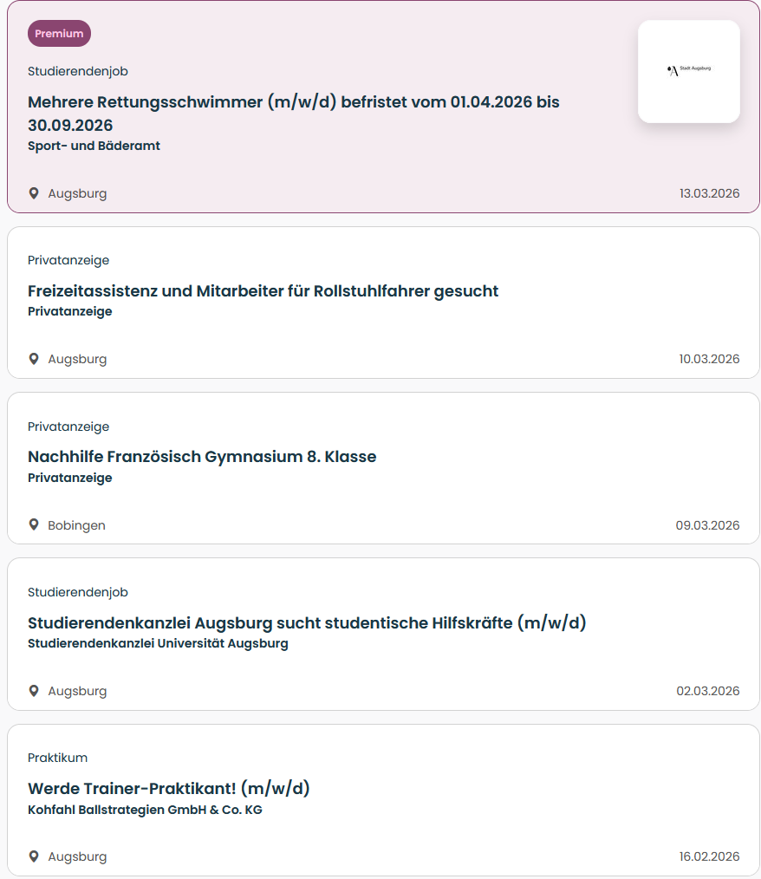
Studierendenwerk: www.studierendenjobs.de

Slide 15
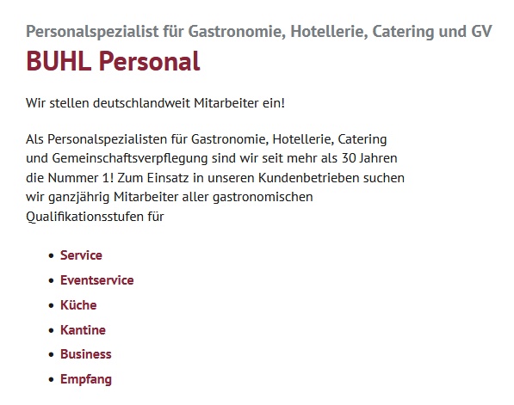


Temporary employment agencies in Augsburg
BUHL Gastronomie
https://www.buhl-gps.de/
Jobmensa
http://www.jobmensa.de/
studentenjobs/augsburg

Slide 16
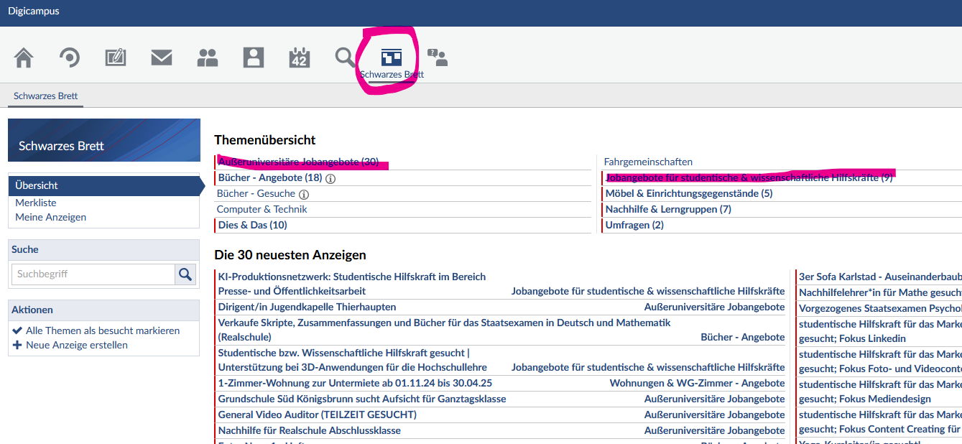
Digicampus: Job board

Slide 17
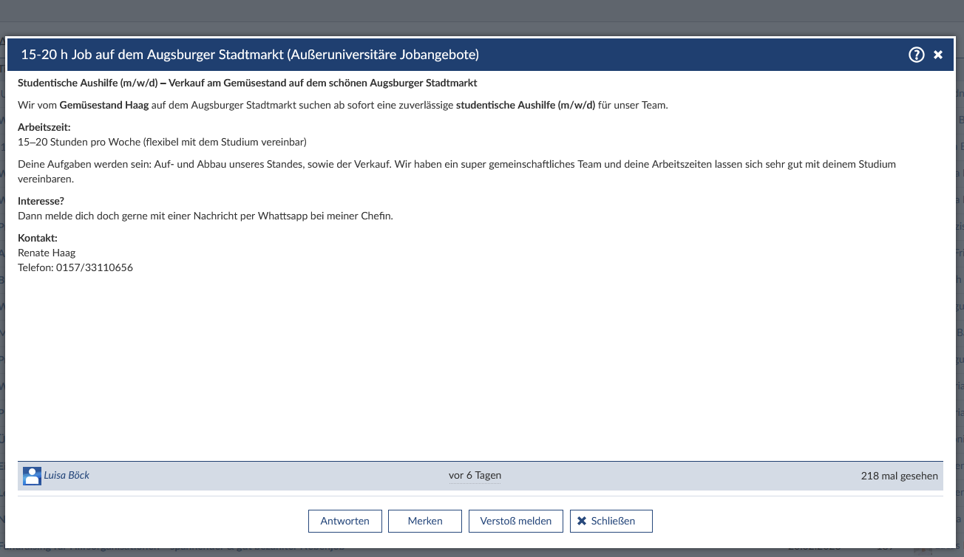
Digicampus: Jobbörse

Slide 18
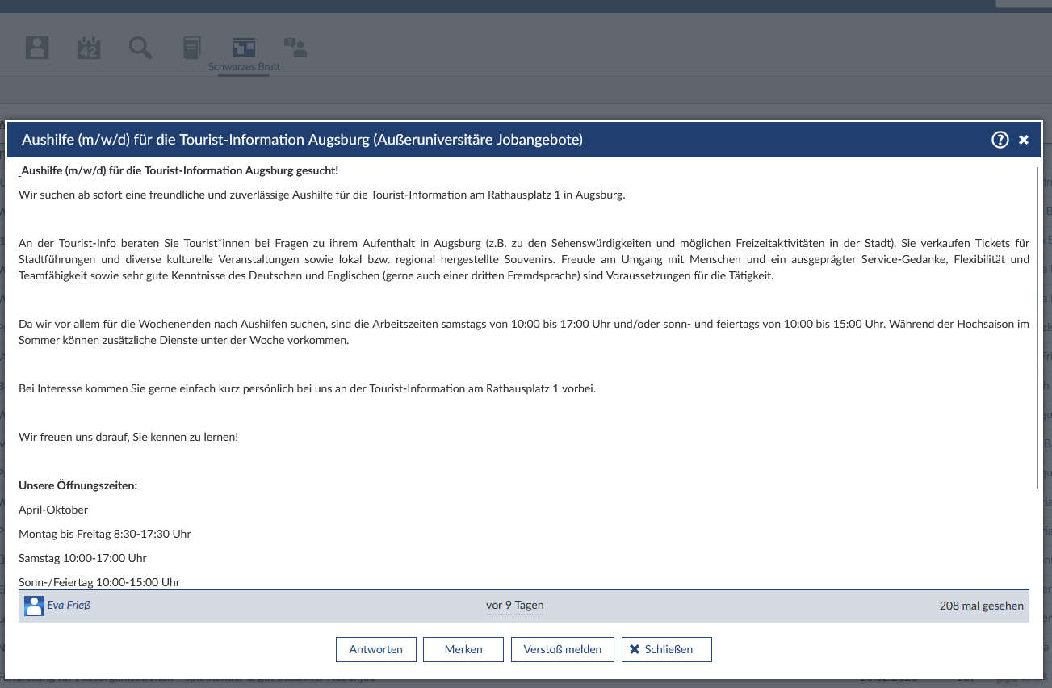
Digicampus: Jobbörse

Slide 19
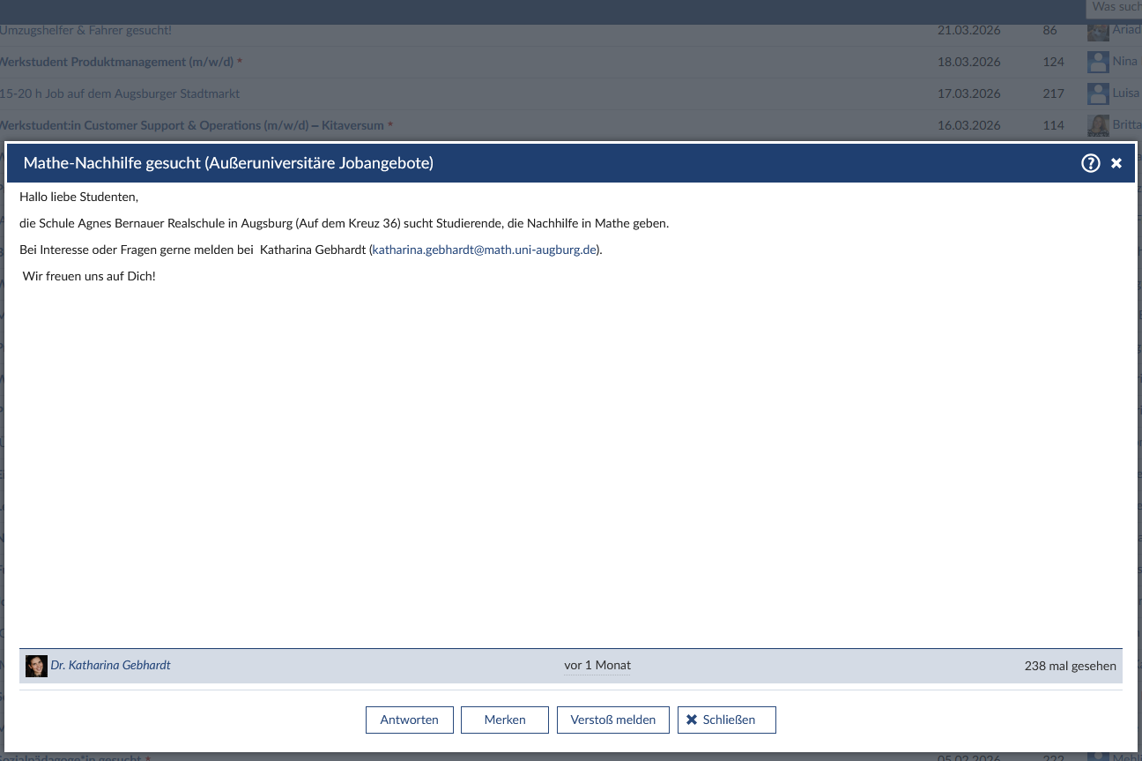
Digicampus: Jobbörse

Slide 20
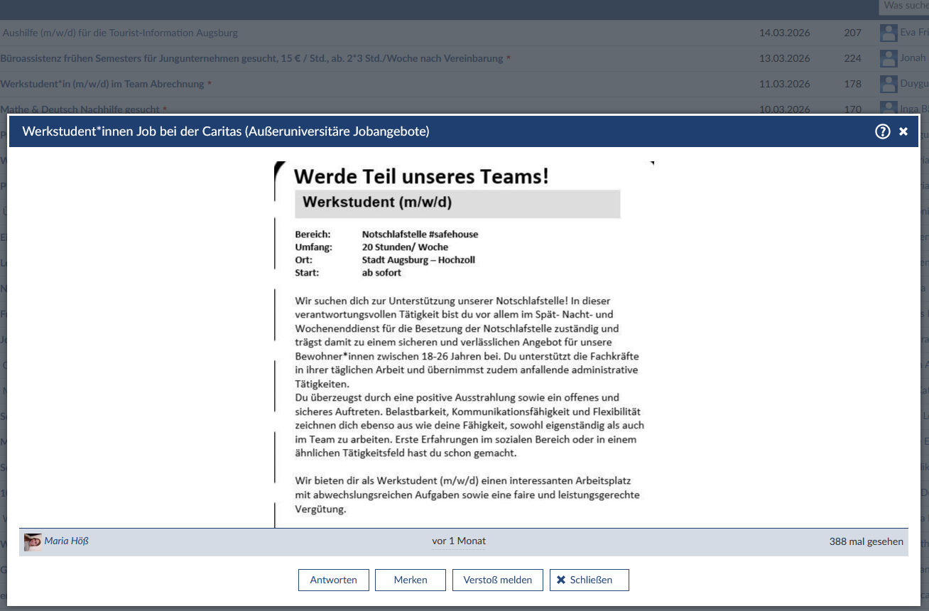
Digicampus: Jobbörse

Slide 21
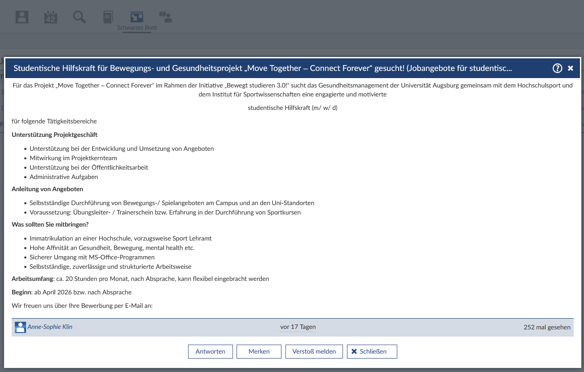
Digicampus: Jobbörse

Slide 22
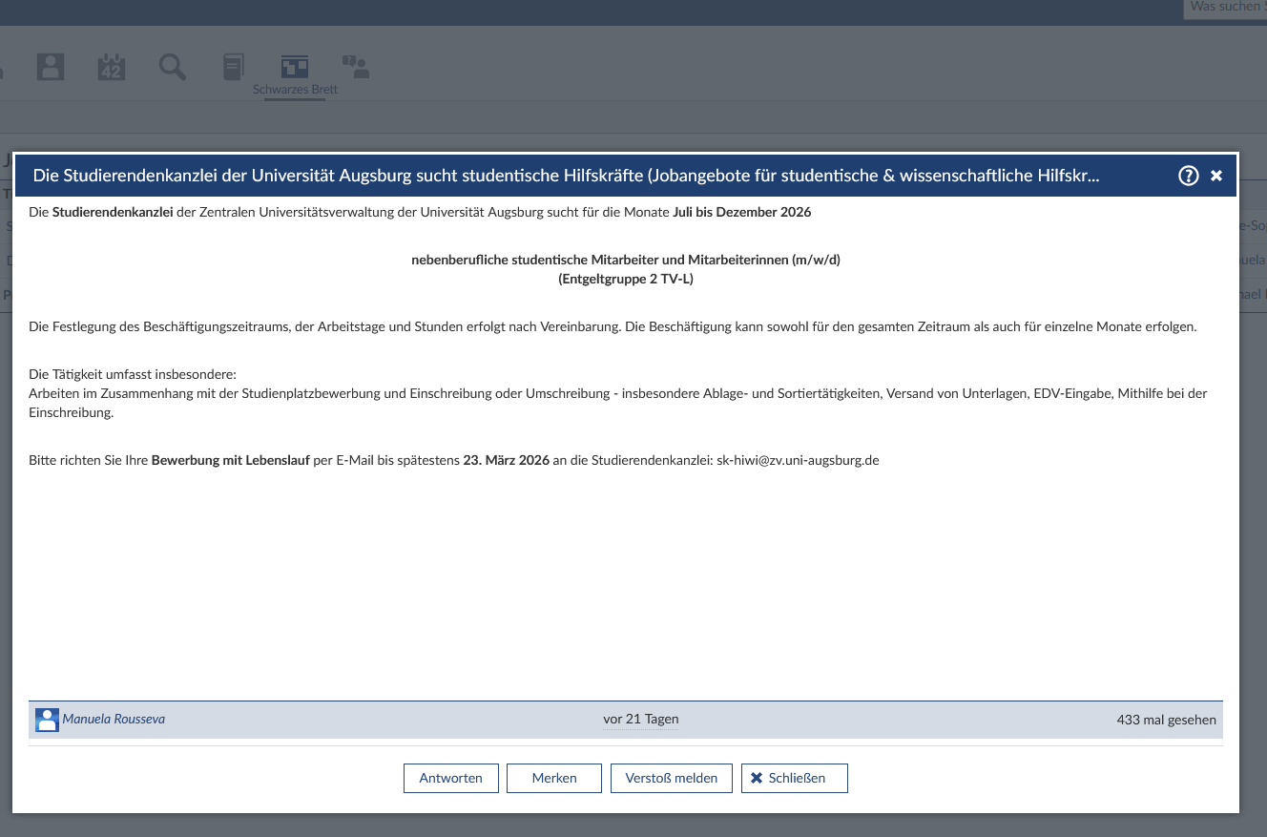
Digicampus: Jobbörse

Slide 23
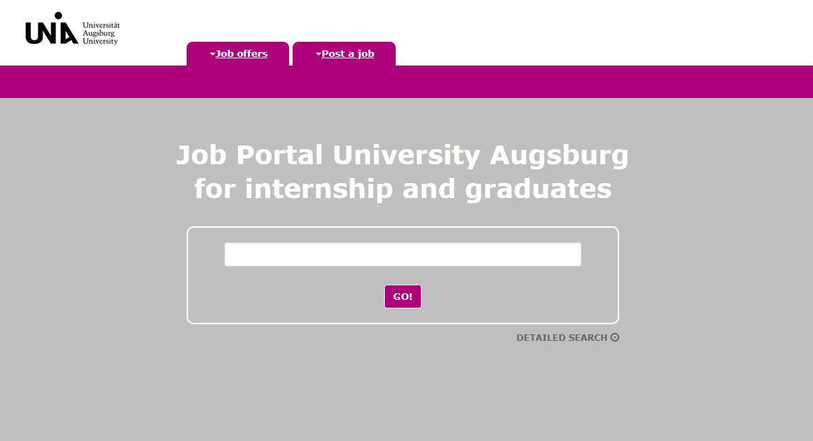
University of Augsburg Job Portal: Internships & Career Starts, Nationwide
https://www.jobportal-augsburg.de/uacc/index.php?lang=2

Slide 24
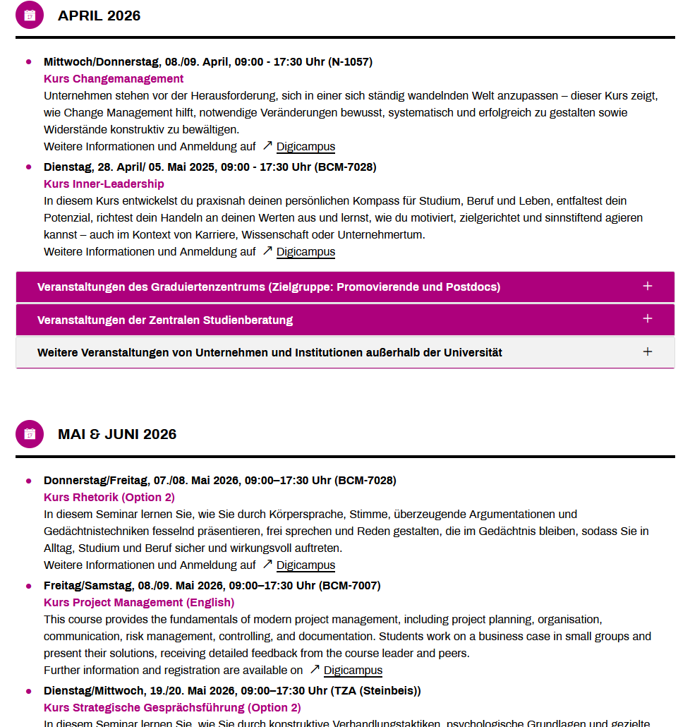
Career Service at the University of Augsburg
Career Service offers a few English workshops and courses:
https://www.uni-augsburg.de/de/organisation/einrichtungen/career-service/veranstaltungsubersicht/
Services:
Field trips to local companies
Soft skills courses
Business administration for humanities students
A guide to job applications
Job interview training

Slide 25
Open questions?
The International Office at the University of Augsburg has put together a series of presentations for international first-year students with the most important information about studying and living in Augsburg.
This presentation is the sixth of seven. We recommend that you carefully review all presentations so that you are well prepared to start your studies and can clarify any important questions:
https://www.uni-augsburg.de/en/portal/internationals/abschluss/study-preparation-course/.
If you still have questions after reviewing all the presentations, please feel free to send us an email at: svk@aaa.uni-augsburg.de.

