Slide 1
Bacchae Costume Concepts
Concepts by Neo, Michael, Janet, Sydney and Elfi Sketches by Neo and Elfi

Slide 2
Colour/Saturation Divide
By Neo

Slide 3
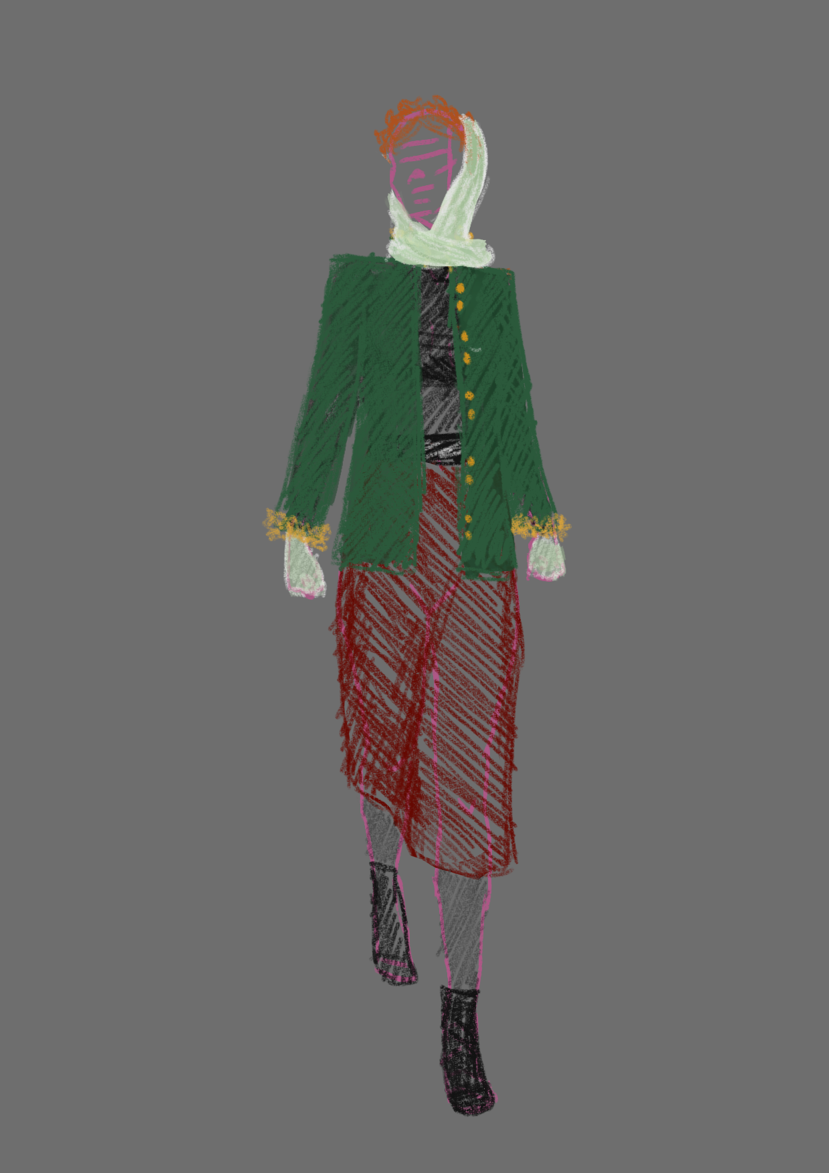
Queen Agave
Braided hair
scarf/gloves 1950’s esque
Green military coat, with “lion”-fur at cuffs
Red skirt

Slide 4
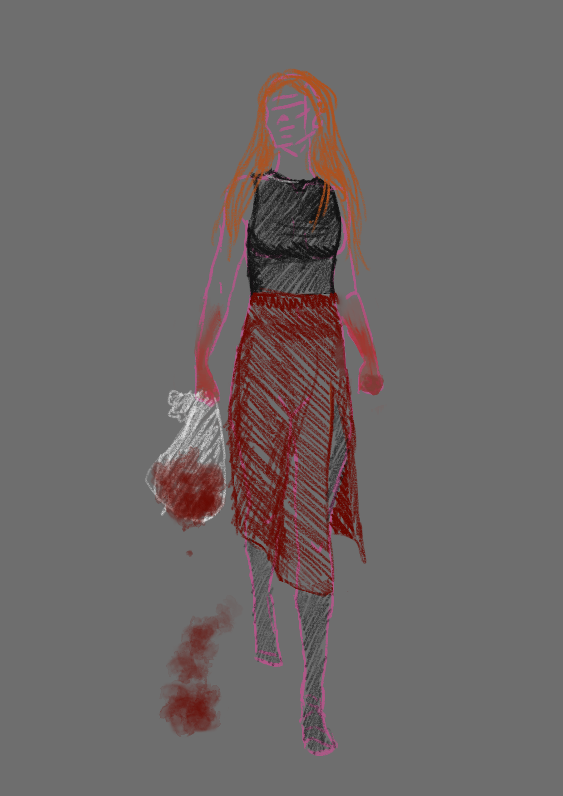
Queen Agave (Murder)
Hair open (scarf and braided hair as one piece)
Hands “stained with blood”
Skirt torn open
No shoes

Slide 5
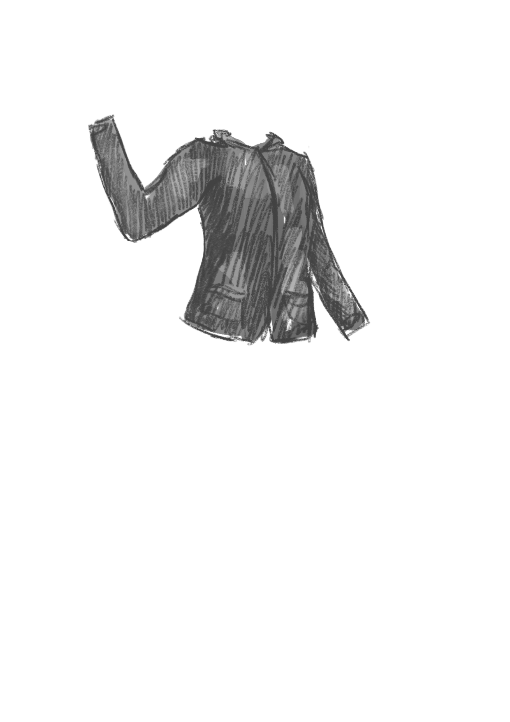
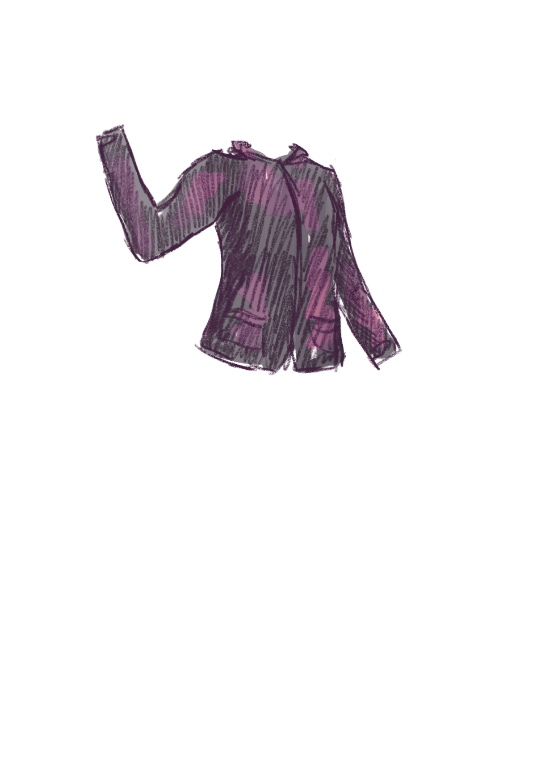
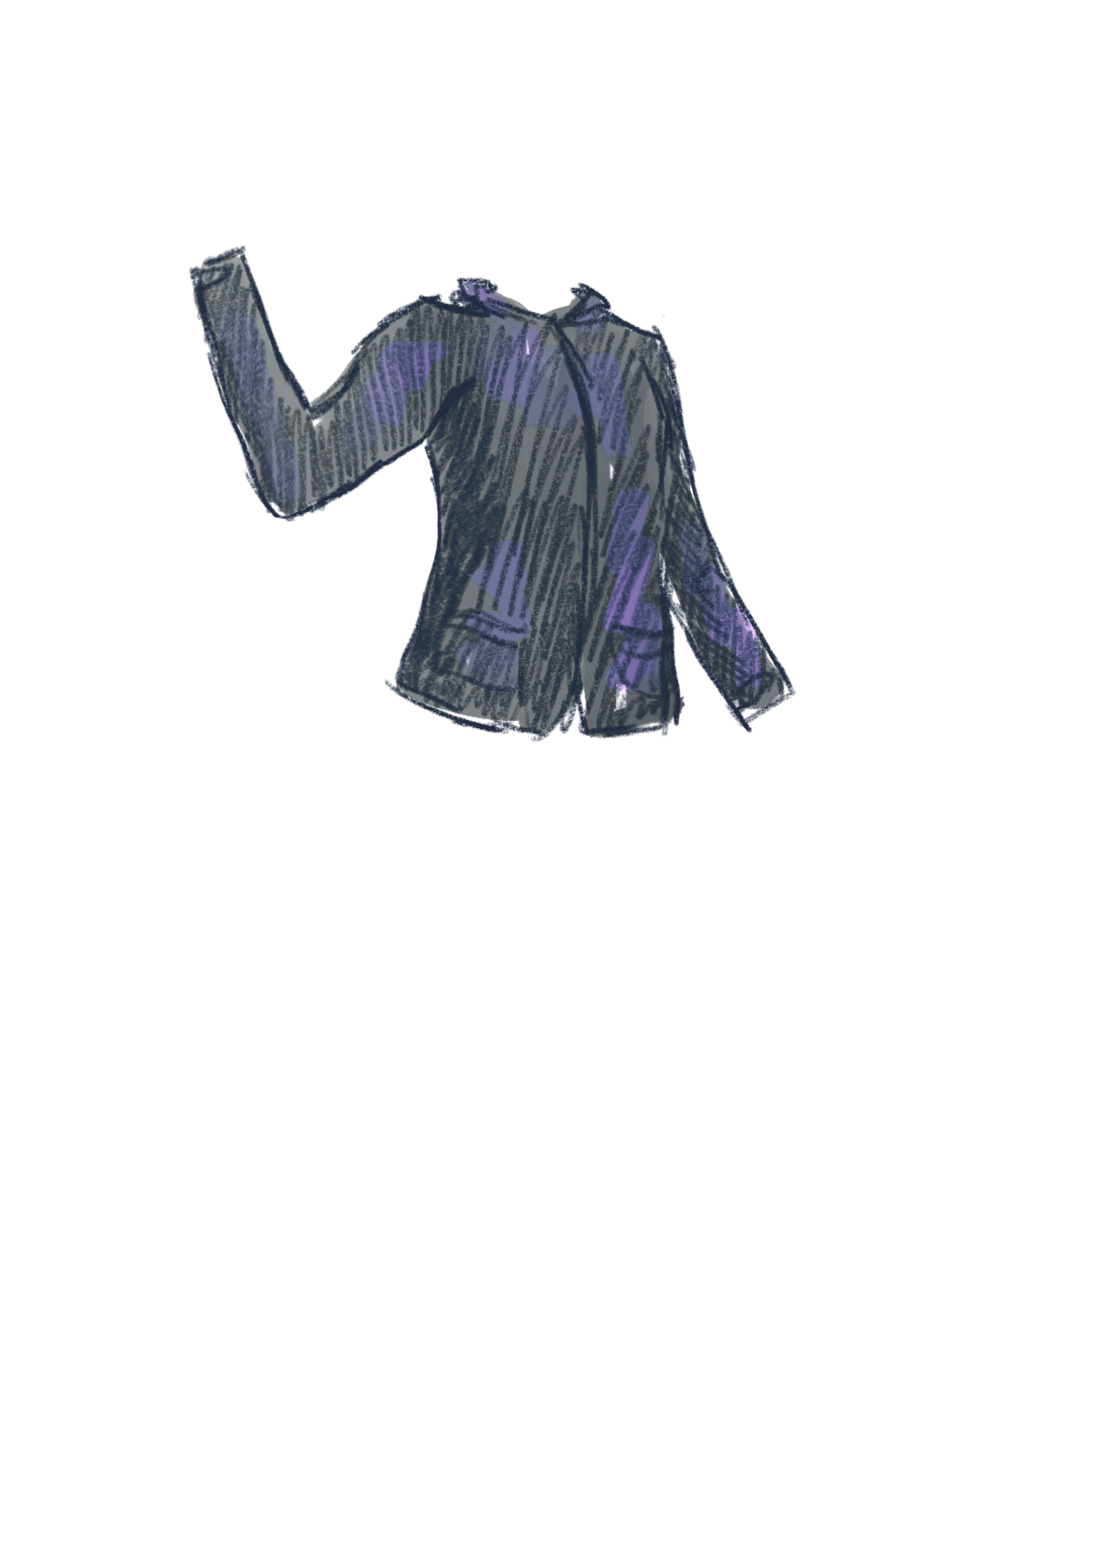
Bacchae (Travelling Aspect)
In general I can see the Bacchae wearing rain-coats, hiking jackets when they first enter.
Though I think that keeping them in travelling clothes the entire time is a bit much
Instead, once they have reached their current destination (woods of Thebes), I think they would shed their travelling gear and start partying in just their party clothes
I also think that trolleys/bags and backpacks are definitely possible and could even potentially be used to “mark” the space of the Bacchae on the stage

Slide 6
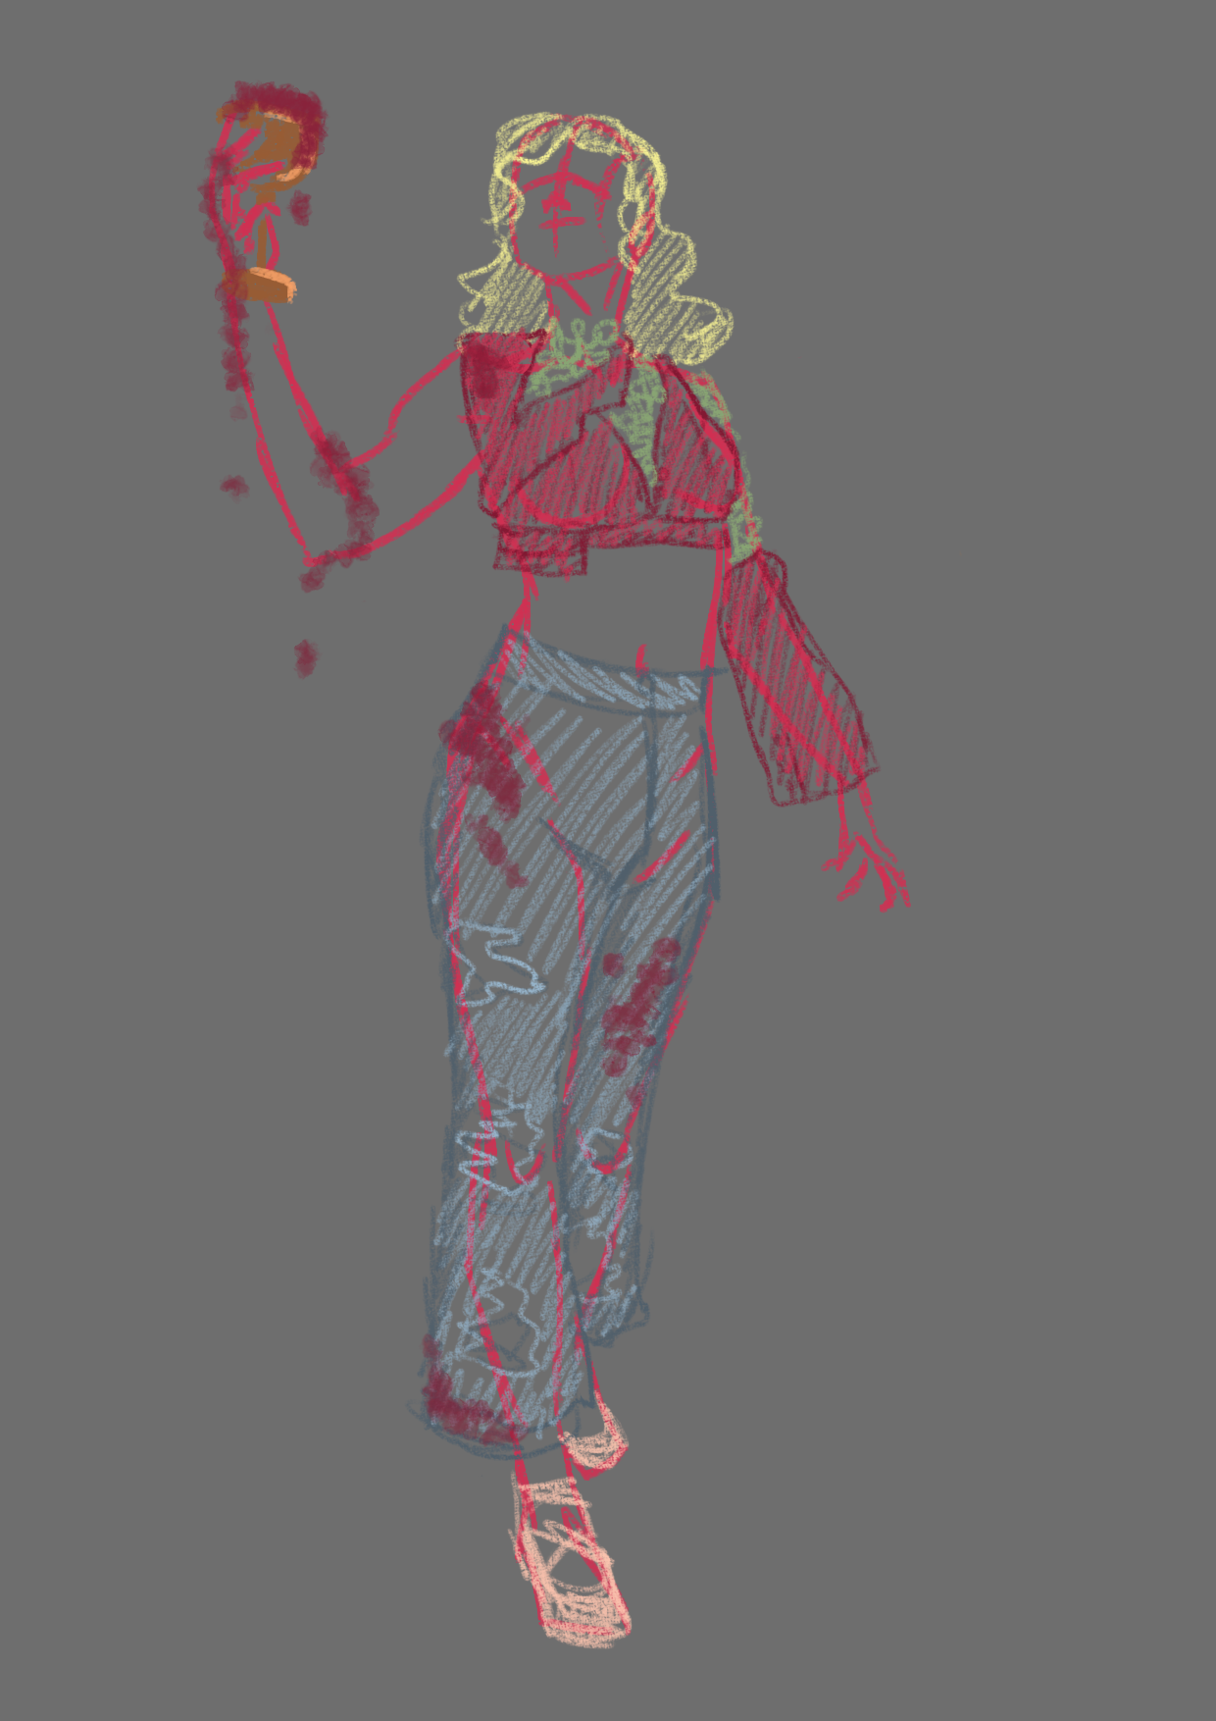
Bacchae (Diana)
Wine stains
Distressed jeans
Taken apart and repaired top (crochet patches)
Maybe ballet shoes

Slide 7
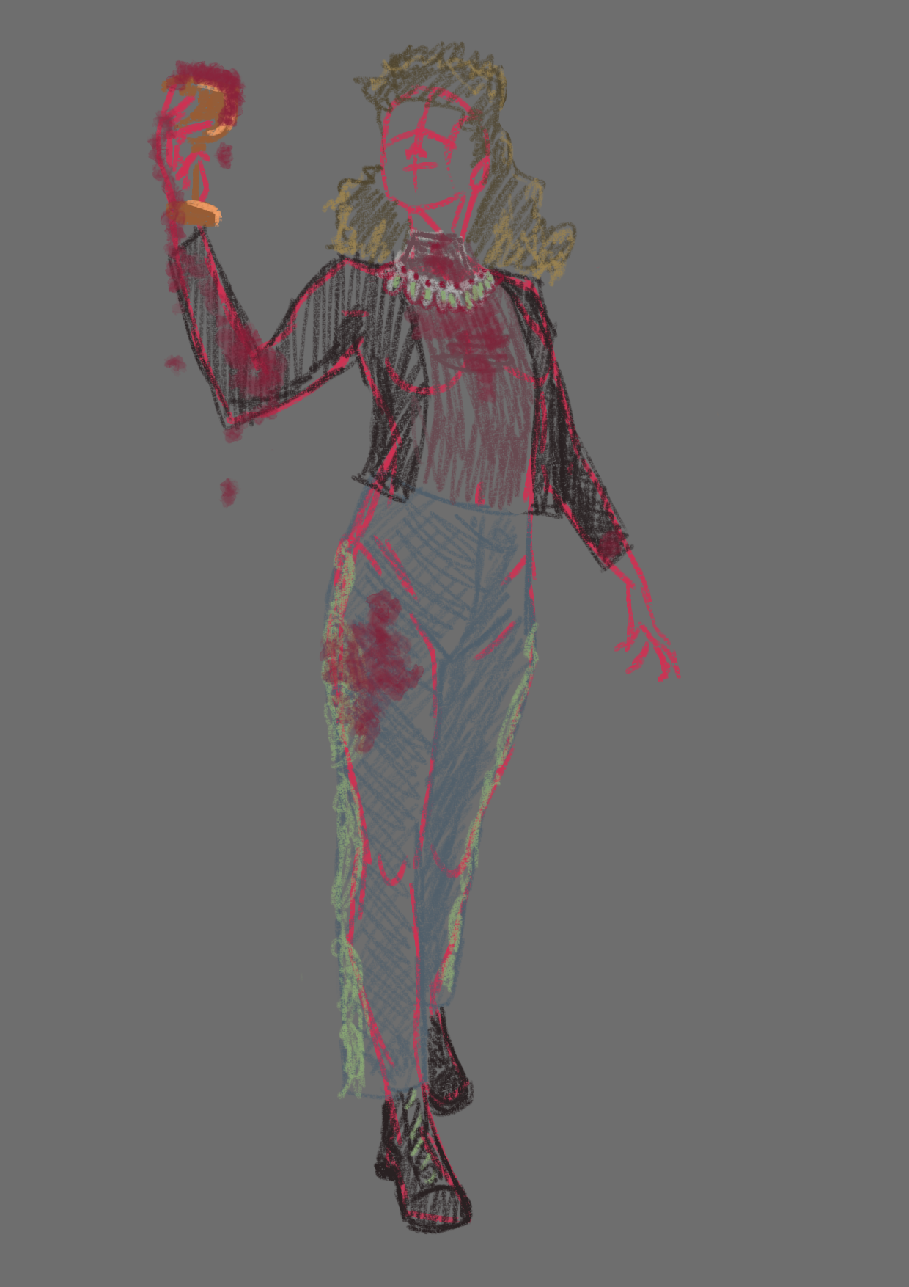
Bacchae (Janet)
Wine stains
Statement necklace
Big 80’s-ish hair
Jeans with crochet patches
Hiking boots

Slide 8
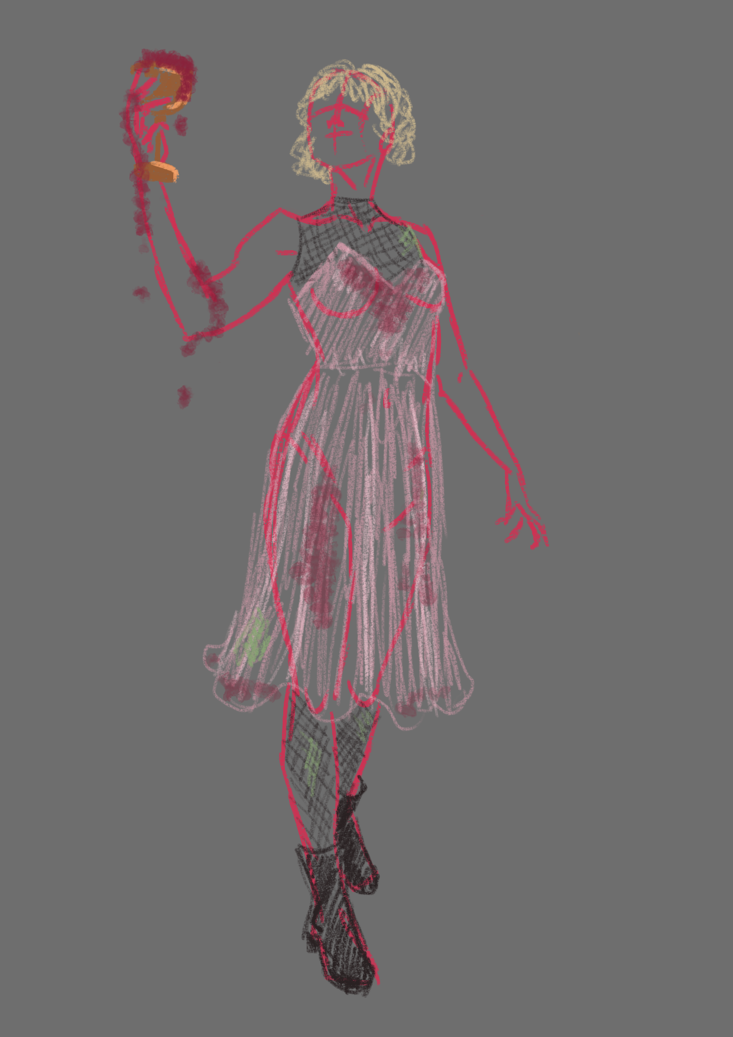
Bacchae (Lenja)
Wine stains
Silk dress (like pyjamas)
Fishnet tights and halter-top underneath dress
Hiking boots

Slide 9
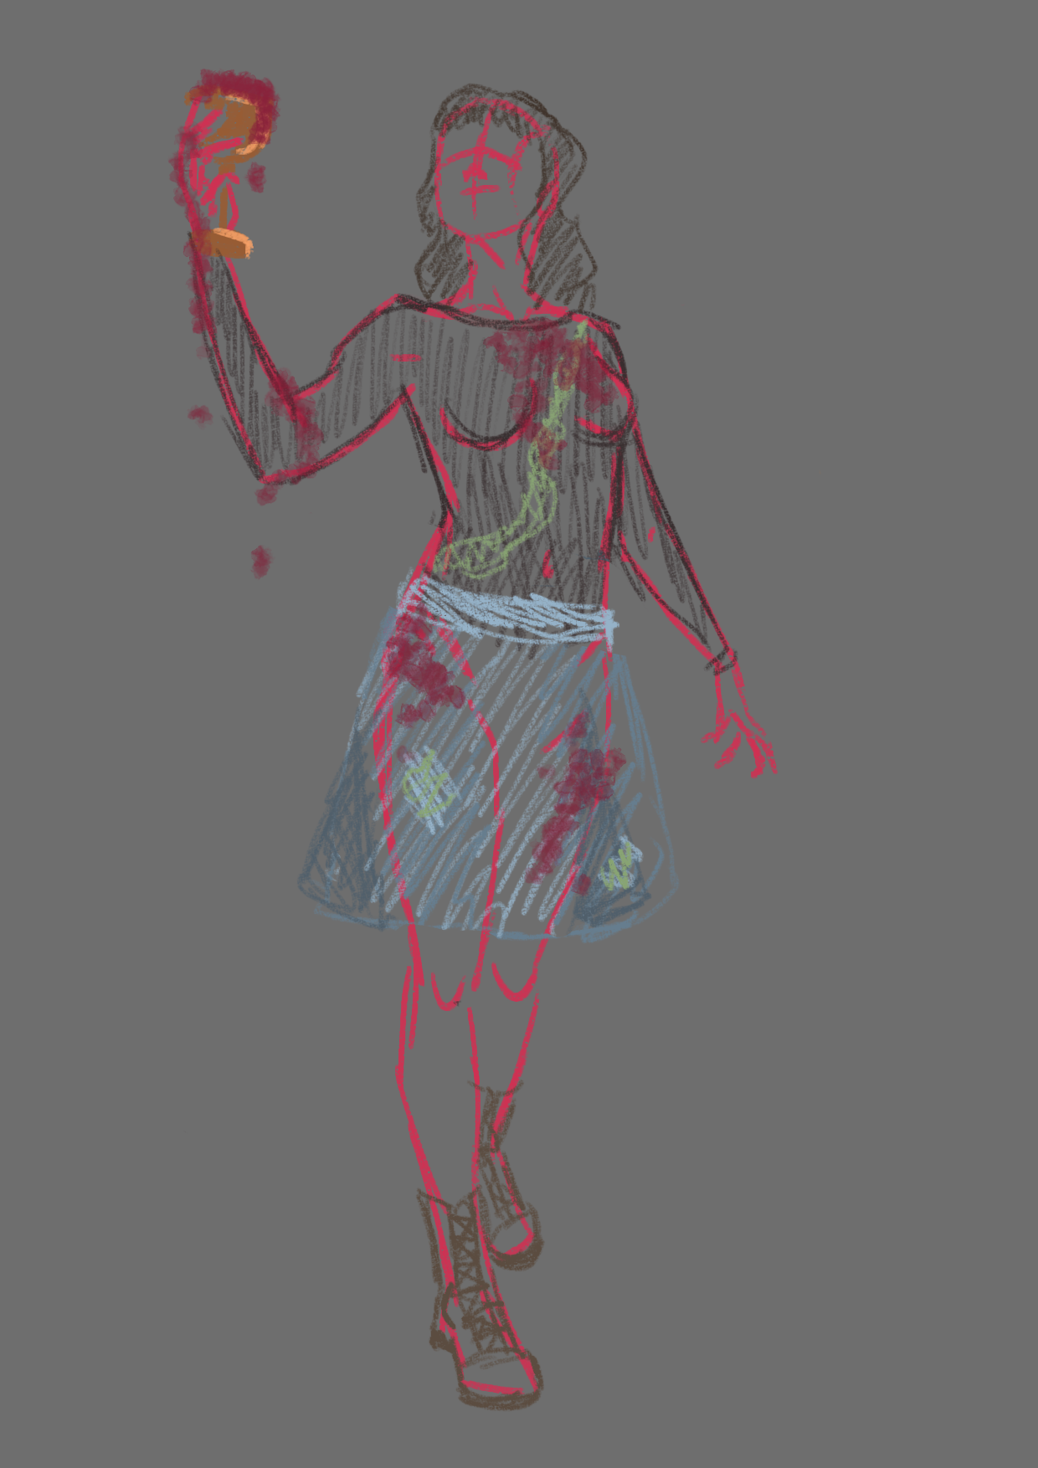
Bacchae (Melina)
Wine Stains
Shirt patches with crochet
Jeans skirt (out of different jeans)
Hiking boots

Slide 10
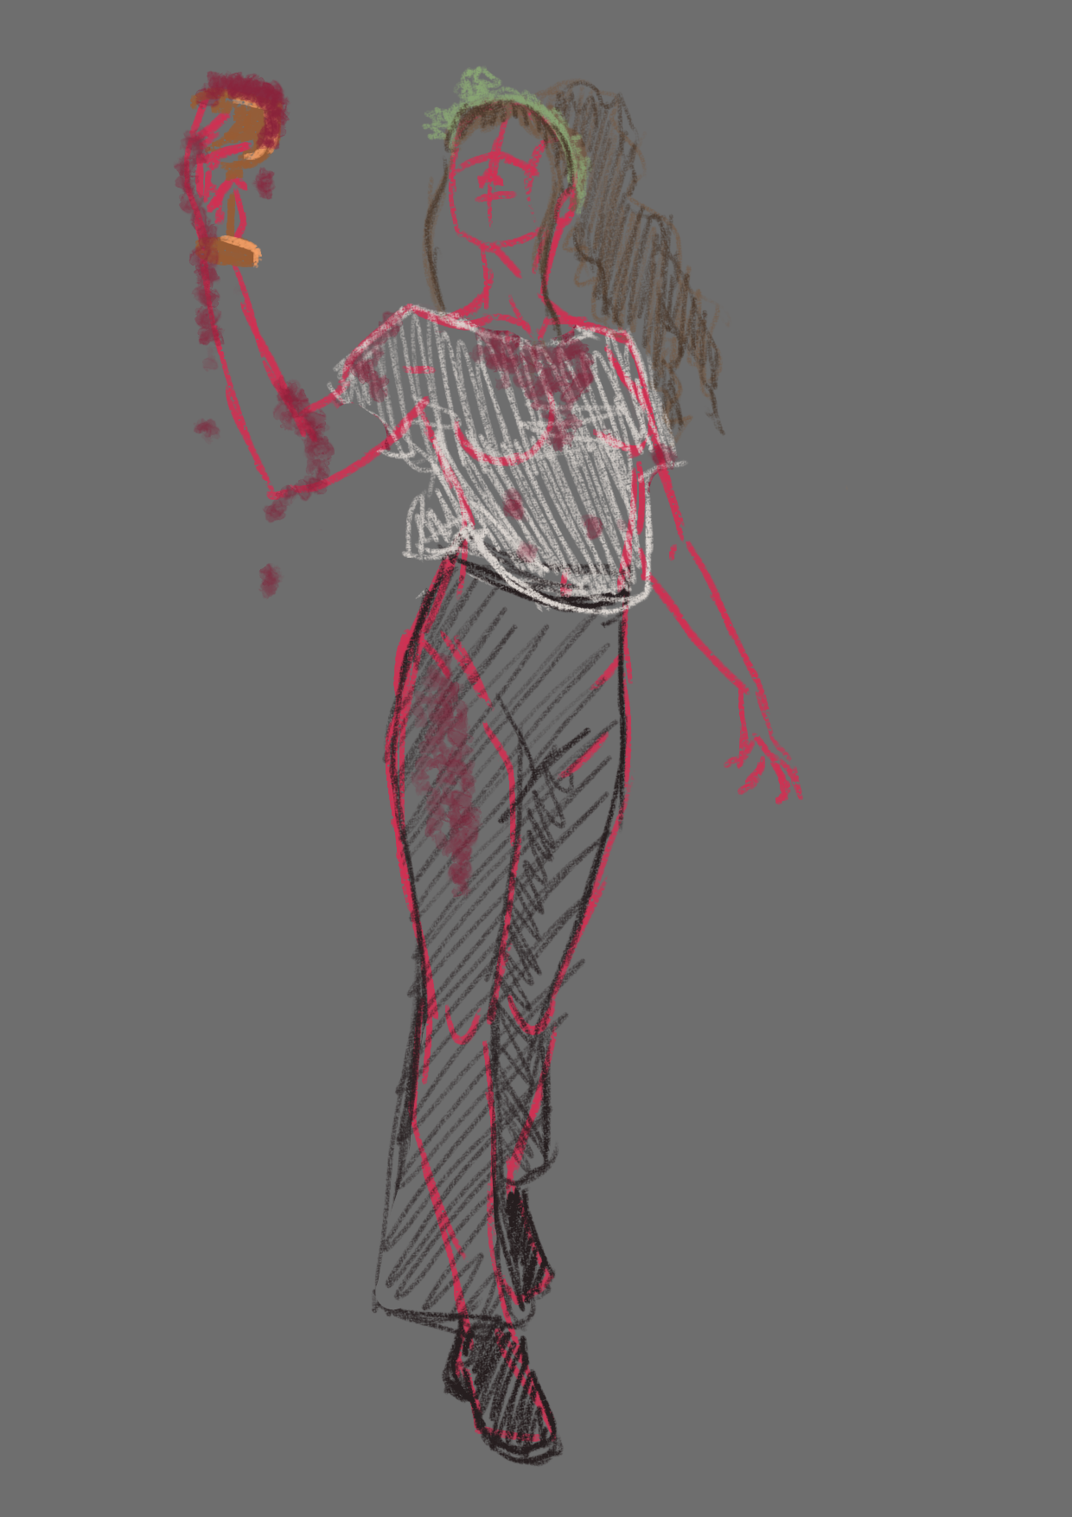
Bacchae (Mirjam)
Wine stains
High Ponytail, potentially crimped hair
Simple white t-shirt
Black disco-esque pants (flared)
Crochet headband

Slide 11
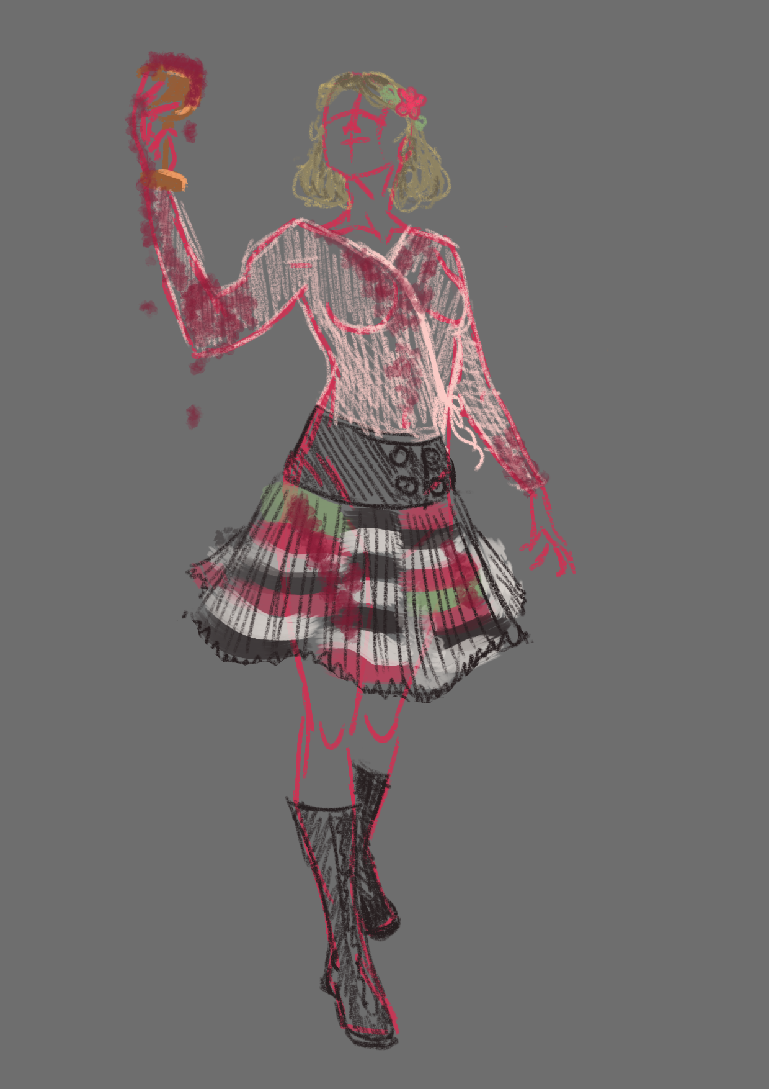
Bacchae (Paula)
Wine stains
Wrap top
Big black belt
Striped, tightly gathered skirt
Knee high boots
Crochet flowers in hair

Slide 12
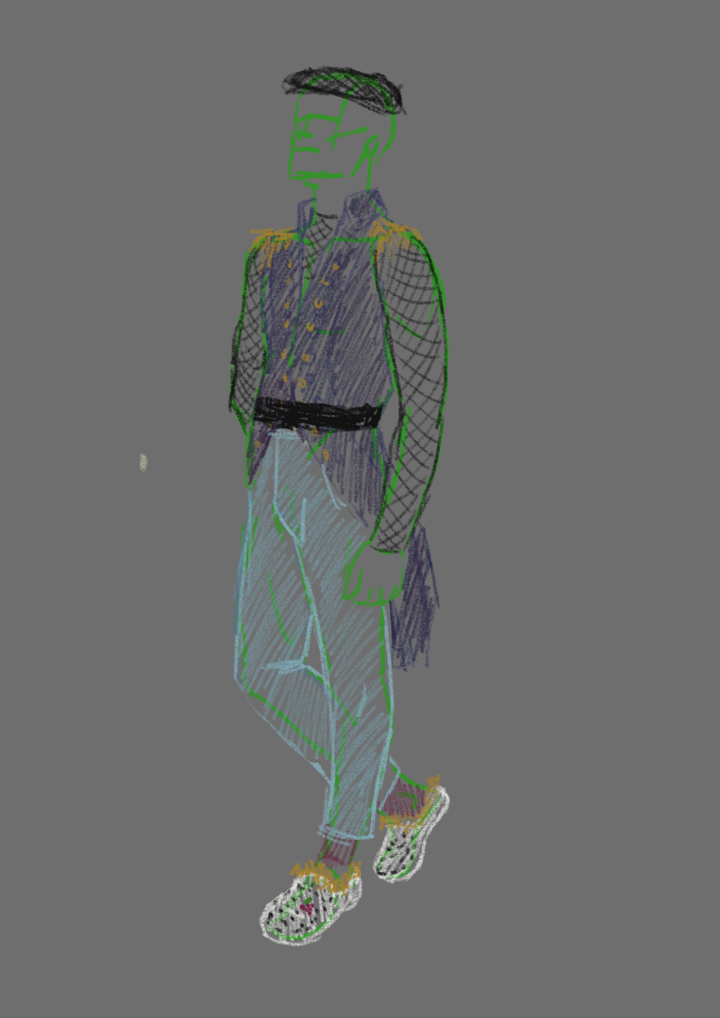
Cadmos
Old Ex-King → “older military coat”
Modified with fishnets for going to Dionysus
Crocs with “lion” fur
jeans

Slide 13
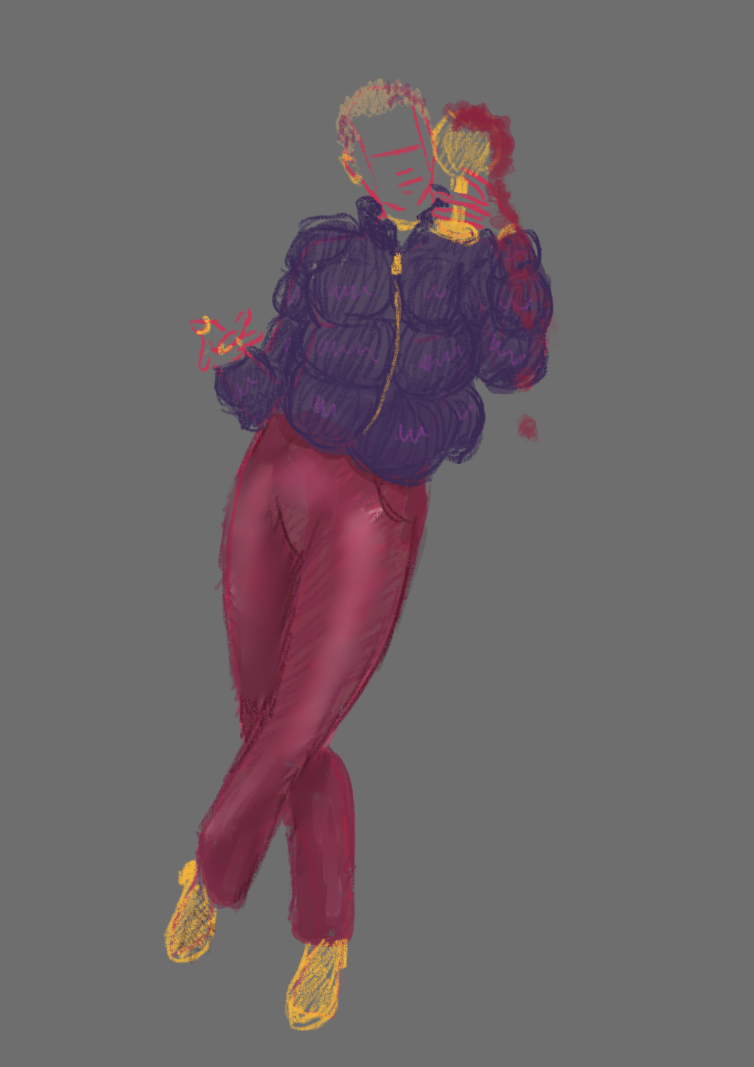
Dionysus (humanoid)
Purple Quilted Jacket
Gold details (+ Boots)
Wine red pants, flared like disco pants
Wine coloured swirls in the hair

Slide 14
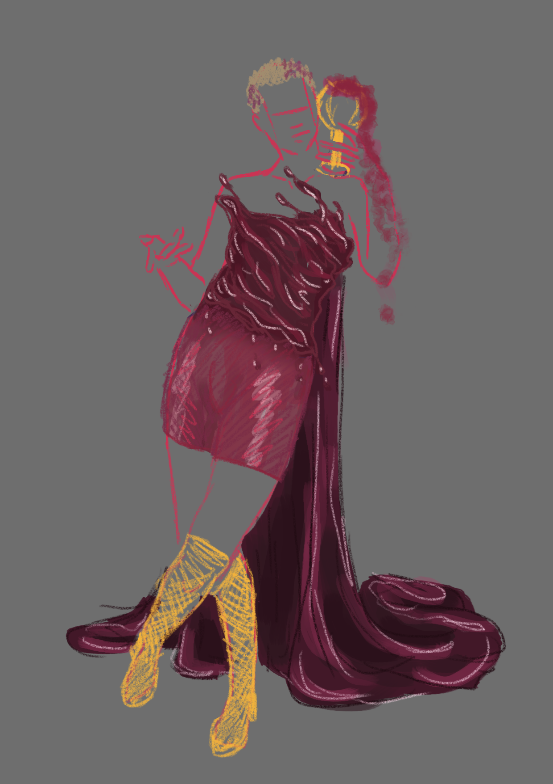
Dionysus (Goddex)
Met Gala
2019
Nina Dobrev
“liquid” formed top ^
Shorts (the rest of the pants are tear-away)
“wine” Cape from fabric which looks liquid →
Gold boots

Slide 15
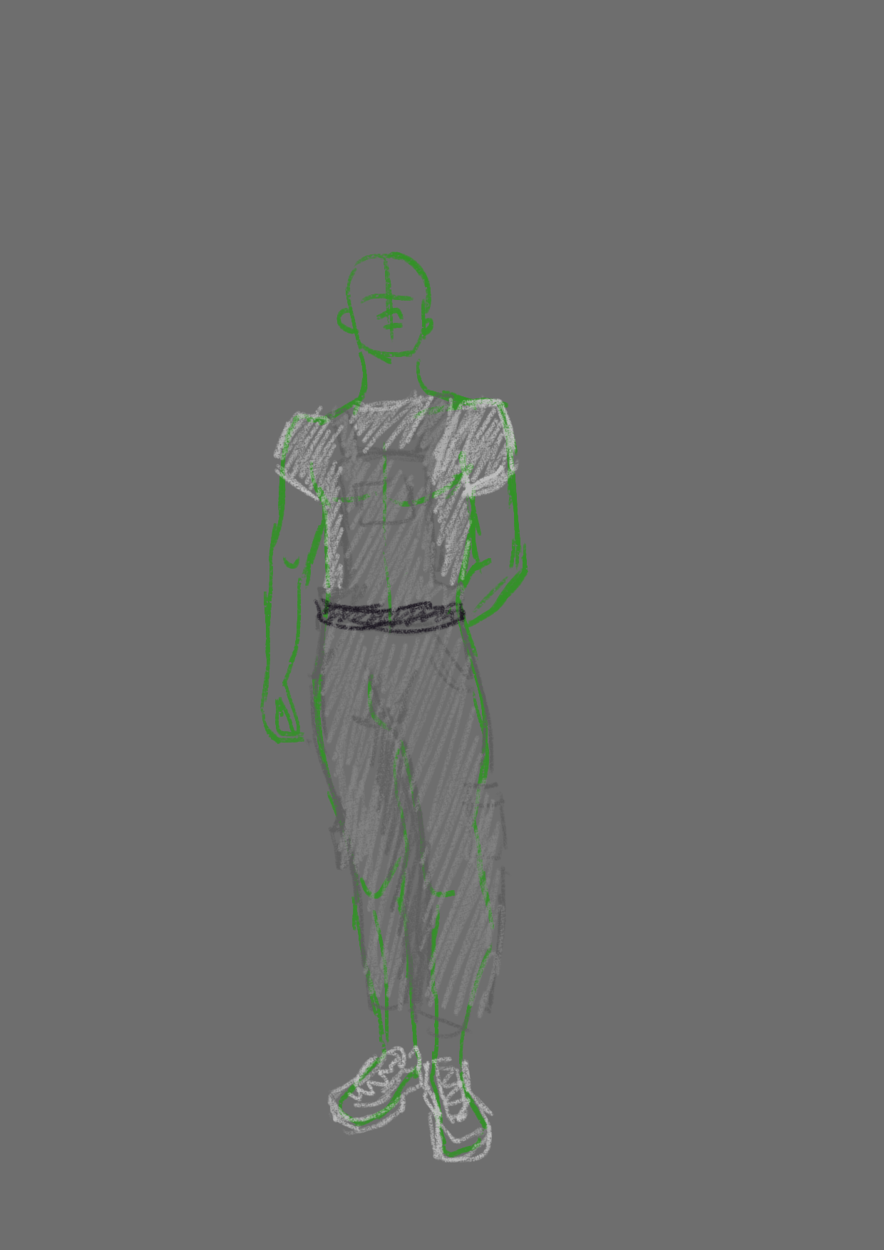
Messenger(s)
Basic grey overalls
White t-shirts
Sport shoes for “running messages”

Slide 16
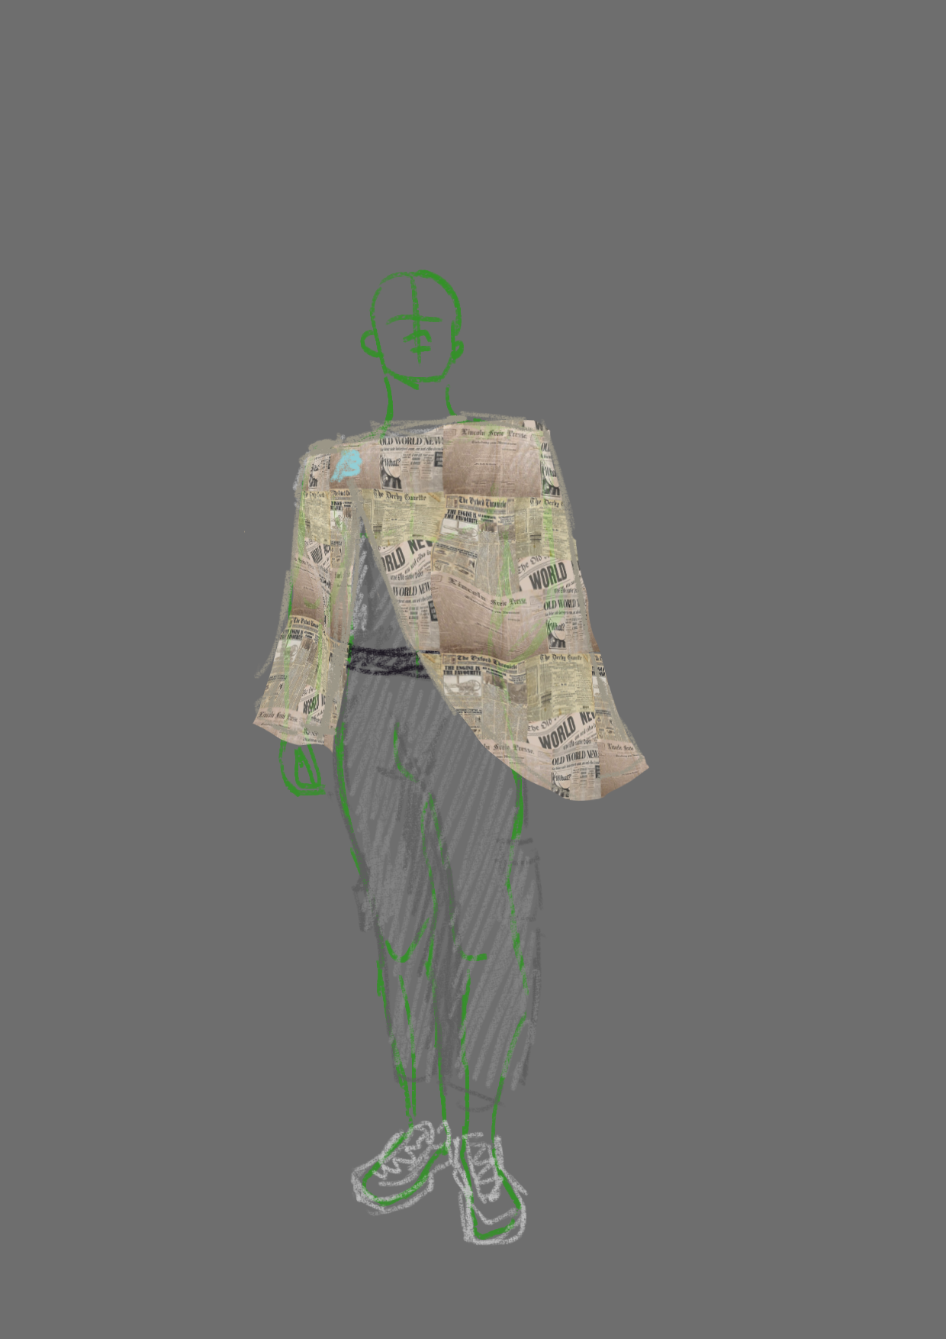
Messenger (s) - Accessorized
Newspaper poncho/jacket
Or
Newspaper carrier bag
Either printed fabric or newspaper adhered to fabric with fabric glue/medium

Slide 17
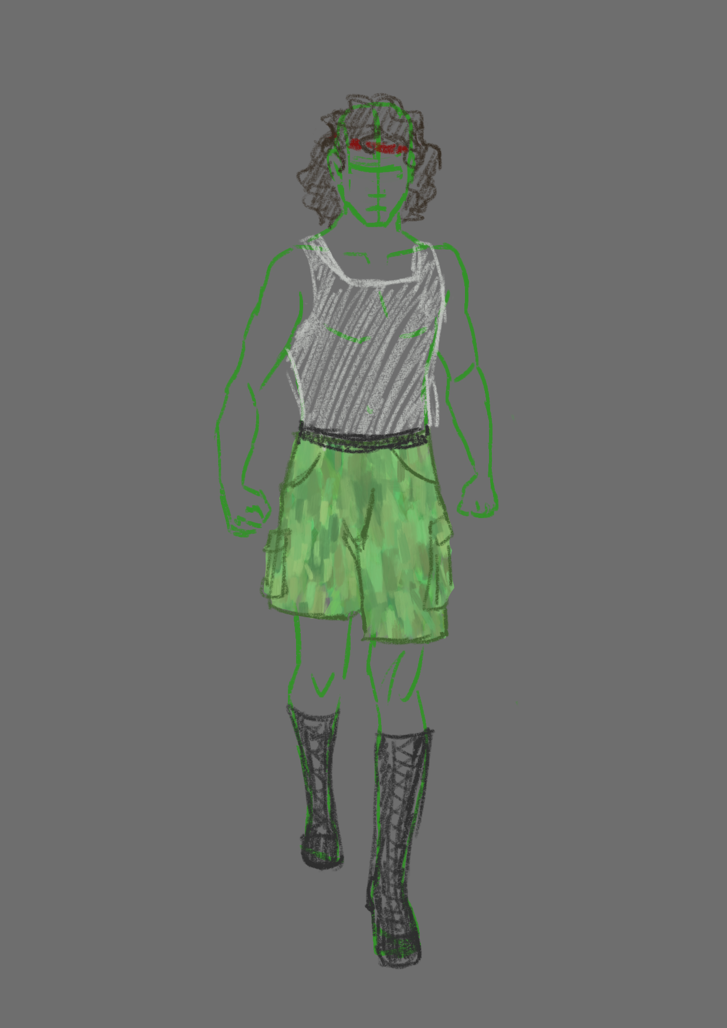
Pentheus (base layer)
Red headband
“lions-mane” hair
White tanktop
cargo/camouflage shorts
Heavy black boots

Slide 18
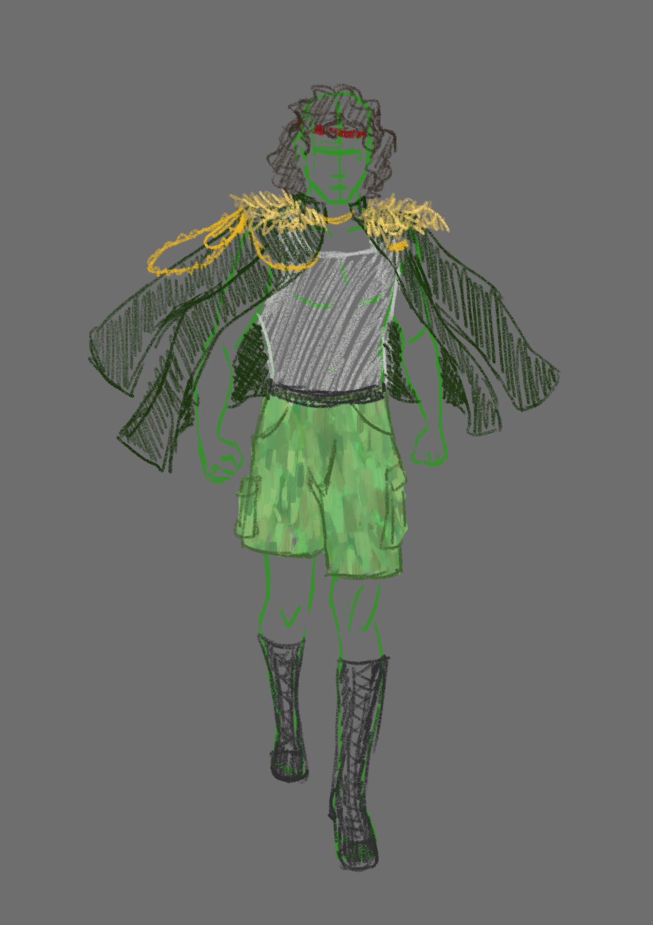
Pentheus (Coat)
Green military coat
Not worn properly, more like a cape
Gold chains
“lion” fur on the shoulders like epoulettes

Slide 19
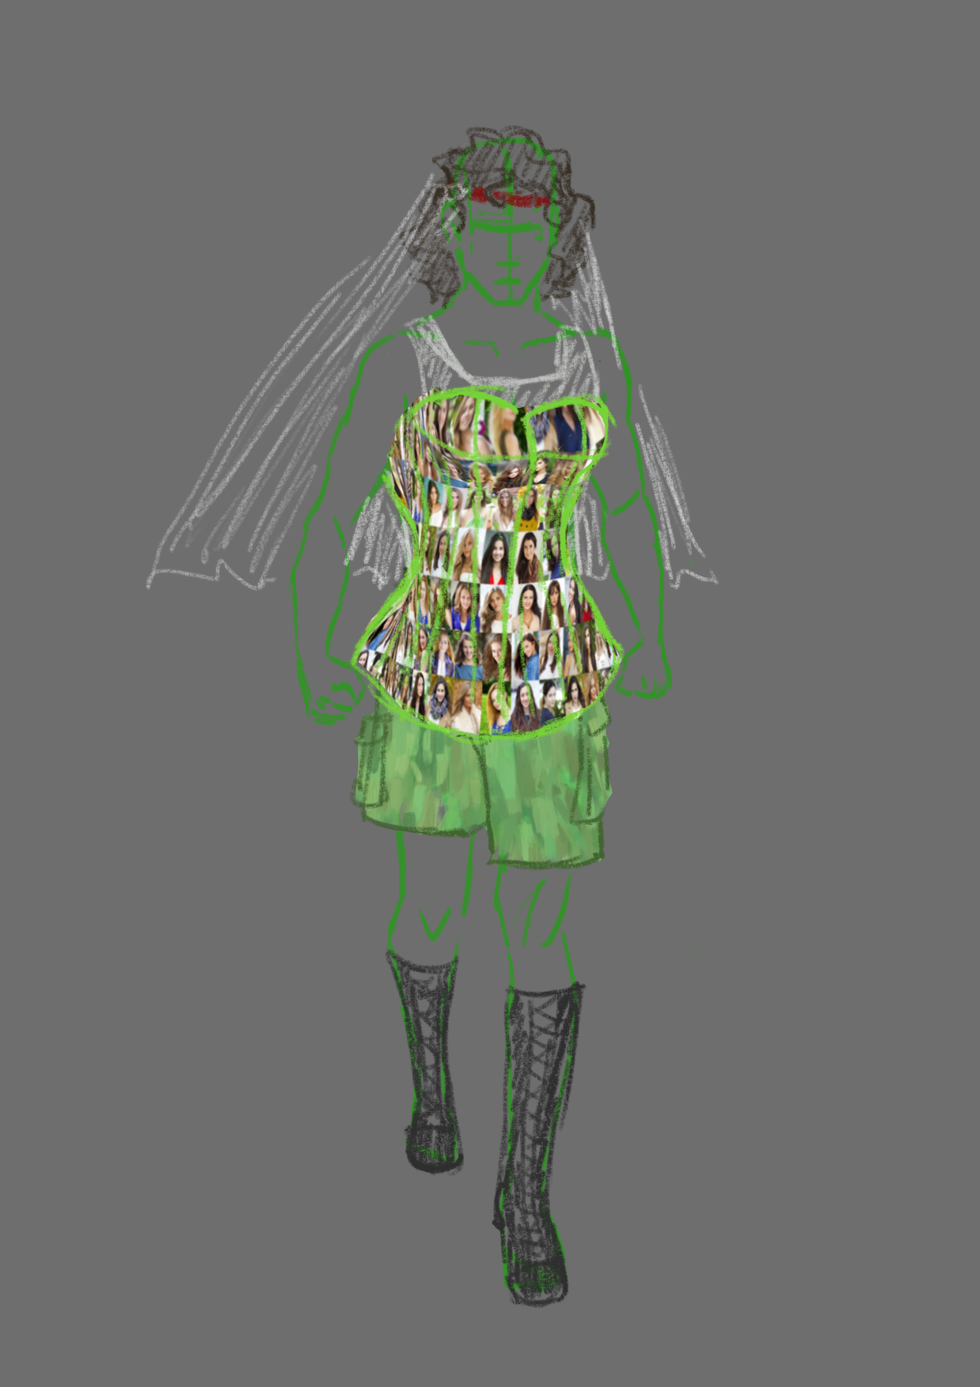
Pentheus (Disguise)
Adding a veil (same fabric as the bag with his “head” inside later)
The corset:
Our first Idea was a mirror dress, but that is difficult to achieve
Since Pentheus is trying to blend in with what he thinks will be debauched women, the corset could have pictures of women in lingerie, ancient greek statues/renaissance paintings of women on it.
The corset could even be stuffed with fake organs, which the Bacchae could throw about while “ripping him apart”

Slide 20
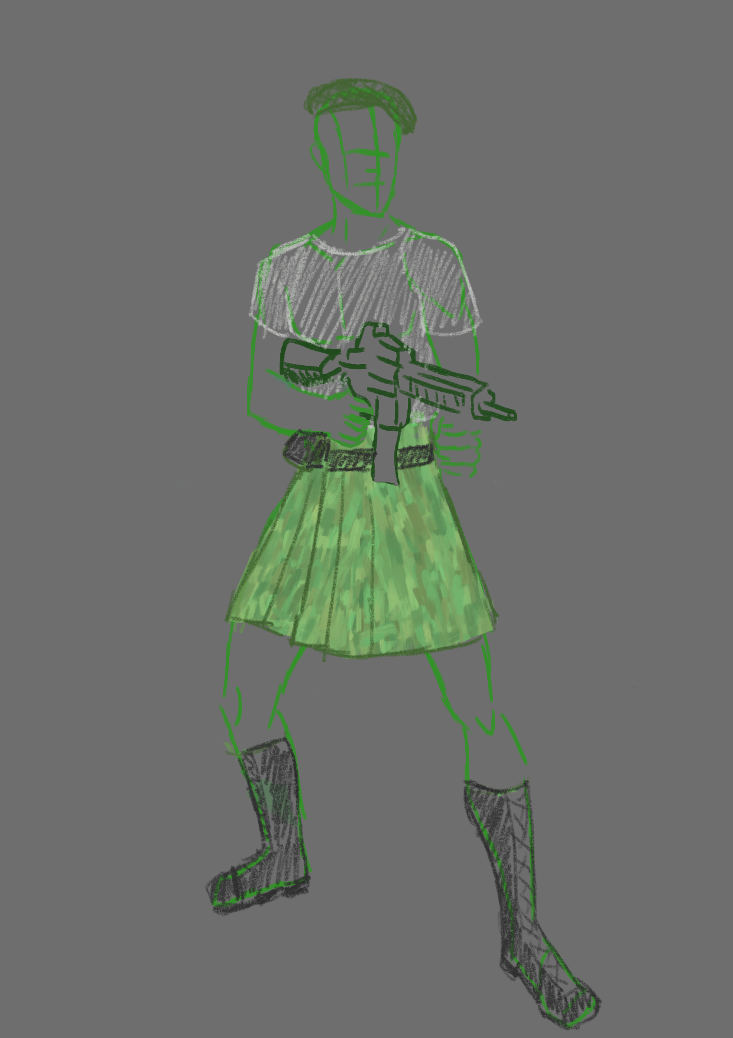
Retinue (Tactical Kilts)
The kilts would somewhat give the silhouette of ancient greek soldiers
The berets could also made red (Michael has us covered in reagrds to the hats)

Slide 21
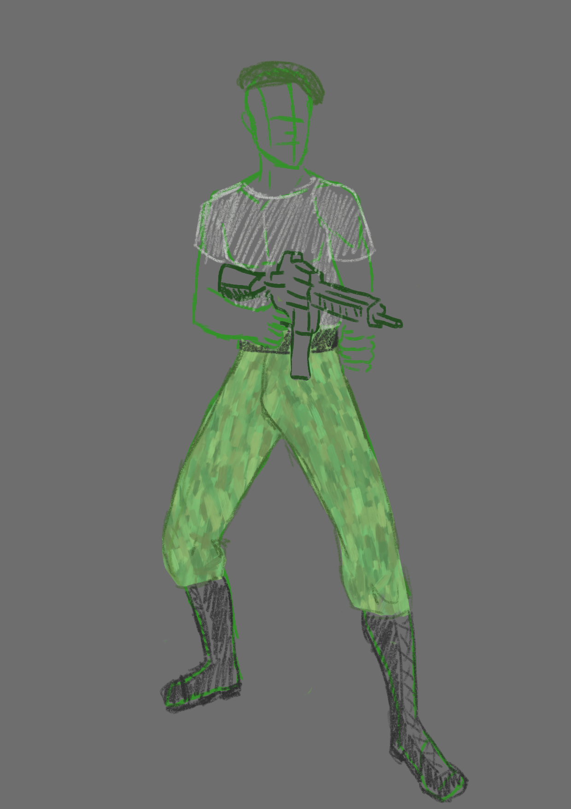
Retinue (Basic Pants Version)
Very basic
Again hat could be red

Slide 22
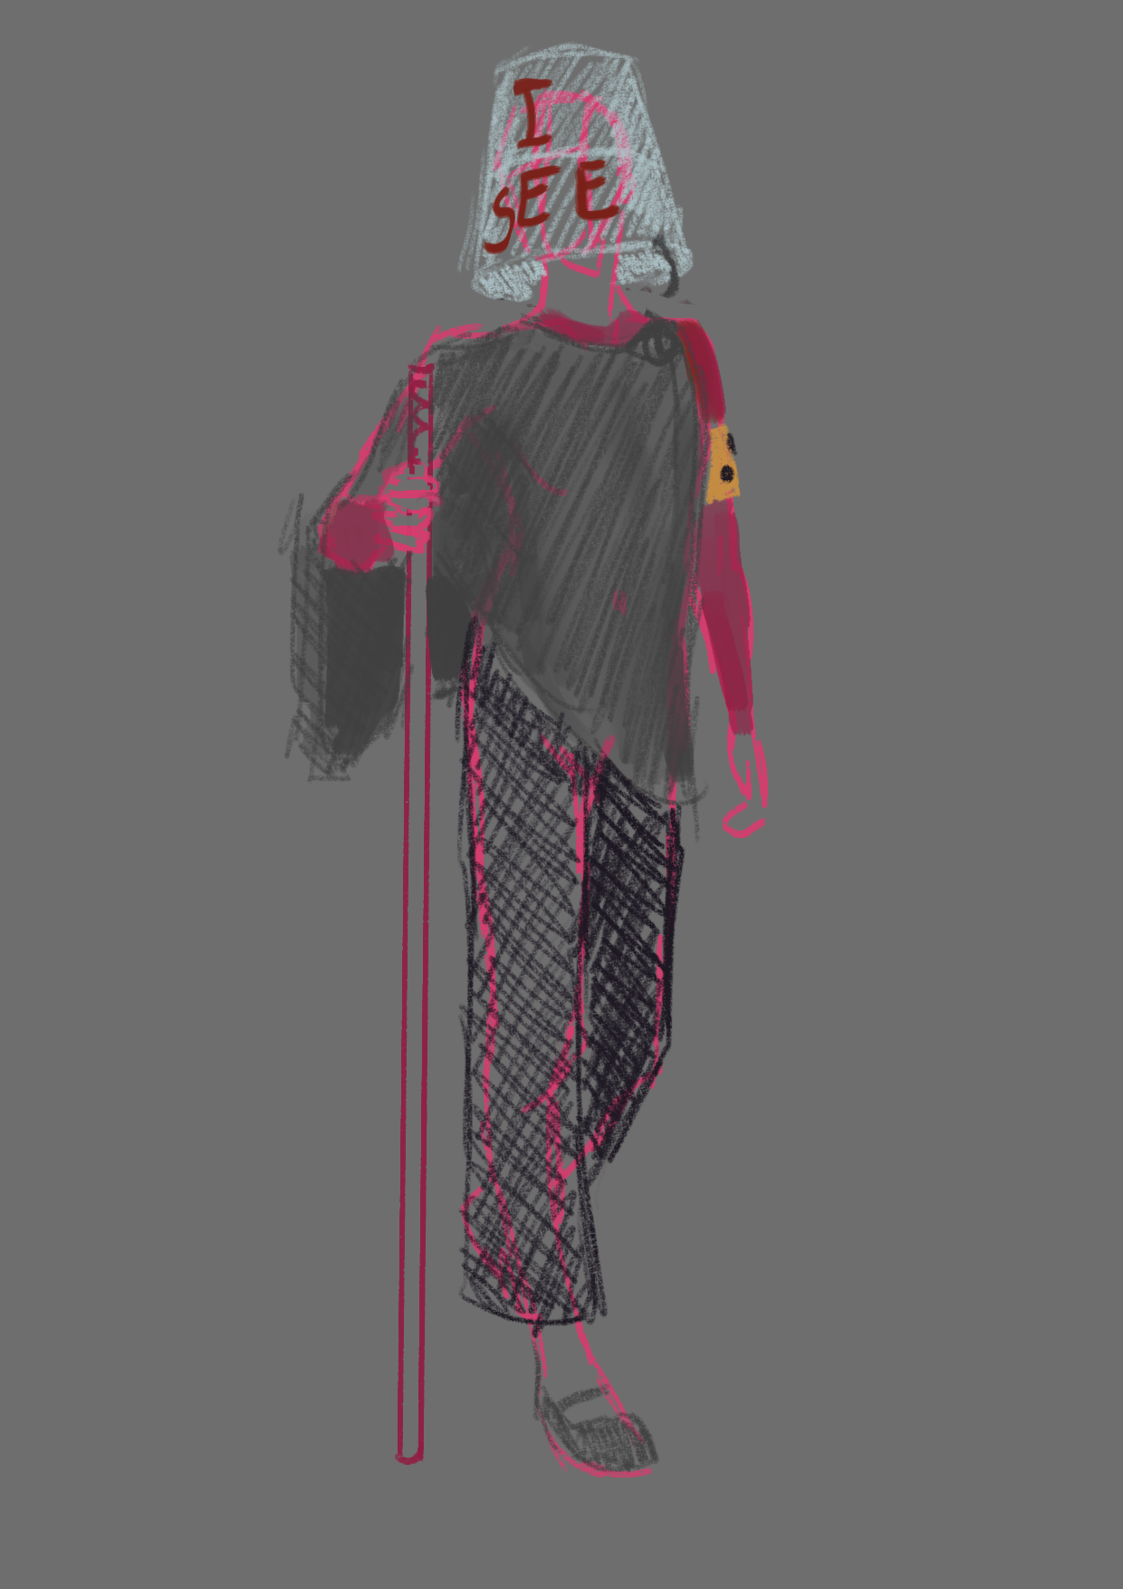
Tiresias
Keeping their colours pretty monotone, except for a maroon shirt and the blind-awareness armband
Why The Bucket:
We had different ideas:
modern take of “doomers” going around with a sign of “the end is here”
Cyber prophet, who knows the end of the play because of internet access (visualization being a VR-Headset
The Bucket is somewhat a combination of the above. Tiresias is not only blind physically, but also metaphorically (?), but still proclaims his use in that he “can see” what others can not

Slide 23
Questions
How gory should the costumes (expected to) be?
Should the soldiers differentiate beyond facial differences?
On a scale from “ancient” to “futuristic” how modern should the costumes be?
Ratio of comedic elements in the costuming in relation to the tragedy of the play?

Slide 24
Thanks for your Attention

