Slide 1
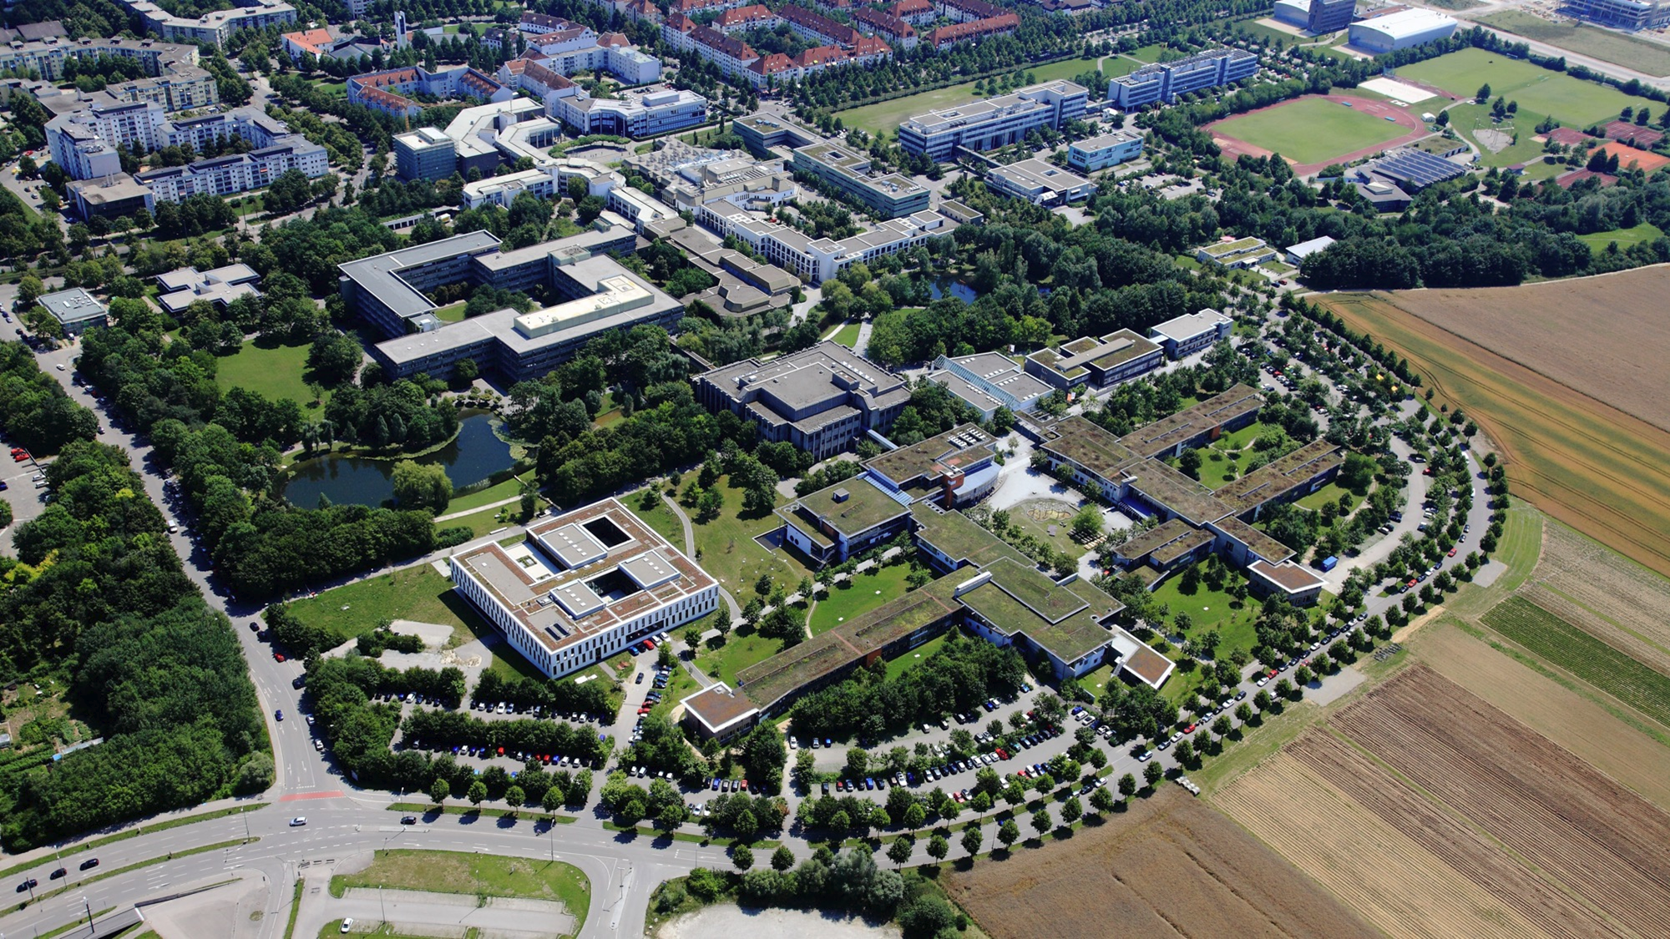

Welcome to the
University of Augsburg!

Slide 2


Important information before starting your studies
The International Office of the University of Augsburg has put together a series of presentations for international first-year students with the most important information about studying and living in Augsburg.
This presentation is the first of seven. We recommend that you review all presentations carefully to ensure you are well prepared to begin your studies and to clarify any important questions.
All presentations are available online and can be downloaded via the following link:
https://www.uni-augsburg.de/en/portal/internationals/abschluss/study-preparation-course/

Slide 3
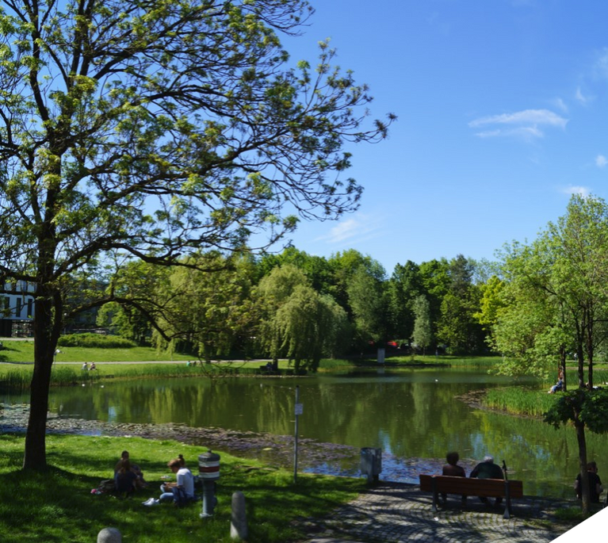
Learn about the University of Augsburg!
Numbers and facts
  The University of Augsburg was founded in 1970 as the sixth university in Bavaria and celebrated its 50th anniversary in 2020.
  There are eight faculties offering:
    92 degree programs (43 Bachelor's and 49 Master's programs)
    17.879 students, 1.668 of them are international students
    309 professors
    1.237 academic staff members
    989 administrative and service staff members (so-called academic support staff)
As of: summer semester 2025

Slide 4









The faculties
Faculty of Philology and History:
Linguistics, literature, cultural studies,
and historical subjects
(4.586 students)
Faculty of Catholic Theology:
Catholic Theology
(290 students)
Faculty of Business and Economics:
Business Administration, Economics, Global Business Management
(2.352 students)
Faculty of Mathematics and Natural Sciences:
Physics, Mathematics, Materials Science, Industrial Engineering
(2.076 students)
Faculty of Law:
Law
(2.635 students)
Faculty of Applied Computer Sciences:
Computer science, geography
(2.517 students)
Faculty of Philosophy and Social Sciences:
Education, music, art, social sciences,
media, philosophy
(2.685 students)
Faculty of Medicine:
Medicine, midwifery
(738 students)

Slide 5
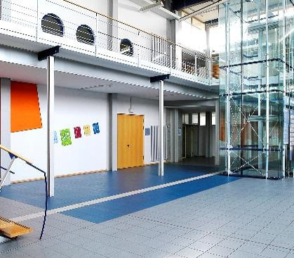
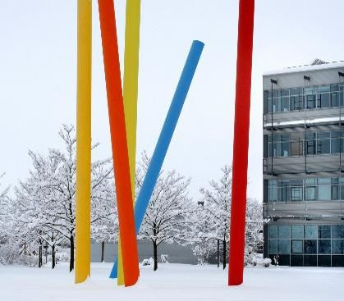
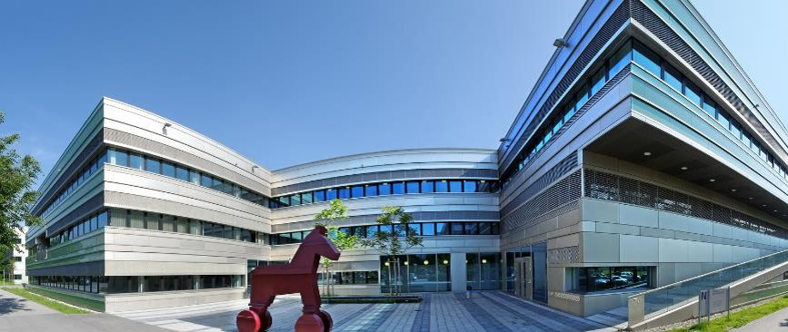
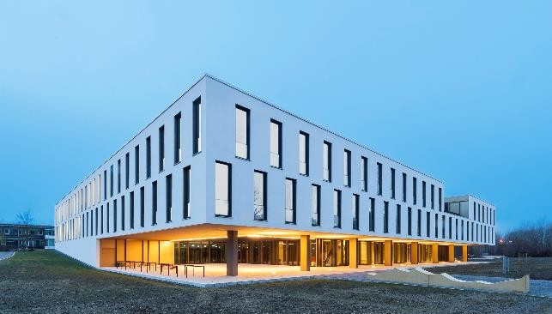
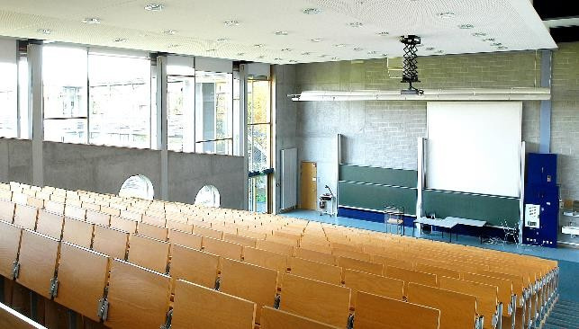
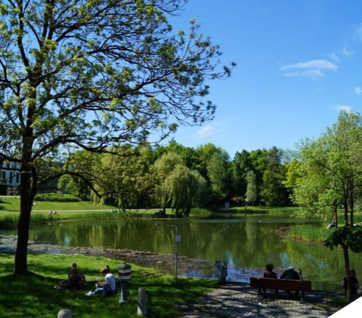
Impressions of the campus

Slide 6
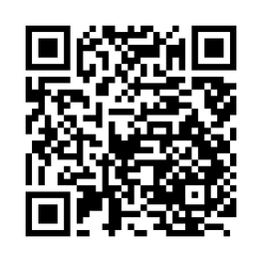

Events for international students!
The University of Augsburg offers a variety of events for international students. City tours, cultural nights, quiz nights, Christmas parties, and summer festivals are organized to help students settle into life in Augsburg, make new friends, and learn more about the cultures of their fellow students!
Further information is available on this website:
https://www.uni-augsburg.de/en/portal/internationals/interkulturelles/.
Instagram account of the International Office:

Slide 7
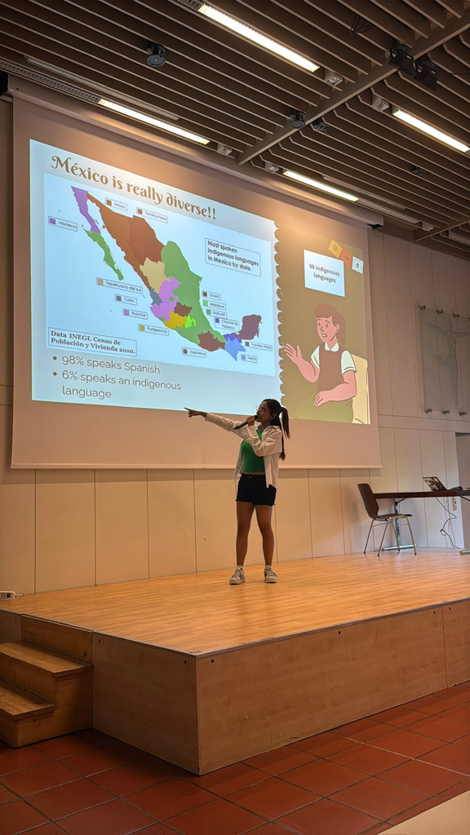
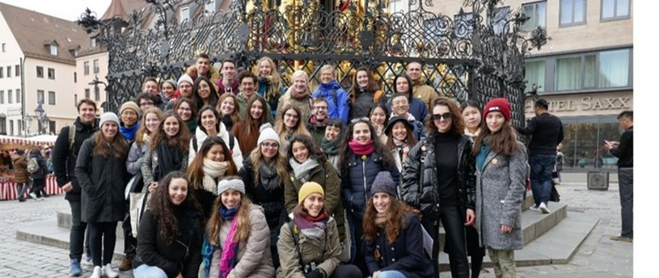
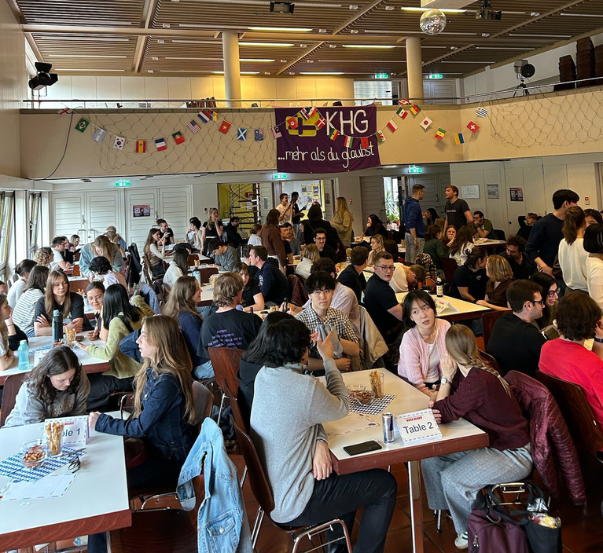
Events for international students!
The International Office organizes city tours in Augsburg!
Students have the opportunity to present their country and culture at the Cultural Nights!
At Quiz Nights, students compete in teams to win!

Slide 8
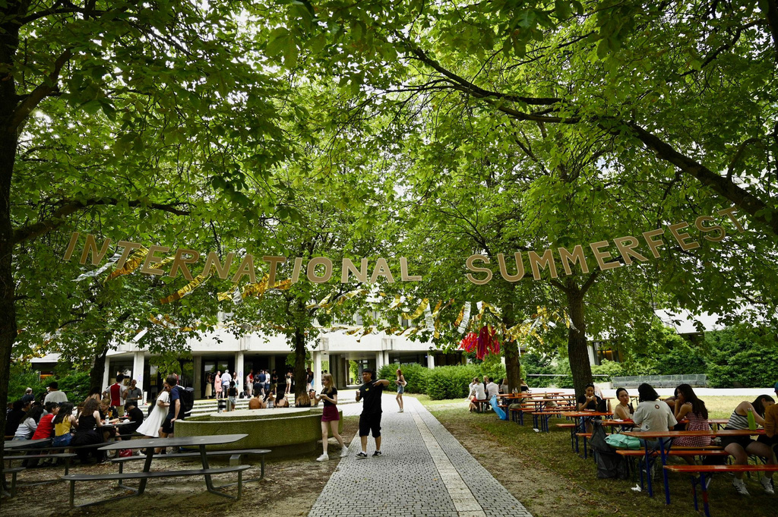

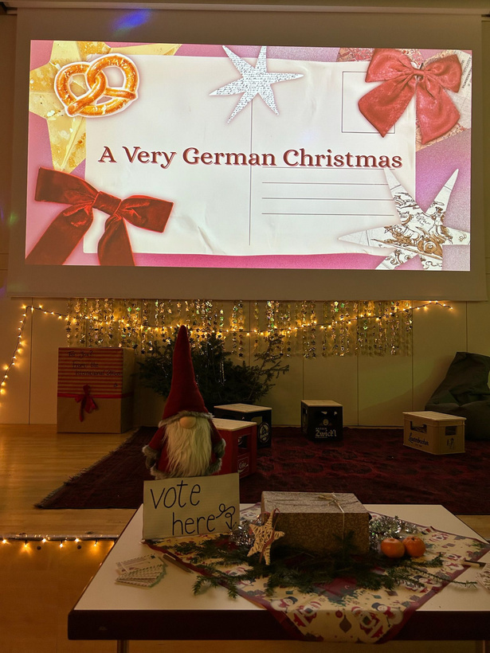
Events for international students!
Christmas party!
ESN is a student network that organizes activities and trips with international students!
Come to the summer festival with its international buffet and various activities!
All students are welcome to attend!

