Slide 1

European funding opportunities
for PhD candidates:
Marie Skłodowska-Curie
Doctoral Networks (MSCA-DN)
Laura Willems, KoWi
Augsburg, 25.09.2025

Slide 2
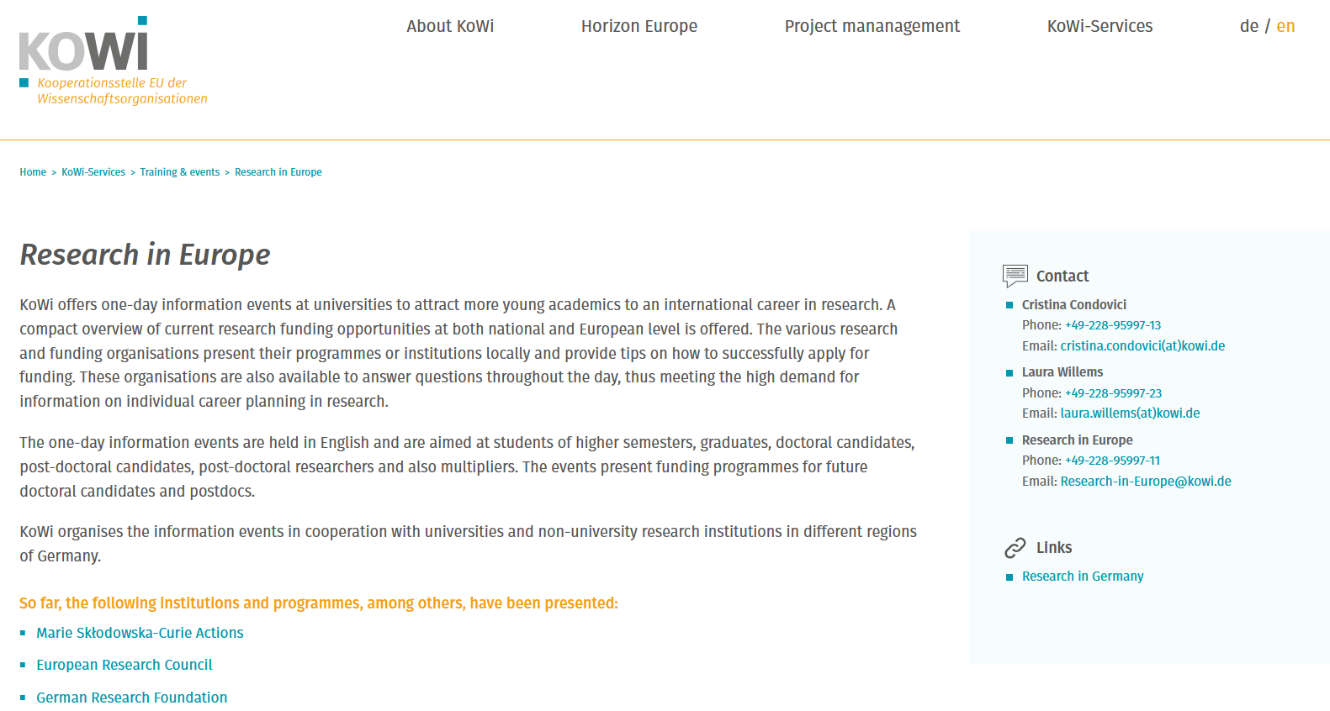
Slides will be shared after the event!

Slide 3

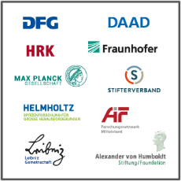
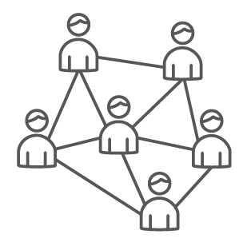
KoWi – EU Liaison Office of the German Research Organisations
Information, advice and training on EU research & innovation funding
One-Stop Shop for Horizon Europe
Service platform for our supporting association*
Funded by the German Research Foundation (DFG)
European network through offices in Bonn & Brussels
*Association for the Promotion of European and International Cooperation in Science e.V.

Slide 4
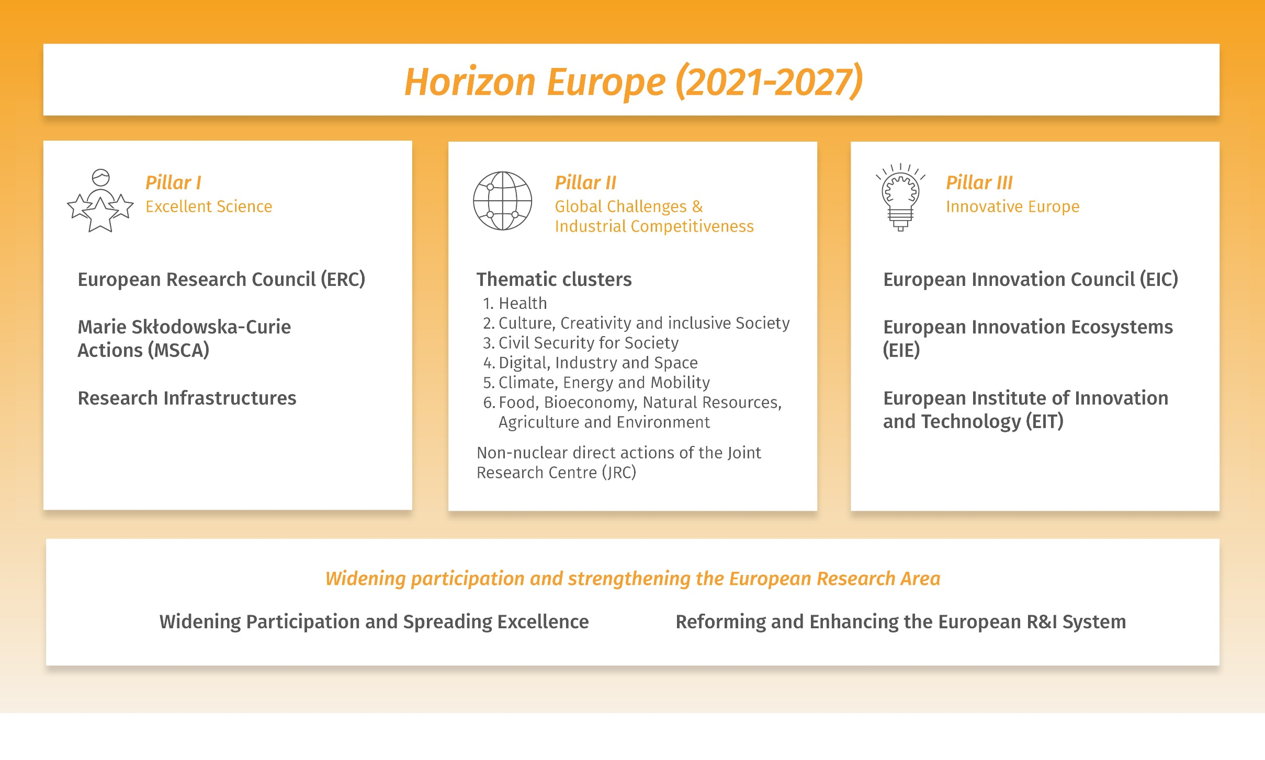
Horizon Europe – Framework Programme for Research and Innovation (2021-2027)

Slide 5
Why should I apply for MSCA?
Fund excellent frontier research and breakthrough scientific ideas
Equip researchers with new knowledge & skills through international mobility and exposure to different disciplines and sectors
“3i dimension”: International – Interdisciplinary – Intersectoral
Promotion of researchers‘ career development
Provide training for key competences in science and industry
Create fair and attractive working conditions
Strengthen the European Research Area (ERA)

Slide 6
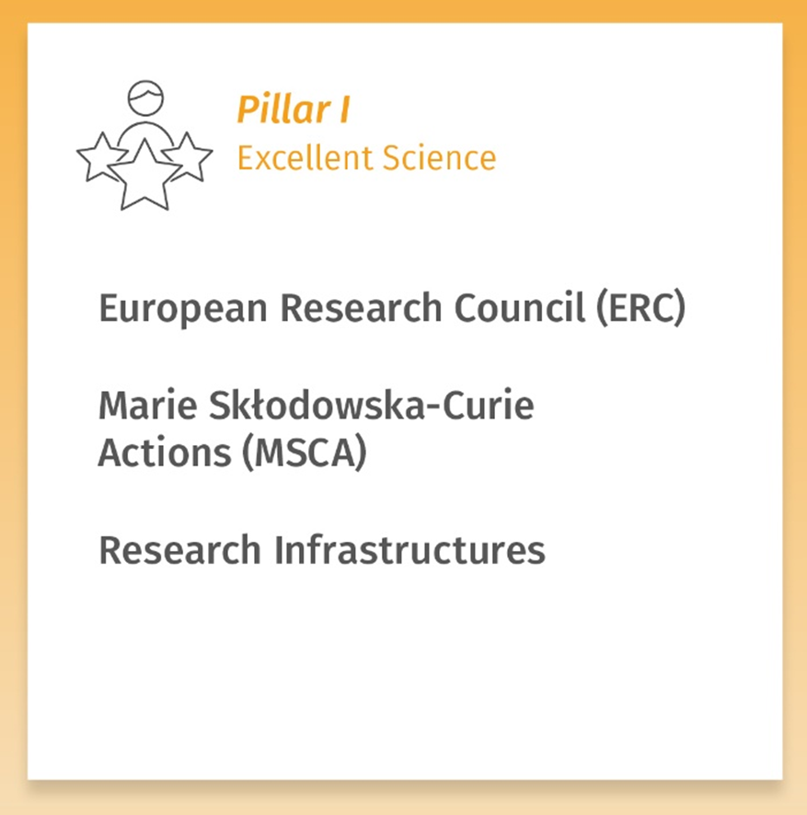
Marie Skłodowska-Curie Actions under Horizon Europe
Doctoral Networks
Postdoctoral Fellowships
Staff Exchanges
COFUND
MSCA & Citizens

Slide 7
What are the MSCA Doctoral Networks?
  What?
    Structured doctoral funding of young researchers in training networks across Europe
    International knowledge transfer between institutions, disciplines and sectors
  How?
    Research-related and transferable competences through training programmes
    Involvement of the non-academic sector
  Who?
    Consortium of at least 3 institutions from 3 different Member states/Horizon Europe Associated countries

Slide 8
Training programme
Secondments To partner organisations
Local training Scientific & soft skills
Training through research Individual projects
Network-wide training

Slide 9
What‘s in it for me?
Funded PhD positions for up to 3 years
All domains of research are covered (bottom-up approach)
Topic of the PhD project already defined → you can start very soon
Employment contract including social security benefits
100% working time on your project
Training within an international network
Contact to the non–academic sector and potential future employers

Slide 10
Conditions for taking part in a DN Project
You apply for vacancies in EU-funded DN projects
You do not hold a PhD
You can be of any nationality & age
You need to follow the MSCA Mobility Rule
Notes:
- Not eligible: Researchers who have successfully defended their doctoral thesis but who have not yet formally been awarded the doctoral degree
- The eligibility of the researcher is determined at the date of their first recruitment in the action & the status will not evolve in the course of the action, even if they are re-recruited at another beneficiary

Slide 11






MSCA Mobility Rule
Fellow has lived or worked ≤ 12 months within the last 3 years in the potential host country
Not eligible for a fellowship in Germany!
A French researcher has lived in Germany for the last 4 years
Eligible for a fellowship in France and other countries

Slide 12
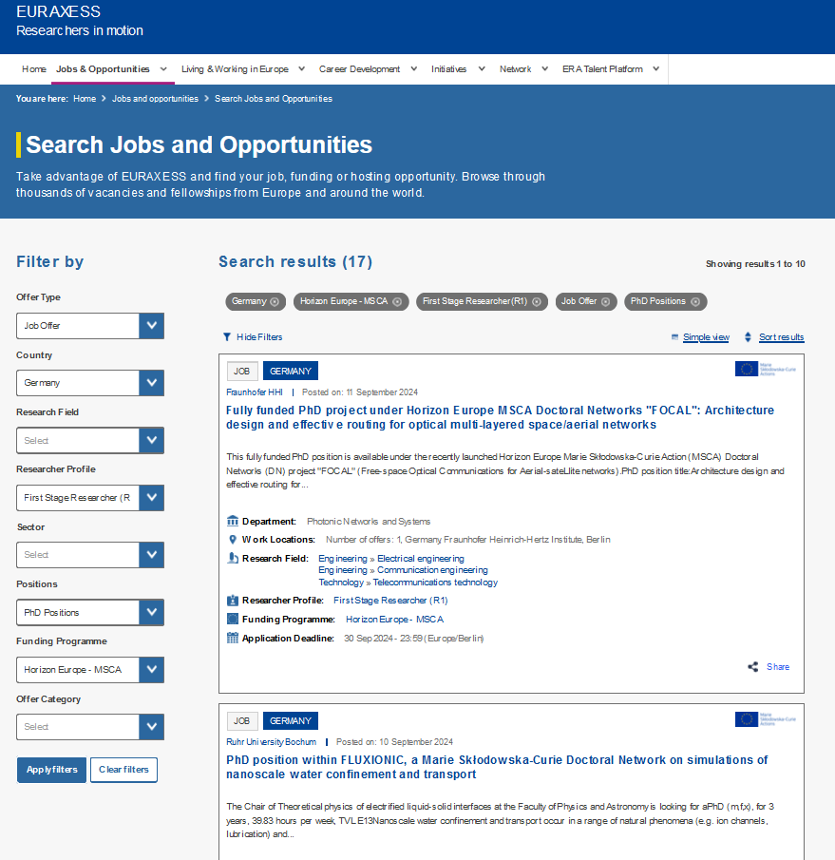
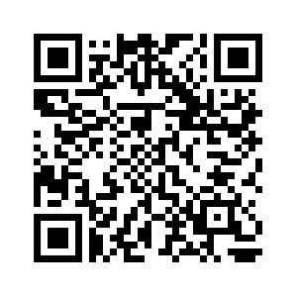
EURAXESS Job portal
University of Augsburg – Institute of Physics
Chair of Experimental Physics I (Prof. Jan Lipfert)
→ 2 PhD positions available
→ Start: as soon as possible

Slide 13
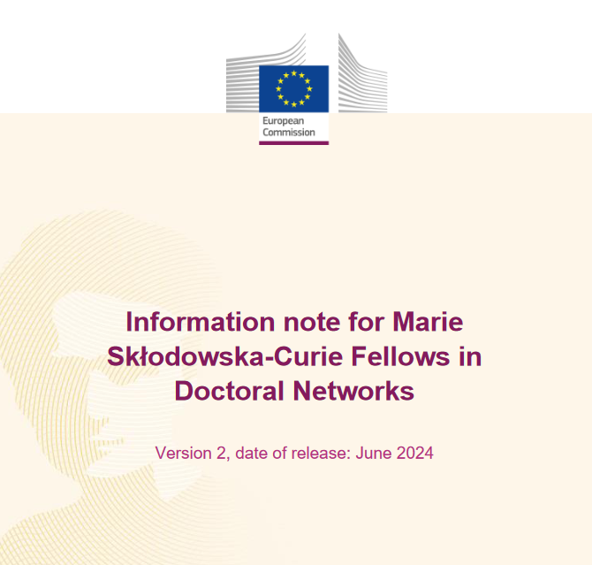
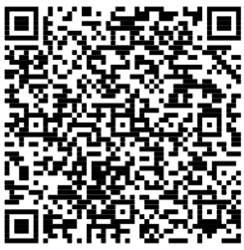
Information for Doctoral Candidates
Your rights as a fellow: recruitment, employment, supervision etc.
Allowances
Secondments
Ethics, intellectual property rights etc.
After your fellowship
Etc.

Slide 14
Contracts
EC/REA
Grant Agreement
Host Institution (MS/AC)
Work contract
Fellow
Notes:
- Work contract with HI, the EU contribution is transferred to the Beneficiary who recruits the researcher under an employment contract

Slide 15
Allowances
In EUR; Funding 100%, in gross | Research unit cost (person/month) |  |  |  |  | Institutional unit cost (person/month)
 | Living allowance* | Mobility allowance | Family allowance** | Long-term leave allowance | Special-needs allowance | Research, training & networking costs | Management & Overhead
MSCA-DN | 4.010 | 710 | 660 | 4.720*** | Depending on request | 1.600 | 1.200
* Application of the country correction coefficient: for Germany 98.3%.
** If applicable, can also be applied for after project start
*** If applicable (4.000 x % covered by the beneficiary)
Notes:
- Researcher unit costs: Budget allocated for the employment costs and other costs paid to the recruited researchers
- Institutional unit costs: Budget allocated for the costs of the work performed in the project and its execution

Slide 16
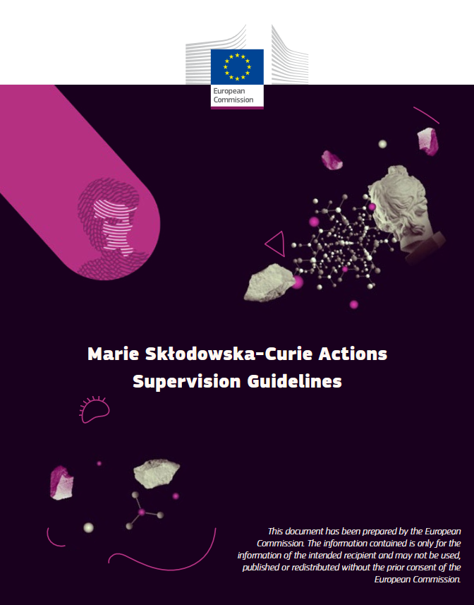
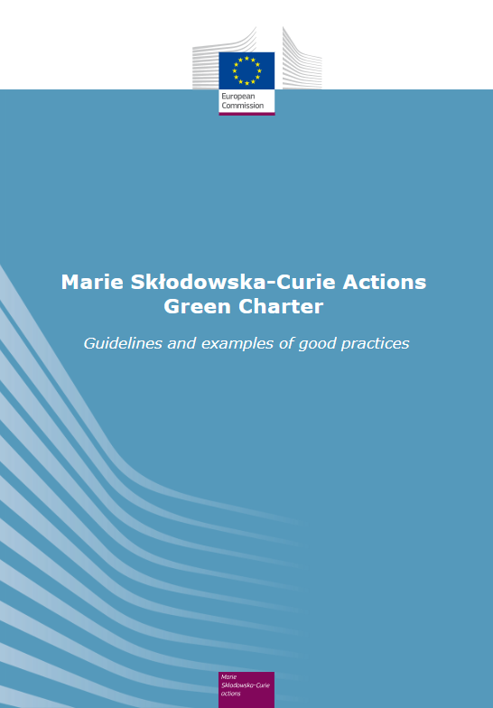
MSCA in Horizon Europe
Guidelines on Supervision
  Recommendations for good supervision
Green Charter
  Code of good practice supporting the European Green Deal
Gender Equality Plan
  Eliminate gender inequalities in R&I
  Guidelines for Inclusion of Researchers at Risk
  The MSCA are open to researchers at risk, their participation is encouraged

Slide 17
European Charter for Researchers
Reference framework for researchers and their recruitment
  Researchers: call for good scientifc practice
  Supervisors: solid support for early career researchers
  Institutions as employers: fair working conditions and transparent recruitment
MSCA principles:
  Promoting career development
  Transparency on recruitment process and selection criteria
  Stability and permanence of employment
  Strengthening the participation of women in research

Slide 18
Insights from coordinators
What makes your project special?
  The combination of excellent supervision during the doctorate at different institutions throughout Europe with a sound education in innovation and entrepreneurship
  Brings together a diverse team of experts in different disciplines
  Focus on individual training (lectures, workshops and opportunities for professional development)

Slide 19
Insights from coordinators
In which way did the project benefit your institution?
  Training excellent young scientists
  Attracting top international talents
  Generating scientific output and advancing research knowledge
  The involvement of researchers in cutting-edge research, increased access to large-scale facilities, and active collaboration with leading scientists and universities
  Positioning as an important stakeholder within Europe and in the respective ecosystem
  Visibility on the international stage
  Long-term collaborations with leading academic and industrial partners, now being part of a well-respected European research network

Slide 20
Our Services on MSCA
Information
Information events & seminars
Website, Newsletter, Social Media etc.
Advice
Advice for applicants (individually/small groups)
Advice on legal & financial project management
Training
Workshops on application & grant management
Workshops on legal & financial project management

Slide 21

Get in touch with us!
Website | Social Media | Podcast | Corporate Video:
Laura Willems
laura.willems@kowi.de
MSCA Doctoral Networks
MSCA Postdoctoral Fellowships
MSCA and Citizens
Website | Social Media | Podcast | Corporate Video: www.kowi.de/en

